Slide 1
Syllabus
The Internet Marketing –
Google Analytic
The Objectives
了解網路的特性與網路行銷的過去，現在與未來。
  介紹網路行銷的演進
  上課的重點將放在網路行銷的現況
  透過即時新聞的分享，洞悉未來網路行銷的趨勢
學會如何操作 Google Analytic
  學習 如何收集與分析大資料。
  從入門，初級，中階到高階。
  為了實際應用 Google Analytic，學習如何設計網站。
個案的報告: 請同學利用所學的 GA 技能，來收集與分析大數據。然後利用對資料的解讀與了解，提出具體的行銷策略。

Slide 2

Schedule
週 | 日期 | Topic | Materials
1 |  | Macro Trend of Internet Market | PPT
2 |  | Google Analytics for Beginner U1 and U2 | GA Academy
3 |  | GA Beginner U3 and U4 | GA Academy
4 |  | How to create you own web page | GA Academy
5 |  | Marketing Mix & GA for advanced users U1 and U2 | GA Academy
6 |  | Product & GA – Ad U3 and U4 | GA Academy
7 |  | Exam 1 on GA | GA Academy
8 |  | Segmentation & GA for power user 1&2 | GA Academy
9 |  | GA – PU 3&4 | GA Academy
10 |  | GA Studio U1 and U2 | GA Academy
11 |  | GA Studio U3 and U4 | GA Academy
12 |  | Google Tag Manager | GA Academy
13 |  | Exam 2 on GA | GA Academy
14 |  | Communication – Earned | GA Academy
15 |  | Final Group Report 1 | GA Academy
16 |  | Final Group Report 2 | GA Academy
17 |  | Final Group Report 3 | GA Academy

Slide 3
Grading (1/2)
Two Exams (50%). Each exam includes two parts – computer and paper questions. Best of the two exams will be your grade.
Final Presentation (20%).

Slide 4
Grading(2/2)
  Class participation (30%) consists of: (1) attendance (10%),(2) preparation (10%), and (3) contribution to discussion (10%). Each group need to pay attention to each presentation and prepare to question the presenters.

Slide 5
The Final Assignment:
Marketing Strategies proposal
Each group need to utilize Google Analytics to analyze the data and present your marketing strategies to increase the profit of the company.
The presenting group need to upload your PPT to Class Facebook. For example, if you are going to present on 3/24, your PPT need to be upload by 3/17
The responsibilities of the other groups is to challenge the arguments made by the presenting group. The group that fails to provide satisfying answers is subject to penalty.

Slide 6
Marketing Strategies proposal in details
Based on lessons from GA for power uses, please propose marketing strategies to improve the profit of an online retailer. Your proposal should comprise three parts: problems identification, problems solving strategies and the conclusions. The following questions may provide some clues for your proposal.
1. Based on the data collected from GA, describe the current problems with this online retailer? For example,
A low converting rate
Ineffective traffic sources
Channels with low actionability rates
Ineffective email campaigns
Low site engagement rate
Outdated KPIs.
Low product purchases rate
High drop out rates during checkout process.
2. What changes do you propose to solve the current problems?
How do you plan to increase your converting rate
To Improve site engagement
To customize your channels to increase actionability
To make your email campaign more effective
To drive more product purchases?
To reduce the number of customers dropping out of your checkout process
3. Conclusions
Q & A (5 to 7 minutes ); Each group is required to ask at least two questions.
Approximate time for your presentation 25 – 30 minutes

Slide 7
I. Google Analytics for Beginners
Google Analytics for Beginners shows new users how to create an account, implement tracking code, and set up data filters.
You'll learn how to navigate the Google Analytics interface and reports, and set up dashboards and shortcuts.
The course will also demonstrate how to analyze basic Audience, Acquisition, and Behavior reports, and set up goals and campaign tracking.

Slide 8
I. Google Analytics for Beginners
Unit 1: Introducing Google Analytics
  Lesson 1: Why digital analytics?
  Lesson 2: How Google Analytics works
  Lesson 3: Google Analytics setup
  Lesson 4: How to set up views with filters
Unit 2: The Google Analytics Interface
  Lesson 1: Navigating Google Analytics
  Lesson 2: Understanding overview reports
  Lesson 3: Understanding full reports
  Lesson 4: How to share reports
  Lesson 5: How to set up dashboards and shortcuts

Slide 9
I. Google Analytics for Beginners
Unit 3: Basic Reports
  Lesson 1: Audience reports
  Lesson 2: Acquisition reports
  Lesson 3: Behavior reports
Unit 4: Basic Campaign and Conversion Tracking
  Lesson 1: How to measure Custom Campaigns
  Lesson 2: Tracking campaigns with the URL Builder
  Lesson 3: Use Goals to measure business objectives
  Lesson 4: How to measure Google Ads campaigns
  Lesson 5: Course review and next steps

Slide 10
II. Advanced Google Analytics
Advanced Google Analytics walks you through how data gets collected and processed into readable reports.
How to use configurations like Custom Dimensions, Custom Metrics, and Event Tracking to collect data that's specific to your business.
Demonstrate more advanced analysis techniques using segmentation, channel reports, audience reports, and custom reports,
Learn marketing strategies like remarketing and Dynamic Remarketing that show ads to customers who have visited your website.

Slide 11
II. Advanced Google Analytics
Unit 1: Data Collection and Processing
  Lesson 1: Google Analytics data collection
  Lesson 2: Categorizing into users and sessions
  Lesson 3: Applying configuration settings
  Lesson 4: Storing data and generating reports
  Lesson 5: Creating a measurement plan
Unit 2: Setting Up Data Collection and Configuration
  Lesson 1: Organize your Analytics account
  Lesson 2: Set up advanced filters on views
  Lesson 3: Create your own Custom Dimensions
  Lesson 4: Create your own Custom Metrics
  Lesson 5: Understand user behavior with Event Tracking
  Lesson 6: More useful configurations
Unit 3: Advanced Analysis Tools and Techniques
  Lesson 1: Segment data for insight
  Lesson 2: Analyze data by channel
  Lesson 3: Analyze data by audience
  Lesson 4: Analyze data with Custom Reports
Unit 4: Advanced Marketing Tools
  Lesson 1: Introduction to remarketing
  Lesson 2: Better targeting with Dynamic Remarketing
  Lesson 3: Course Summary

Slide 12
III. Google Analytics for Power Users
Now that you're familiar with the range of features Analytics offers, put your knowledge into action.
Learn and practice techniques for comparing users who convert with those who don't.
Analyzing traffic sources that bring the most value, customizing channels for increased actionability.
Identifying top performing content on your site, and improving ecommerce performance.

Slide 13
III. Google Analytics for Power Users
Unit 1: Understand users
  Lesson 1: Course Intro
  Lesson 2: Which users are converting and which aren't?
  Lesson 3: How can you see which platforms to develop or optimize for?
Unit 2: Attract high-value traffic
  Lesson 1: Which traffic sources bring in the most value?
  Lesson 2: How can you customize your channels for increased actionability?
  Lesson 3: When should you send your newsletter emails?
Unit 3: Improve site engagement
  Lesson 1: What KPIs should you use for your content site?
  Lesson 2: Which pages are helping conversions?
Unit 4: Improve product performance
  Lesson 1: How can you drive more product purchases?
  Lesson 2: Which products are performing the best and worst on your site?
  Lesson 3: Where are people dropping out of your checkout process?
  Lesson 4: Course Summary

Slide 14
IV. Data Studio
The Introduction to Data Studio online course teaches marketers, business owners, agencies, and data analysts how to visualize data online to gain insights. You’ll learn how to connect your data, create impactful reports, and collaborate with teammates. You’ll gain the knowledge and tools you need to design compelling reports to share with different stakeholders.

Slide 15
IV. Data Studio
Unit 1: Welcome to Data Studio
  Lesson 1: Data Studio overview
  Lesson 2: How Data Studio works
  Lesson 3: Access controls
Unit 2: Navigate Data Studio
  Lesson 1: Data Studio Home page
  Lesson 2: Data source overview
  Lesson 3: Report overview
  Lesson 4: Report edit mode overview
Unit 3: Build your first report
  Lesson 1: Connect Data
  Lesson 2: Create a new report and add charts
  Lesson 3: Add and configure report controls
  Lesson 4: Share reports with others
Unit 4: Format and Design Reports
  Lesson 1: Data visualization basics
  Lesson 2: Create and use report templates

Slide 16
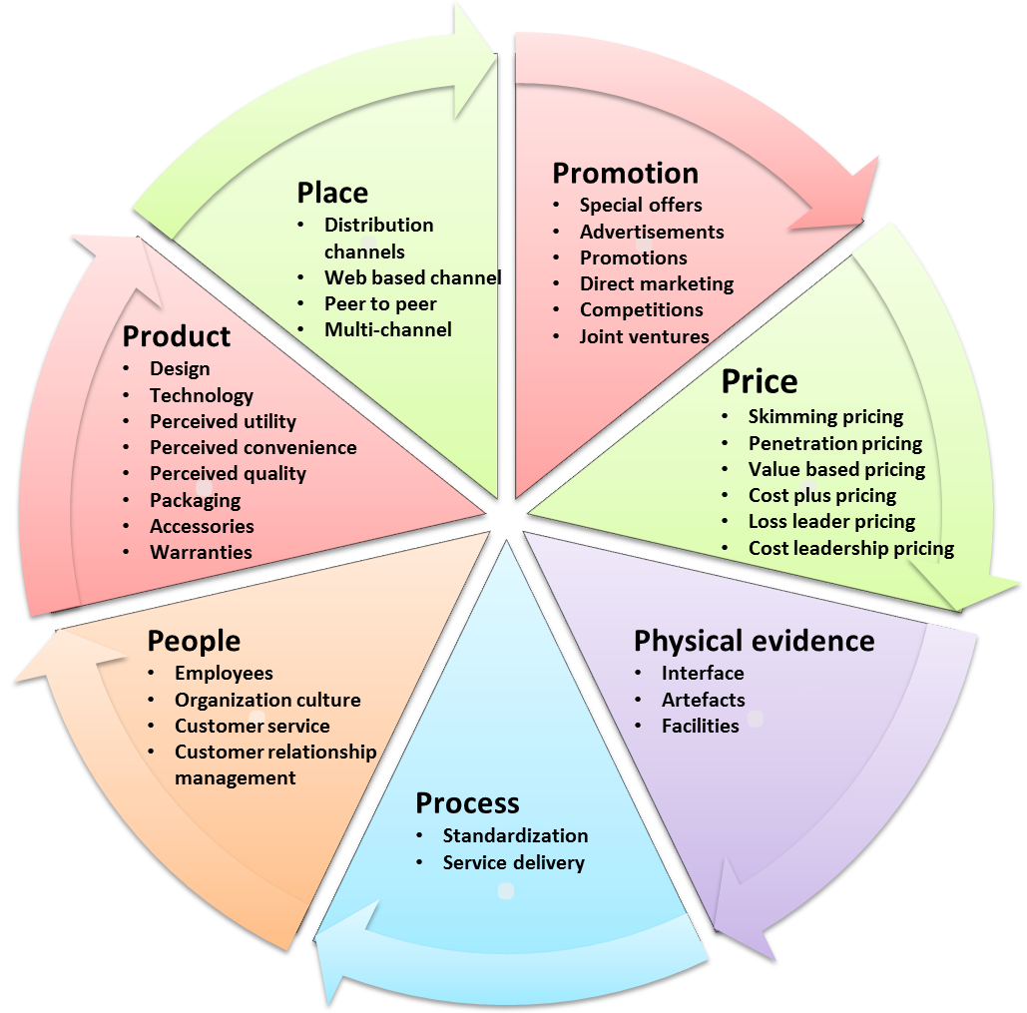
Service Marketing

