Slide 1

Department of Business Administration
National Chung Cheng University
Consumer Behavior 2026
SYLLABUS
Eric Su Office: 4313
Extension：34317 E-mail: bmaesu@gmail.com
/
Course Objectives: What is consumer behavior? 2. What factors influence consumer behavior? 3. What are the stages of the decision-making process? 4. How does consumer behavior impact markets?
Text Book

Slide 2
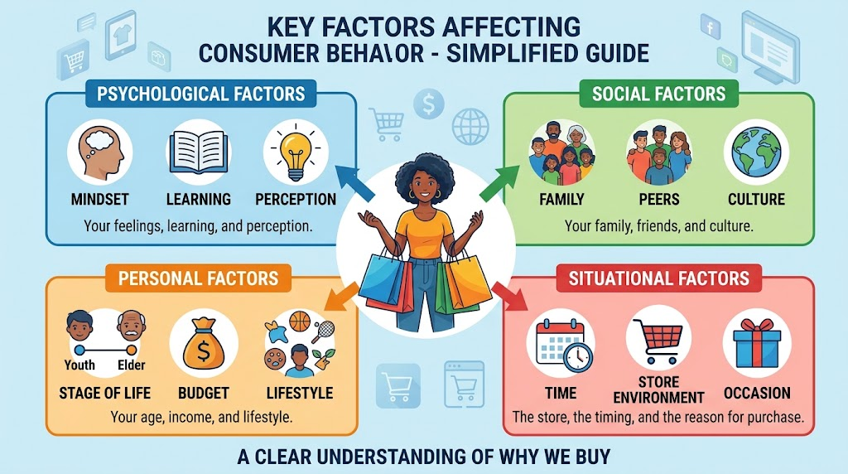
What factors affect consumer behavior?

Slide 3
Department of Business Administration
National Chung Cheng University
Consumer Behavior 2026
SYLLABUS
Grade Breakdown
  Examination 60%
    Midterm (30%)
    Final (30%)
  Class Participation 40%
  Class participation is based on three components:
  Attendance (5%)
  (2) Contributions to discussions (15%)
  (3) Quizzes (Kahoot) (20 %)

Slide 4
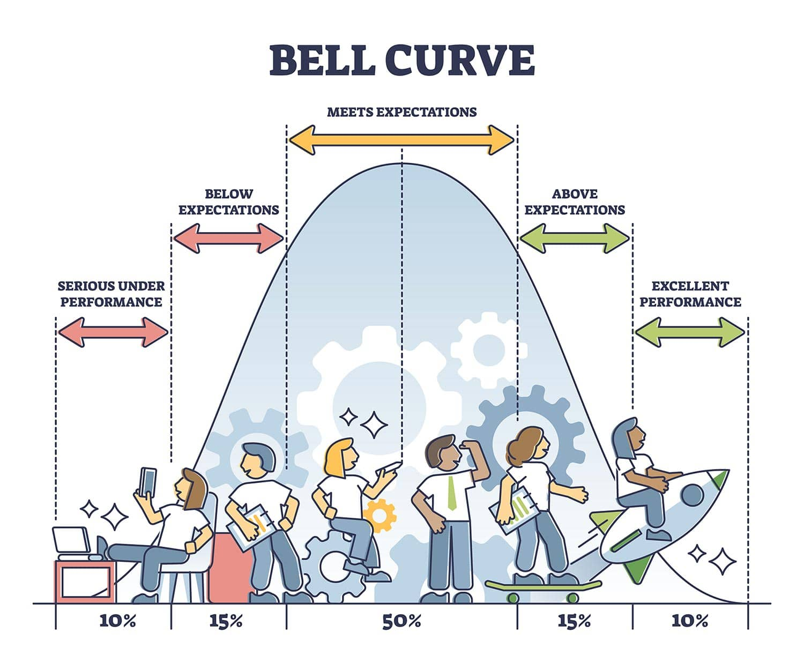
Class Participation 25%
Kahoot and Class participation

Slide 5
Department of Business Administration
National Chung Cheng University
Consumer Behavior 2026
SYLLABUS
Contribution to class discussion 15%
Your class participation points come from two sources:
Class responses: 1 point for each response to a question in class.
Class LINE group: 1 point for sharing a news article before each class, covering topics such as market trends or consumer behavior.

Slide 6
Kahoot Quiz
At the end of each class, students will participate in a Kahoot! quiz:
🥇 1st place: 5 points
🥈 2nd place: 3 points
🥉 3rd place: 2 points
4th–5th place: 1 point each

Slide 7
週 | 日期 | Topic | Chapter
1 |  | Introduction | 1
2 |  | Motivation | 2
3 |  | Perception (First HW due) | 3
4 |  | Learning | 4
5 |  | Memory | 7
6 |  | Attitude 1 | 5
7 |  | Attitude 2 | 6
8 |  | Midterm Exam
9 |  | The process of making decision : Problem recognition and information search | 8
10 |  | Judgment and Decision Making | 9 & 10
10 |  | Judgment and Decision Making | 9 & 10
11 |  | Post-Decision Making | 11
12 |  | Psychographics, values, personality, and lifestyles | 14
13 |  | Social Influence | 15
14 |  | Adoption | 16
15 |  | Symbol | 17
16 |  | Final Exam
  Important Note: The information on this syllabus is subject to change. Students are responsible for all changes announced in class

Slide 8
Exam Format : 25 Multiple Choices
Answering correctly requires a clear understanding of each term, so stay focused and pay close attention during lectures.
You may bring one handwritten A4 cheat sheet. Printed or copied materials are not allowed.
A dictionary will be available for vocabulary reference.
Multiple-choice questions will be more challenging than those in Kahoot!

Slide 9
Exam Format : 25 Multiple Choices
Example Question:
A retail store arranges its window display in a way that makes all the items look more stylish and desirable when viewed together rather than individually. What principle does this illustrate?
Perceptual Vigilance
B) Gestalt
C) Expectancy Theory
D) Sensory Adaptation

