Slide 1

Department of Business Administration National Chung Cheng University Consumer Behavior 2025
SYLLABUS
Eric Su Office: 4313
Extension：34317 E-mail: bmaesu@gmail.com
/
Course Objectives: What is consumer behavior? 2. What factors affect consumer behavior? 3. What are the stages of the decision-making process? 4. What are the implications of consumer behavior for marketers?
Text Book

Slide 2
Department of Business Administration National Chung Cheng University Consumer Behavior 2025
SYLLABUS
Grade Breakdown
Examination 70%
Midterm (35%)
Final (35%)
Class Participation 30%
Class participation is based on three components:
Attendance (5%)
(2) Contributions to discussions (10%)
(3) Quizzes (Kahoot) (15%)

Slide 3
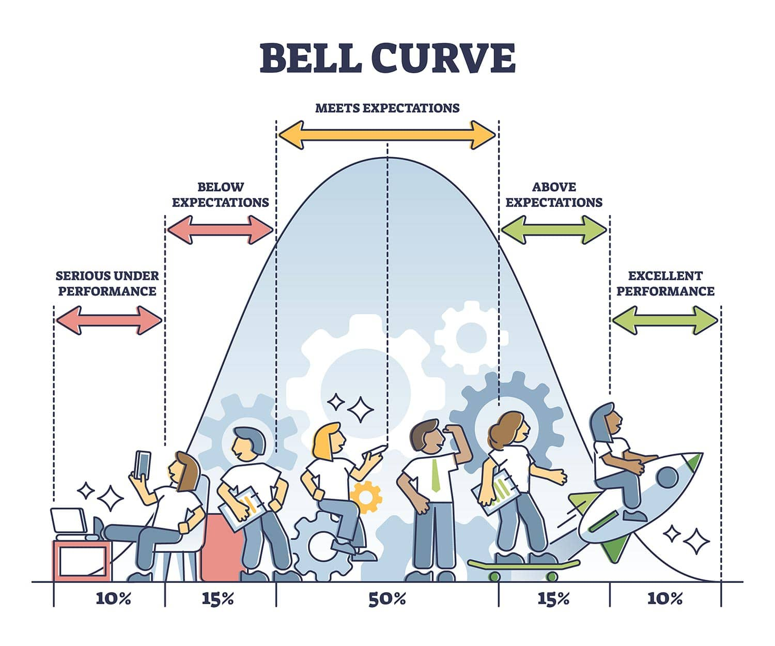
Class Participation 25% Kahoot and Class participation

Slide 4
Department of Business Administration National Chung Cheng University Consumer Behavior 2025
SYLLABUS
Contribution to class discussion 15%
Your class participation points come from two sources:
Responses in class - You will receive 1 point for every time for you reply to my questions.
1 point for sharing news in the class Line group before each class – The news can cover broad topics such as market trends or more specific areas such as consumer behavior.

Slide 5
Kahoot Quiz
Quiz (15%)
At the end of each class, there will be a quiz o Kahoot!
The top scorer will earn 5 points,
The second-place student will receive 3 points, and
The third-place student will get 2 points.
Students in fourth and fifth place will each earn 1 point.

Slide 6
週 | 日期 | Topic | Chapter
1 |  | Introduction | 1
2 |  | Motivation | 2
3 |  | Perception (First HW due) | 3
4 |  | Learning | 4
5 |  | Memory | 7
6 |  | Attitude 1 | 5
7 |  | Attitude 2 | 6
8 |  | Midterm Exam
9 |  | The process of making decision : Problem recognition and information search | 8
10 |  | Judgment and Decision Making | 9 & 10
10 |  | Judgment and Decision Making | 9 & 10
11 |  | Post-Decision Making | 11
12 |  | Psychographics, values, personality, and lifestyles | 14
13 |  | Social Influence | 15
14 |  | Adoption | 16
15 |  | Symbol | 17
16 |  | Final Exam
Important Note: The information on this syllabus is subject to change. Students are responsible for all changes announced in class

Slide 7
Exam Format : 25 Multiple Choices
The multiple choices questions will be more difficult than those in Kahoot.
To answer each question correctly, you must have a crystally clear understanding of each term, which may require staying focused and paying close attention during the lecture.
You are allowed to bring an A4 cheat sheet. However, you must handwrite the cheat sheet and cannot simply copy and paste printed materials.
A dictionary will be available in case you want to look up some vocabulary.

Slide 8
Exam Format : 25 Multiple Choices
Example Question:
A retail store arranges its window display in a way that makes all the items look more stylish and desirable when viewed together rather than individually. What principle does this illustrate?
Perceptual Vigilance
B) Gestalt
C) Expectancy Theory
D) Sensory Adaptation

