Slide 1
品牌管理 Fall 2025
PROFESSOR: Hung-Jen Su
Office: 管院 4313
Email: bmaesu@gmail.com
CLASS SCHEDULE: Thursday, 1:10 – 4:00pm,
OFFICE HOURS: by appointment.
Class Facebook: https://www.facebook.com/groups/CCUBM/

Slide 2


Example

Slide 3
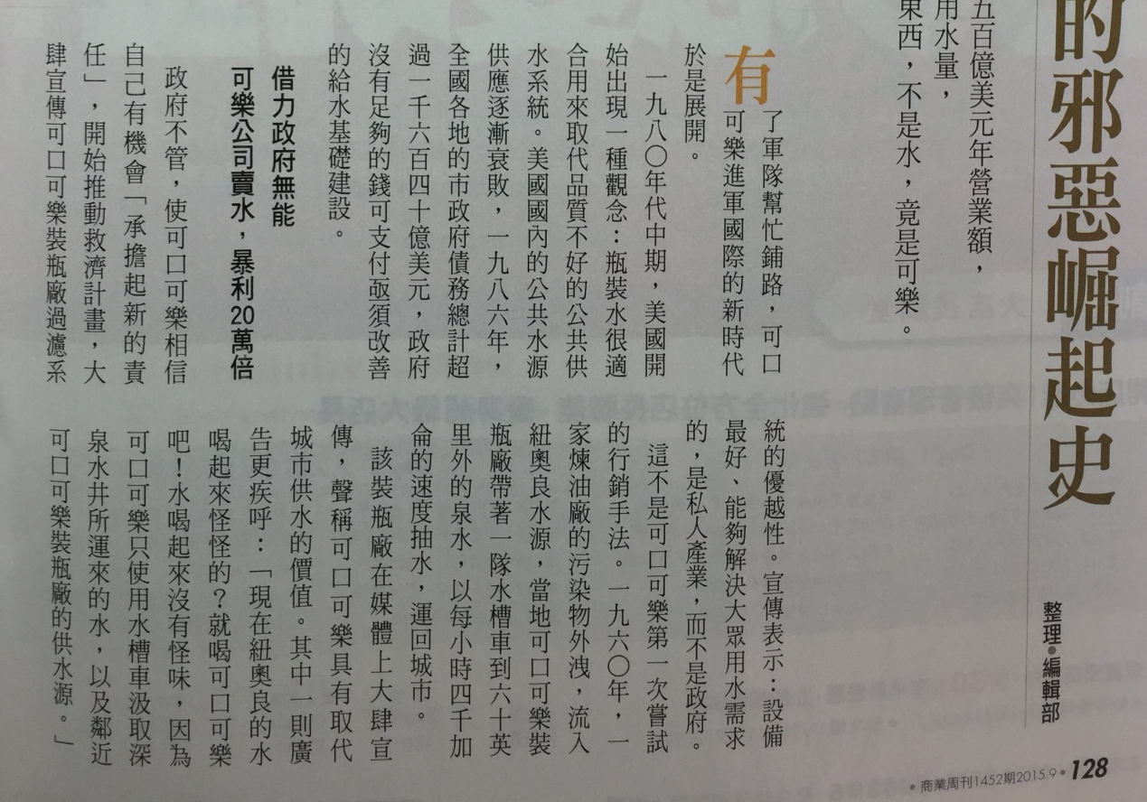
Example
Find this book online.

Slide 4
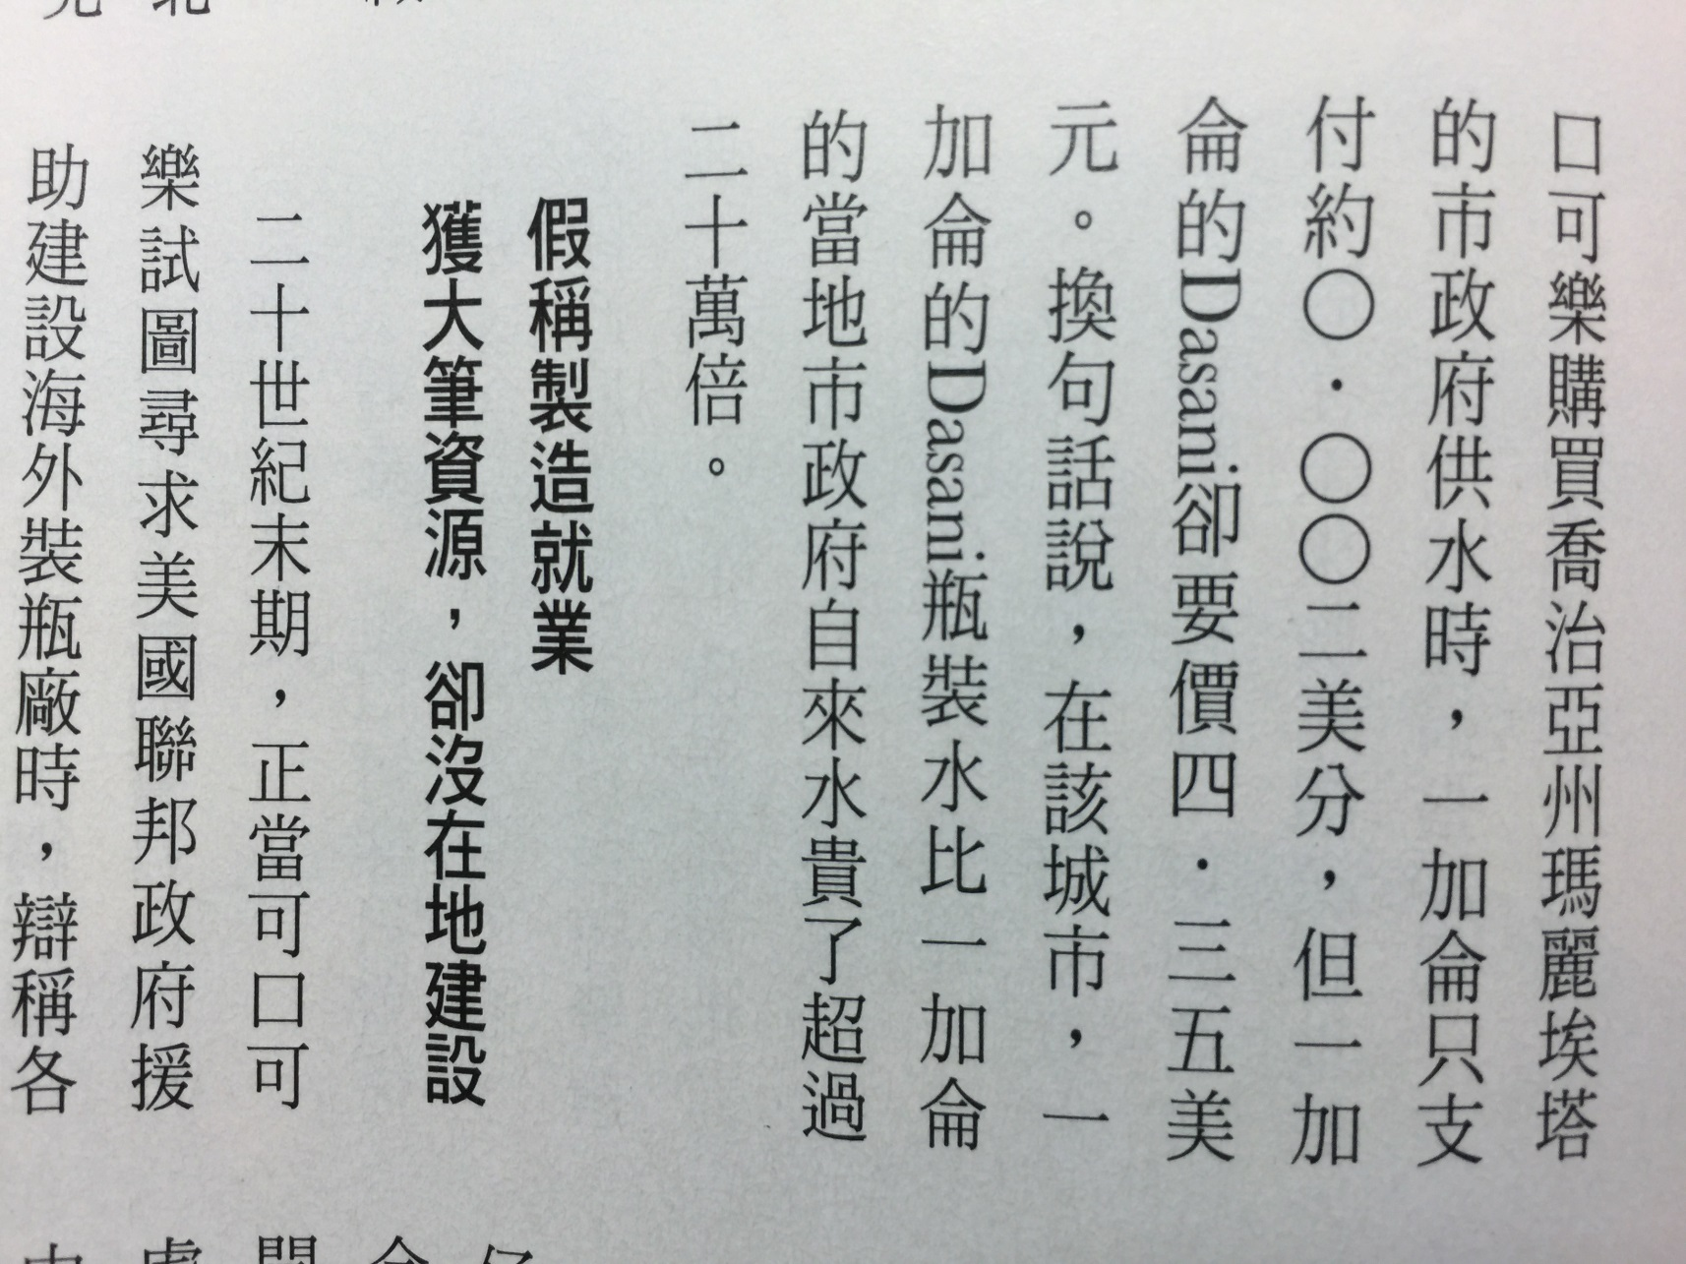
Example

Slide 5
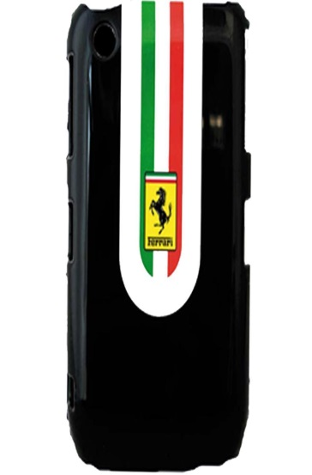
COURSE OBJECTIVES
This course will provide students practical tools to address the following questions:
How does branding influence consumer behavior?
What is brand equity?
How can I build brand equity?
How should I measure brand equity?
How can I leverage my brand equity?
How should I manage my brand equity over time?

Slide 6
COURSE OBJECTIVES
This course will provide students practical tools to address the following questions:
What is brand equity?
How can I build brand equity?

Slide 7
COURSE FORMAT 1/2
Class sessions will combine lectures, assignment presentations and case analyses.
At the beginning of each class, we will discuss the current news related to branding.

Slide 8
COURSE FORMAT 2/2
You are encouraged to upload interesting and major business news to the Line class group.
The student who provides the most interesting and impacting business news will be rewarded with “one” participation point.

Slide 9
Example of class assignment
Find a brand you like and make a list of its elements. Does these elements meet the criteria described in the PPT?

Slide 10

GRADING
Course grades breaks down:
Class participation 30%
Absence (5%) ; Class participation (25%)
Assignment presentation (PPT) 30%
Case performance 30%; Case participation 10%.

Slide 11
Class Participation (25%)
Actively taking part in what happens during class rather than just sitting and listening. It shows that the student is engaged, interested, and contributing to the learning process.

Slide 12
Class Participation (25%)
Answering questions when the teacher asks.
Asking questions if something is confusing or interesting.
Sharing ideas or opinions during discussions.
Bringing relevant examples or news related to the topic.
If you engage in any of the above activities during class, you will earn one participation point. At the end of the semester, your participation grade will be based on your overall class performance.

Slide 13
Assignment presentation (PPT) 30%
In the first half of the class, the lecture will cover the basics of branding. After each class, there will be a take-home assignment. You must place your work on PPT slides and be prepared to present it the following week.
Students will be called randomly. If you are called for one assignment, you will not be called for the next, but you may be called again after that.
For example, if you present the first assignment, you will be skipped for the second but may be called for the third.

Slide 14
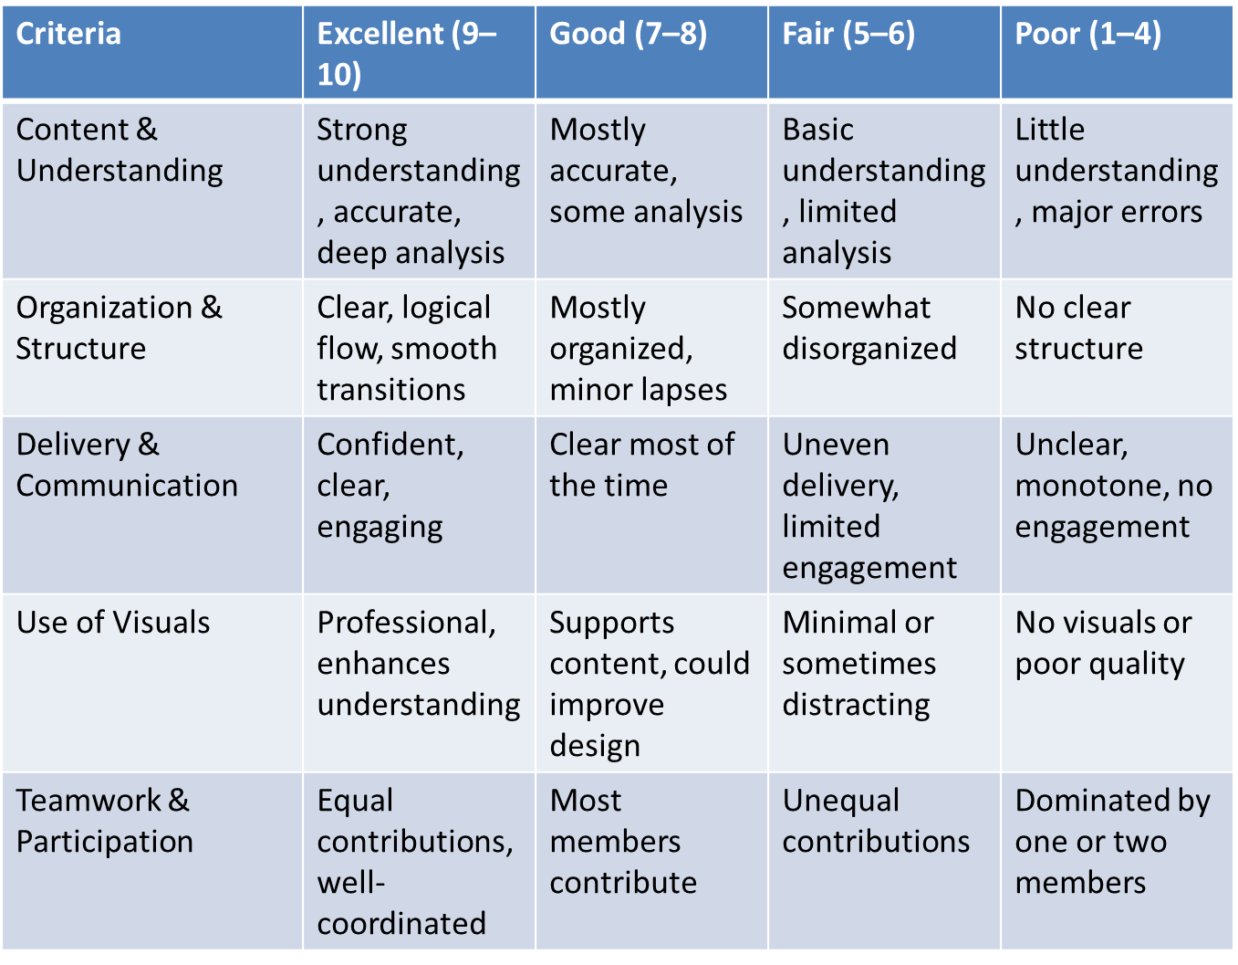

Evaluation of Presentation (30%)

Slide 15
Case Participation (10%)
Sharing ideas or opinions during discussions.
Working with group members actively in group projects or case discussions.
Being prepared (having done the reading or homework) so you can join the conversation.

Slide 16
Case Participation (10%)
At the conclusion of the semester, each student will be required to complete a peer evaluation of their group members.
The evaluation will consist of five items designed to assess each member’s contributions, rated on a scale of 1 to 10.

Slide 17
Case performance evaluation (30%)
Did you integrate the AI-sourced information into the case analysis meaningfully?
Did you propose reasonable solutions or strategies?
Were your points clear, well-organized, and persuasive?
Did you connect the AI-found evidence back to the case question?

Slide 18
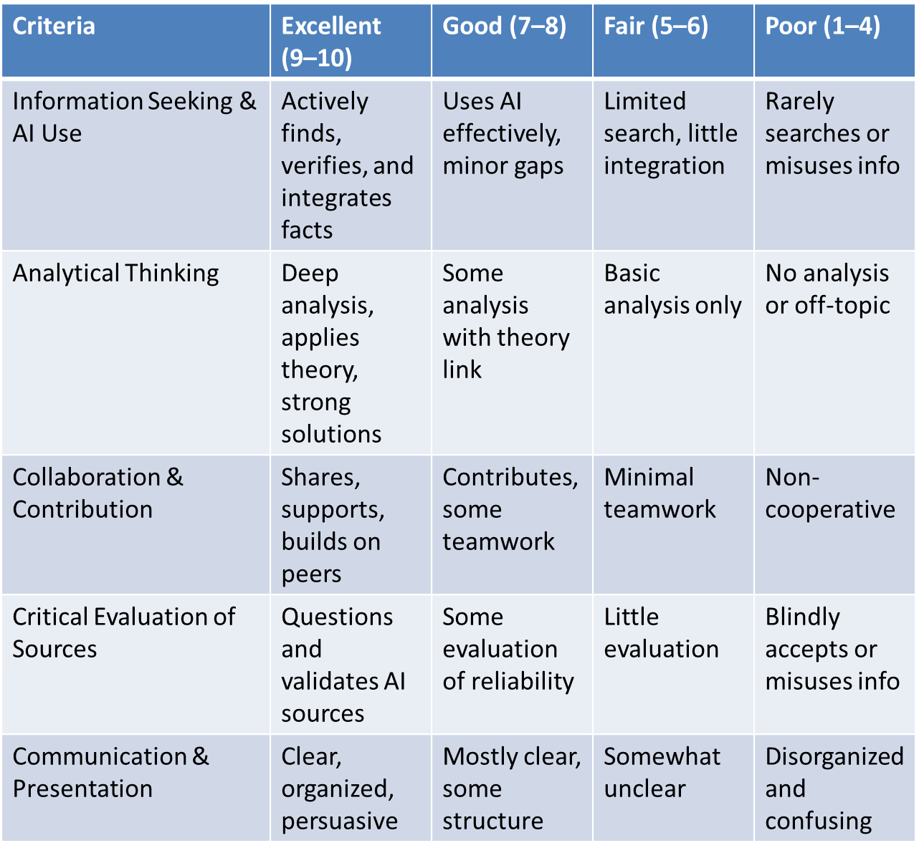
Evaluation Rubic (30%)

Slide 19
Evaluation Form (1/2)
1. Contribution to Group Tasks
How actively did the student contribute ideas, complete assigned tasks, and share responsibility for the group’s work?
2. Quality of Work
How accurate, thorough, and professional was the student’s work in supporting the group’s goals?
3. Cooperation and Teamwork
How well did the student collaborate with others, show respect, and support group members?

Slide 20
Evaluation Form (2/2)
4. Communication Skills
How effectively did the student express ideas, listen to others, and engage in group discussions?
5. Dependability and Responsibility
How reliable was the student in meeting deadlines, attending meetings, and fulfilling commitments?

Slide 21

Case Discussion
You will form group of three or four students.
Group member will be assigned randomly for each class.
At the beginning of the session, your group will receive three to four pages case study.
The case will also be available in the Teaching Platform before class, so you may review it in advance.

Slide 22
Case Discussion
You and your group member will have 20 to 30 minutes to read, analyze, and discuss the issues presented in the case.
Please note that the case do not provide all the answer. Your group is encouraged to use AI tools to find the facts or evident to support your arguments.
After group discuss, we will discuss these issues together as a class.

Slide 23
Schedule
週 | Topic | Assignment
1 | Syllabus & Brand Equity (ALAQO) | Please choice the best model out of the four brand equity models discussed on the PPT and explain why this model is the best?
2 | Elements of the brand &Brand Association | AI & ALAQO Assignment
3 | Brand Position | Take a trip to a supermarket and observe the extent of private-label brands. In which categories do you think private labels might be successful? Why?
4 | Brand personality | Brand personality : AI vs Human
5 | Brand Quality | Assignment
6 | 7P and Branding | Assignment
7 | Brand Extension | Nike

Slide 24
Schedule
週 | Topic | Case
8 | House of Brands | 全聯
9 | Brand Story & Myth | Starbuck and brand story
10 | Cause-Related & ESG Branding | Pure Plus
11 | Co-Creation | IKEA
12 | Personalization & AI-Driven Branding | Gogoro and global expansion
13 | Co-Branding | Starbuck and Spotify
14 | Ingredient Branding | Gore-Tex, Dolby, Teflon
15 | Experiential Branding | Red Bull or Airbnb
16 | Sub-branding | Acer & Subbrand

