Slide 1

Chapter 26
The first shall be last
Writing for Engineering and Science Students:
Staking your Claim
Gerald Rau

Slide 2
Goals:
Why is it essential to rewrite your Abstract after the paper is complete?
Why do Abstracts in science tend to reflect the structure of the article, while those in engineering may not?
What principles can help you create a better title?
Should keywords duplicate words in the title?
How do Highlights differ from the Abstract?
What types of information should go in the Acknowledgments?

Slide 3
Attracting attention
Section 26.1

Slide 4
Powers of 10
If you can increase each level to 11%
0.133 download
Of those who read your title
10% may read your abstract
1% may look at graphics
0.1% may download article
Title and Abstract must be good to attract attention

Slide 5
Abstract
Section 26.2

Slide 6
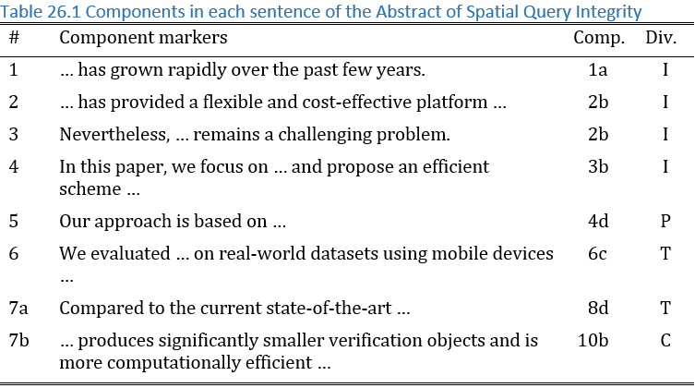
Exemplar Abstracts
Identify components and divisions represented

Slide 7
Science vs. Engineering
IMRD
  Often reflects proportion of article
  Emphasis on Results & Discussion
IPTC
  Often does not reflect proportion of article
  Emphasis on Introduction or Testing
  Perhaps because Process is too detailed for Abstract

Slide 8
Exercise 26.1
1) How many sentences do the Abstracts of your exemplars contain? What is the average number of words per sentence?
2) Based on your knowledge of the components, assign each sentence to a component and to the division where that component usually occurs in an article. Do the sentences appear in the same order as the order of the divisions? How many sentences are devoted to each division?
3) If there is a required structure, as in some medical journals?

Slide 9
What to include
Importance, Need, Framework
Research goal or Conclusion (always)
Results, Comparisons, Interpretations

Slide 10
How to write
Copy key words or phrases from main document
Reorganize, rewrite to clarify (follow 7Cs)
Ensures nothing not in the article is in the Abstract
Present tense, active voice
  Stronger

Slide 11
Each genre is different
Research article (contribution)
Conference (preliminary = less Results)
Thesis (longer, summary of entire thesis)

Slide 12
Exercise 26.2
Using the information on what is expected in an abstract in your field from Exercise 26.1, write or rewrite your abstract.

Slide 13
Title
Section 26.3

Slide 14
Types of titles
Noun phrases (most common)
Title: subtitle
Statements or question (less common)

Slide 15
Title related to research goal
General research area
Specific contribution
A Year in Key West and Cuba With Hemmingway
With Hemingway: A Year in Key West and Cuba
Human Pose Estimation in Video Using Spatio-Temporal Matching
Spatio-Temporal Matching for Human Pose Estimation in Video
Stronger if placed first

Slide 16
Exercise 26.3
How long are the titles of your exemplars? Are the titles statements or questions (containing a verb) or noun phrases (no verb)? Do any contain a colon? If so, what is the relationship between the first and second parts?
Do the titles include the research goal or main contribution of the research, the general topic or research area, or anything else? In what order?
Write several different versions of a title before choosing the best.

Slide 17
Keywords
Section 26.4

Slide 18
The times, they are a-changin’
Before: Bound citation indices
  Keywords used to find articles
Now: Computer searches
  Keywords used to …

Slide 19
Exercise 26.4
Check the instructions to authors to find how many keywords are required, and whether they must be selected from a list.
Look at your exemplar articles to see which keywords were chosen by others studying a similar topic.
Choose suitable keywords for your article.

Slide 20
Highlights
Section 26.5

Slide 21
Elsevier
3-5 highlights
Each no more than 85 characters including spaces
Listing the core results
Simple declarative sentence, about 10 words

Slide 22
Exercise 26.5
1) Check the instructions to authors to find out whether highlights are required. If they are, look at examples in the online version of your journal. Do they fit the general pattern suggested above for length and sentence structure? What divisions of the paper are represented?
2) Write your own highlights following the same pattern.

Slide 23
Acknowledgements etc.
Section 26.6

Slide 24
Acknowledgements
Relatively fixed phrases
“This work was supported [in part] by [grant agency] [grant number].”
“The authors wish to thank [technician] for providing technical support.”

Slide 25
Author Bios
More common in engineering
How long? (depends on journal)
What to include? (will change over time)

Slide 26
Exercise 26.6
Write the final parts, following the requirements of the journal, department, conference, or funding agency.
Hint: You may need to gather information from your advisor or other authors.

Slide 27
Evaluate your understanding
Why is it essential to rewrite your Abstract after the paper is complete?
Why do Abstracts in science tend to reflect the structure of the article, while those in engineering may not?
What principles can help you create a better title?
Should keywords duplicate words in the title?
How do Highlights differ from the Abstract?
What types of information should go in the Acknowledgments?

Slide 28
References
HU, L., KU, W.-S., BAKIRAS, S. & SHAHABI, C. 2013. Spatial Query Integrity with Voronoi Neighbors. IEEE Transactions on Knowledge and Data Engineering, 25, 863-876.
SAMUELSON, A. 1984. With Hemingway: A Year in Key West and Cuba New York, Random House.
ZHOU, F. & DE LA TORRE, F. 2016. Spatio-Temporal Matching for Human Pose Estimation in Video. IEEE Trans. Pattern Anal. Mach. Intell., 38, 1492-1504.

