Slide 1

Chapter 24
Illustrating your manuscript
Writing for Engineering and Science Students:
Staking your Claim
Gerald Rau

Slide 2
Goals:
How do table titles and figure captions differ?
How should the arrangement differ for numerical and non-numerical tables?
Why is it beneficial to minimize the number of horizontal and vertical lines in a table?
Why should the instructions to authors be considered minimum requirements rather than the goal?
How can you improve the default output of your graphing program?
Why are illustrations more common in engineering than science?
Why is it impossible for a writing textbook to give absolute rules on what makes a good graphic?

Slide 3
The purpose of graphics
Section 24.1

Slide 4
Graphics ≠ Graph
Graphics
  Tables
    Numerical – mostly numbers, often comparing down columns
    Non-numerical – mostly words, often comparing across rows
  Figures
    Graphs
      Line – used for time or other continuous variables
      Bar – used for non-continuous variables
    Illustrations
      Photograph – including digital microscopic images
      Diagram – many different types

Slide 5
Graphics are like a movie trailer
Attract attention
Unanswered questions
Make people want to see the whole thing

Slide 6
Graphics are like a movie
Graphics = Video
Text = Soundtrack
Both required to get the whole message

Slide 7
Terms used when referring to graphics
Section 24.2

Slide 8
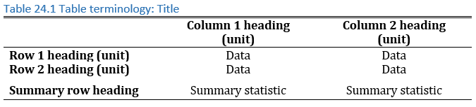
Tables
Column heading,
units in parentheses
Table Title Top
1
Reading direction
2
3
4
Row heading,
units in parentheses

Slide 9
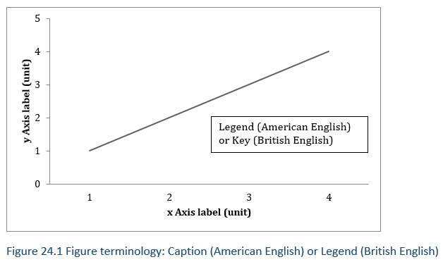
Figures
Caption Follows Figure
4
Names differ in British vs. American English
Names differ in British vs. American English
Reading direction
3
Axis label,
units in parentheses
2
1

Slide 10
Titles and Captions
Sections 24.3-5

Slide 11
Title or Caption Formats
Table I
Short Title in Small Caps Common in Engineering
1
2
Table 1. Longer titles in sentence case with more information are common in science and also more common with figure captions.
1 | 2
Center aligned | Left aligned
Title on following line | Title on same line
“Small Caps” | “Sentence case”
I = Roman numeral | 1. = Arabic numeral
I = No period after number | 1. = Period after number
Title short, no period | Title long, ends with period.

Slide 12
Title and Captions
General principles
  Self-sufficient (summarize what the graphic shows)
Number of words may differ by field and graphic type
Format for Tables and Figures: same or different
Tables:
  Often brief noun phrase, no verb
Figures:
  May be longer, sentences

Slide 13
Tables
Section 24.3

Slide 14
Fit in, stand out
Same type of graphics
Stand out for quality
Default output is single cells, hard to read

Slide 15
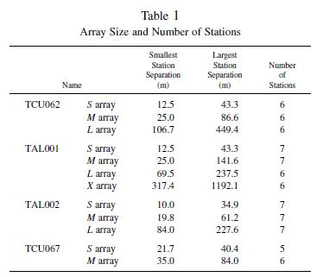
Good Numerical Table
Natural direction to compare numbers
Space guides reading
Satoh et al., 2001

Slide 16
Good Numerical Table
Vertical (columns)
  Quantities you want to compare
    Allows quick impression of size based on first digit
  Often results
Horizontal (rows)
  Categories to be compared, in logical order
    Ascending, descending, sequential, alphabetical
  Often treatments

Slide 17
Table Formatting
Unit on second line of Header, in parentheses
Round data to the same number of decimal places
  Or significant digits
Do not split words
Eliminate blank space
Fit the column size of journal
  See Instructions to Authors
Separation
Satoh et al., 2001

Slide 18
Table Dividing Lines
No vertical dividing lines
  (Historical reason – difficulty of typesetting)
  Occasionally between Row Headings and Data
  Use space instead
Few horizontal dividing lines
  Table Title /Column Headings
  Column Headings /Data
  Data /Summary
  Table /Footnotes or bottom
1
2
(No summary)
4

Slide 19
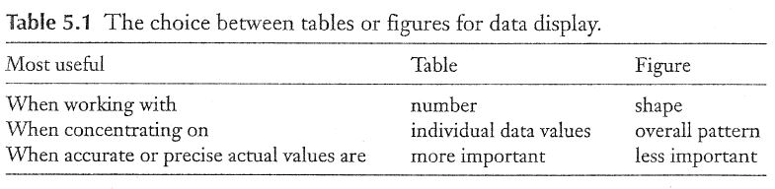
Good Non-numerical Table
Natural direction to compare words
Natural reading direction
Cargill and O'Connor, 2013

Slide 20
Good Non-numerical Table
Horizontal (rows)
  Items you want to compare
    Normal reading pattern: across row
Vertical (columns)
  Categories to be compared

Slide 21
Figures: Graphs
Section 24.4

Slide 22
Fit in, stand out
Same type of graphics
Stand out for quality
Default output often is poorly sized, too many lines

Slide 23
Default
A 2012
B 2014
C 2o17
D 2018
Current

Slide 24
Improved
Only compare with current best
Line order matches legend
Lines distinguishable in grayscale
Eliminate unnecessary white space
Current
A 2018
B 2o17

Slide 25
Figures: Illustrations
Section 24.5

Slide 26
Illustrations
More common in engineering
  Show new design

Slide 27
Good illustrations
Photographs
  Crop out unnecessary background
  Retain length:width ratio when resizing
Other illustrations
  Simplify
Size
  Resolution 150-300 dpi
  Text can be read in print version, not your monitor

Slide 28
Graphics that break the rules
Section 24.6

Slide 29
One (usually) inviolable rule
Each graphic must be mentioned in the text
Okay, Two:
Graphics should be helpful to the reader

Slide 30
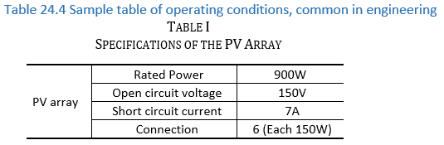
Easily represented in text
Makes it easy for the reader to find, read

Slide 31
Evaluate your understanding
How do table titles and figure captions differ?
How should the arrangement differ for numerical and non-numerical tables?
Why is it beneficial to minimize the number of horizontal and vertical lines in a table?
Why should the instructions to authors be considered minimum requirements rather than the goal?
How can you improve the default output of your graphing program?
Why are illustrations more common in engineering than science?
Why is it impossible for a writing textbook to give absolute rules on what makes a good graphic?

Slide 32
References
CARGILL, M. & O'CONNOR, P. 2013. Writing scientific research articles: Strategy and steps, John Wiley & Sons.
SATOH, T., KAWASE, H., IWATA, T., HIGASHI, S., SATO, T., IRIKURA, K. & HUANG, H.-C. 2001. S-wave velocity structure of the Taichung basin, Taiwan, estimated from array and single-station records of microtremors. Bulletin of the Seismological Society of America, 91, 1267-1282.

