Slide 1

Chapter 23
Finalization
Writing for Engineering and Science Students:
Staking your Claim
Gerald Rau

Slide 2
Goals:
Why do many writers restate the research goal when the paper is nearly complete?
What techniques can be used to check for consistency?
Which of the many points of correctness mentioned in this chapter is most difficult for you?
As a first-time author, why is it important to seek advice from your collaborators early in the writing process?

Slide 3
Time’s up
Section 23.1

Slide 4
Perfection is unattainable
Always more that could be improved
  Research
  Writing

Slide 5
7Cs of Change
Rewriting
  1. Coherence
  2. Conciseness
  3. Connection
  4. Connotation
Revising
  5. Consistency
  6. Correctness
  7. Collaboration
Organization
Clarification
Finalization
Notes:
Paragraph/sentence level, this week: Elimination, Organization
Word level, next week: Clarification
Revision, last week: Modification

Slide 6
C5 Consistency
Section 23.2

Slide 7
Final change of research goal
Called “Research goal”
Actually the goal of this particular writing
  Probably changed in the course of research

Slide 8
Consistency
Do you use the same vocabulary in the
first part as in the last section?
Do you use the same vocabulary in the
first section as the last section?
Often change ideas, focus over course of paper
  Rewrite earlier sections to match later

Slide 9
Ambiguity
Abbreviations
  How well-known is the abbreviation?
Relative pronouns and antecedents
  What is “this”?
Noun or verb or …
  Liquid flows …
    downhill (Noun Verb)
    can be collected (Adj. Noun)

Slide 10
Squid technique
Hiding behind a cloud of ink
“Much more work will be required to provide definitive answers to these questions”
Means: “I don’t have a clue how to explain the data.”
Emphasize what you do know, contribution

Slide 11
Exercise 23.1
Check your writing to make sure key terms are used consistently. Apart from those words, if the same word appears twice in a paragraph, consider whether it would be possible to substitute a synonym.

Slide 12
C6 Correctness
Section 23.3

Slide 13
Frequently Misused Words
Section 23.3.1

Slide 14
Correct word
Similar sound or meaning
Device (n)/devise (v): A device is something that someone has devised.
  Our solution to the problem is a workable device.
  We devised a workable solution to the problem.

Slide 15
Respectively
Two lists to be merged
  Same number of objects
  Same order
Comma separated
Does not mean sequentially

Slide 16
Respectively
Correct :
  The two subjects were male and female, aged 67 and 63, respectively.
  The two subjects were, respectively, male and female, aged 67 and 63.
  A1 and B1, A2 and B2, respectively

Slide 17
Respectively
Incorrect :
  The two subjects were aged 67 and 63, respectively.
    [No second list.]
  The three subjects were male and female, aged 67, 63 and 62, respectively.
    [Unequal numbers.]
  The two subjects were a male aged 67 and a female aged 63, respectively.
    [Two lists are already merged.]
  The two subjects will be described respectively.
    [Sequentially, not respectively.]

Slide 18
Prepositions
Section 23.3.2

Slide 19
Prepositions
In the morning I found the information in an article in a folder while getting in the car, so I will give it to you in an hour.
time of the day
metaphorical
physical space
into
length of time

Slide 20
Articles
Section 23.3.3

Slide 21
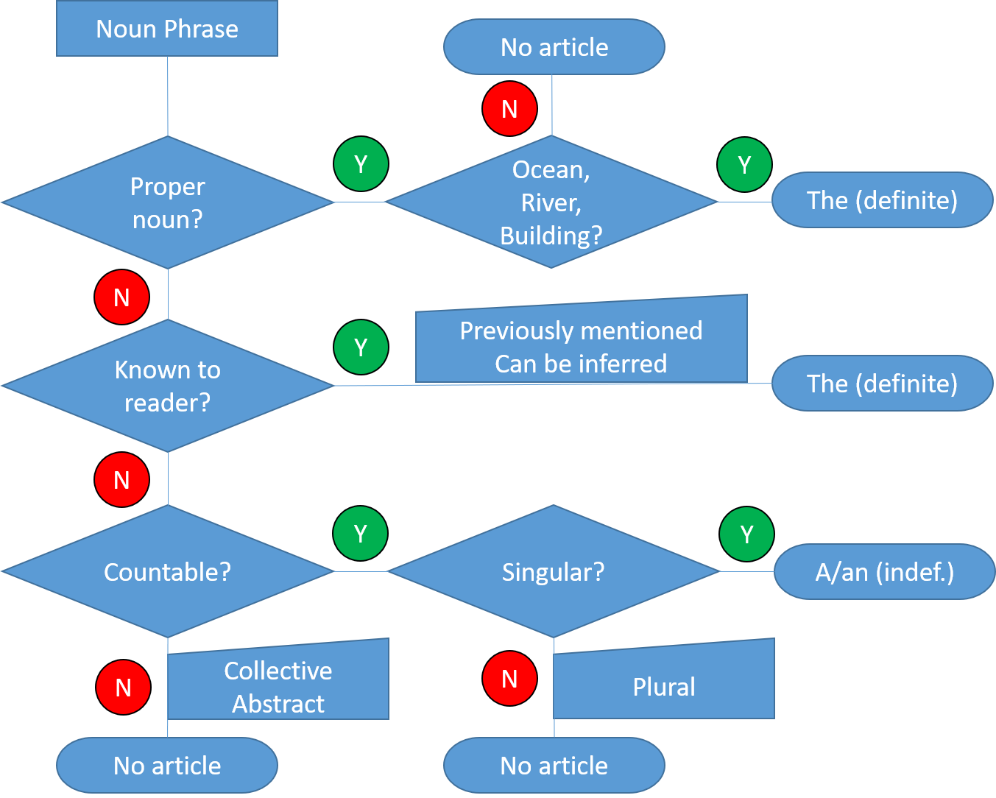
Which article to use?

Slide 22
Known to reader
Previously mentioned
  I had a cheese sandwich and an apple for lunch.
  The sandwich was fine, but the apple had a worm.
Can be inferred
  I bought a new computer but the keyboard did not work.

Slide 23
Which article to use?

Slide 24
Countable or Uncountable?
Countable nouns: particle(s), circuit(s)
  Countable nouns need an article (a, the)
    Or other ‘determiner’: my, this, one, some
Uncountable nouns: equipment, excellence
  Collective can use the (specific), not a
    Equipment was used; I used the equipment
  Abstract do not use either (no specific)
    Excellence is our goal
Chinese consider equipment countable
Notes:
Note equipment in Chinese, considered countable

Slide 25
Countable or Uncountable?
Either countable or uncountable:
absence, failure, paper, science
Sometimes considered uncountable only (NOT TRUE):
work, freedom, earth, intelligence
Uncountable in American, countable in British:
math(s), research(es)

Slide 26
A or An with Abbreviations?
Consider the way the letter is said, not letter itself
Use ‘a’ if the following sound is a consonant.
Use ‘an’ if the following sound is a vowel.
We used a UV light. (U = only exception)
This is a unique situation.
This is an uncommon situation.
I had an MRI scan. (F, H, L, M, N, R, S, X)

Slide 27
Changing the Meaning
Use of ‘a’, ‘the’, or Ø (neither) can change meaning:
This may reveal a connection between the two.
  One of several
This may reveal the connection between the two.
  Only one
Attach the wires to two adjacent sites.
  Any two
Attach the wires to the two adjacent sites.
  Only two

Slide 28
Which article to use?
Sometimes more than one answer possible
  Depends whether something has been mentioned
Strive for 90%
  Some use based on native intuition, not rules
  Usually does not affect understanding

Slide 29
Exercise 23.2
In your exemplar article, circle all the ‘a’, ‘the’ or places in front of a noun that could have an article but do not (Ø), and try to determine which rule is being followed.

Slide 30
British vs. American English
Section 23.3.4

Slide 31
Numbers
 | American | British
1 thousand | 1,000.00 | 1.000,00
Billion | thousand million (10⁹) | million million (10¹²)
12/1/16 | December 1, 2016 | 12 January 2016

Slide 32
Spelling
 | British | American
Technical words | Aluminium Cotton wool | Aluminum Absorbent cotton
Vowels | Grey Colour Amoeba | Gray Color Ameba
Noun/verb | Practice (n) Practise (v) | Practice (both)
Device (n)
Devise (v)
Also punctuation, spacing

Slide 33
Spelling, Punctuation, Formatting
Section 23.3.5

Slide 34
Correctness – Spelling, Grammar
Spelling and grammar checkers will not catch every problem
Bee sewer you’re spilling id collect, the punctuation is right: and everything is formatted the same.
Be sure your spelling is correct, the punctuation is right, and everything is formatted the same.

Slide 35
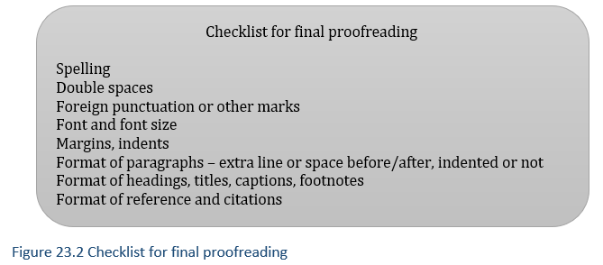
Proofreading

Slide 36
Variation in an ELF world
Section 23.3.6

Slide 37
Expectations are changing
English as a lingua franca
  Common language of communication
More emphasis on communicative competence
  Rather than correctness

Slide 38
“Edited by a native speaker”
English editors are not perfect
  May miss some things
  “Native speakers” not know your field
Your name is on the paper, not theirs

Slide 39
C7 Collaboration
Section 23.4

Slide 40
Collaboration
May involve rewriting at all levels
May be done several times during the process
  More for less experienced writers

Slide 41
Evaluate your understanding
Why do many writers restate the research goal when the paper is nearly complete?
What techniques can be used to check for consistency?
Which of the many points of correctness mentioned in this chapter is most difficult for you?
As a first-time author, why is it important to seek advice from your collaborators early in the writing process?

