Slide 1

Chapter 22(b)
Rewriting: Clarification (Connotation)
Writing for Engineering and Science Students:
Staking your Claim
Gerald Rau

Slide 2
7Cs of Change
Rewriting
  1. Coherence
  2. Conciseness
  3. Connection
  4. Connotation
Revising
  5. Consistency
  6. Correctness
  7. Collaboration
Organization
Clarification
Finalization
Notes:
Paragraph/sentence level, this week: Elimination, Organization
Word level, next week: Clarification
Revision, last week: Modification

Slide 3
Goals:
What is one of the most important uses of connotation in science and engineering research articles?
What commonly used terms should be avoided in research articles, unless used in their technical statistical sense?
What types of qualifiers can be used in summarizing data as well as clarifying claims?
What is the purpose of using modals, delimiters and hedges?

Slide 4
C4 Connotation
Section 22.3

Slide 5
4) Connotation
Making supportable claims
Statistical terms: Significant, Causation, Correlation
Qualifiers
  Likelihood
  Frequency
  Similarity
  Modal Verbs
  Delimiters, Hedges
  Verb connotations
Make claims easier to support

Slide 6

Tailored suit
Fasteners
Necessary
At end
Cannot make up for
poor fabric
poor stitching

Slide 7
Making Supportable Claims
Section 22.3.1

Slide 8
Making supportable claims
The cause?
A cause?
Correlation?
How
confident
A causes change in B
Hedges
How
often
Delimiters
How
close
Modals

Slide 9
Why would you modify claims?
My work is
  Best?
  Second best?
  Best in a particular situation
A caused B
  Are you 100% sure?
  A appears to have caused B
The current best may be your reviewer
Why should it be published?
Never

Slide 10
Modifying your claim
Can I really support that?
Original
  This is the first paper to present an optimal solution.
Revised
  To the best of our knowledge, this is the first paper to present a method that optimizes value B for all values of A within range A₁-A₂.

Slide 11
Significant
Section 22.3.2

Slide 12
Significant
Specific technical meaning related to statistics
If a statistical test has been performed, not significant
  A>B, but A is not significantly greater than B
  Means A=B, within the variability of the measurement
  Therefore you cannot say A>B

Slide 13
How large or small?
If no statistical test has been performed, use other words
A was much larger than B.
A was significantly larger than B.
A was larger than B.
  Substantially, appreciably, noticeably, considerably
Weak
significantly
No statistics

Slide 14
Causation vs. Correlation
Section 22.3.3

Slide 15
Causation vs. Correlation
In a scientific sense:
Causation or causality is the capacity of one variable to influence another in a predictable way,
  either by bringing the second into existence
  or modifying it in some way.
Correlation is a relationship between two variables such that both change together in some predictable way,
  either as a result of their action on one another
  or of some other factor that affects both.

Slide 16
Causation vs. Correlation
Causation: One thing causes another
  A ➔ B
Correlation: Linked, but cause unknown
  A ➔ B, or B ➔ A, or C ➔ both A and B
What do you want to claim?
  A is the cause of B (the only cause)
  A is one cause of B (but there may be another)
  A is correlated with B

Slide 17
Qualifiers
Section 22.3.4

Slide 18
Qualifiers
Data do not speak for themselves
Highlight what you want readers to conclude
  This occurred in 23% of the cases
Is that a lot or a little?

Slide 19
Qualifiers
Modify the strength of a claim (e.g. causality)
  Likelihood qualifiers
    Likely, probably, possibly, unlikely
  Frequency qualifier
    Often, frequently, rarely
  Similarity qualifier
    Essentially, more than, as few as
  Modal verbs
    May have, could have, might have
  Delimiters and hedges
    Evidence suggests, it can be assumed, preliminary data

Slide 20
Likelihood Qualifiers

Slide 21
Likelihood
Likelihood qualifiers specify how likely you think your claim is to be correct.
Basic claim: A caused B
  How confident are you that this it correct?
    Likelihood qualifiers

Slide 22
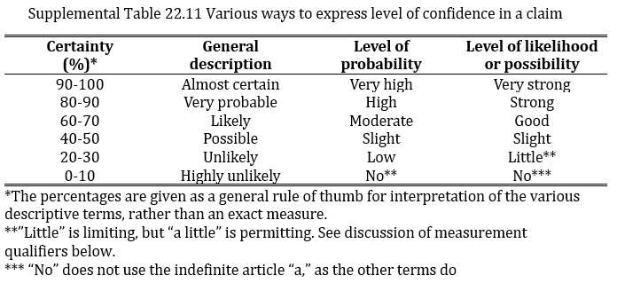
How confident are you?
It is very probable that A caused B
There is a high probability that A caused B
There is a strong likelihood that A caused B
There is a strong possibility that A caused B

Slide 23
Frequency Qualifiers

Slide 24
Frequency
Frequency qualifiers are used to draw attention to how frequently something occurs. They may be used not only to modify claims but also to summarize data.

Slide 25
How often does it happen?
Data do not speak for themselves
Highlight what you want readers to conclude
  This occurred in 23% of the cases
  This occurred rarely, in 23% of the cases
  This occurred frequently, in 23% of the cases
Is that a lot or a little?
See Supplemental Material

Slide 26
Similarity Qualifiers

Slide 27
Similarity
Like frequency qualifiers, similarity qualifiers are used both when summarizing data and to modify claims. Commonly, they direct attention to how some measurement compared to another or to expectations.

Slide 28
Similarity
What do you want to emphasize about the quantity?
  Is it about the same as expected?
  Is it larger than expected?
  Is it smaller than expected?
  Is it exceptionally large or small?
  Do you not want to commit yourself or did you not have any idea what to expect?

Slide 29
How close to expectations?
This occurred in 17% of the cases
How similar are your data to expectations?
  Predicted values based on hypothesis
  Expected values based on model
This occurred in 17% of the cases,
nearly equal to our expectations

Slide 30
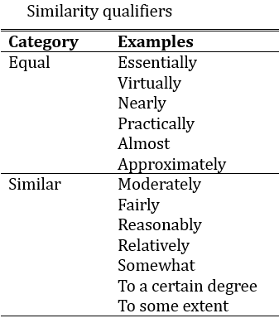
How close to expectations?
Virtually equal to
expectations
Reasonably similar to
expectations
Closest Furthest
Equal to Same as
Similar to

Slide 31
How close to a limit?
There can be a maximum of 16 different options.
There can be as many as 16 different options.
There can be no more than 16 different options.

Slide 32
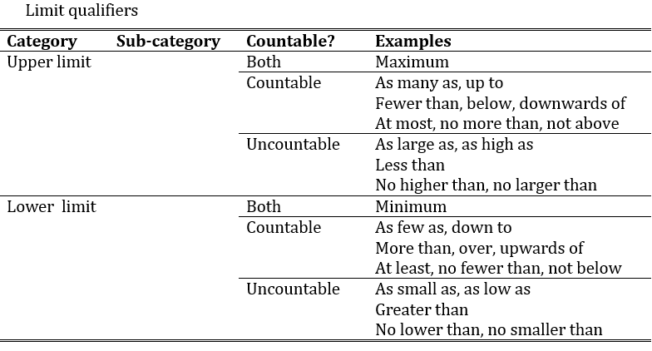
How close to a limit?
Permitting
Neutral
Limiting

Slide 33
How close to a limit / expectations?
Eight occurrences were detected in a single trial.
As many as 8 occurrences were detected in a single trial,
so the results were essentially the same as predicted.
No more than 8 occurrences were detected in a single trial,
which is appreciably less than formerly reported.

Slide 34
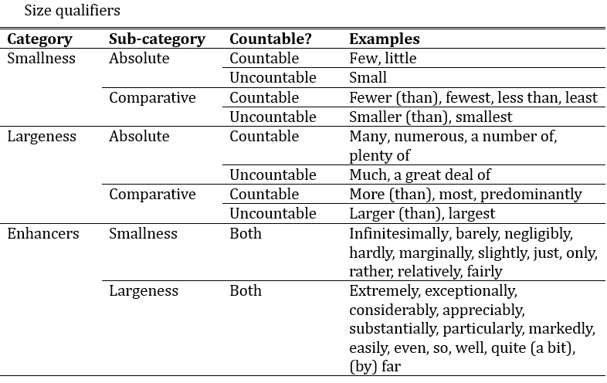
How large or small?
Significantly:
only with statistical comparison

Slide 35
Modal Verbs

Slide 36
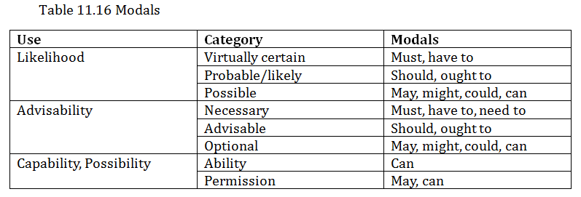
Modals
Table 22.4
Note that most of the modals can have more than one meaning
Notes:
Likelihood and choice correlated
Capability within optional category

Slide 37
Modifying ‘Truth value’
How likely is something to be true?
  The rise in temperature was due to …
    Fact, with evidence to back up the claim
  The rise in temperature must have been due to …
    Virtually certain, but no direct evidence
  The rise in temperature ought to have been due to …
    Probable, but no evidence
  The rise in temperature may have been due to …
    Possible, but no evidence

Slide 38
Modals: Advisability
Table 22.4

Slide 39
Modifying Advice
How strongly do we want to advise a certain action?
  To avoid this rise in temperature we must …
    Author views as necessary
  To avoid this rise in temperature we should …
    Author views as advisable
  To avoid this rise in temperature we could…
    Author views as optional

Slide 40
Modals: Capability, Possibility
Table 22.4

Slide 41
Ability or Permission
You can submit your paper to Science.
  Ambiguous (ability or permission)
You may submit your paper to Science.
  Permission

Slide 42
Possibility
‘Can’ commonly used in IPTC for possibility
  Can improve, can reduce (active)
  Can be improved, can be reduced (passive)
Notes:
Leave for later?

Slide 43
Delimiters

Slide 44
Delimiters
Toward the end of the Testing division it is common to note the limitations of your study and what work remains to be done, either by your lab or others. This is highlighted by words and phrases that act as limitation markers.

Slide 45
Delimiters
Based on our limited data, A appears to cause B.
As far as we know, this study is the first of its kind.

Slide 46
Hedges

Slide 47
Hedges
In addition to softening claims to make them easier to defend, words are sometimes used to reduce the impact of an utterance on the hearer, … especially those whose work you are claiming to surpass.

Slide 48
Hedges
Ours is the best solution! It is far better than the previous one proposed by Chen.
Our solution appears to be better than the one proposed by Chen, within the range x-y.
That may be, but I am reviewing your paper,
which will never be published
Ok, I can accept that

Slide 49
Hedges
Easier to defend claim
Avoid angering other researchers

Slide 50
Combining qualifiers
A caused B
[Begin with a basic claim]
It is likely that A often caused B.
[+Likelihood +Frequency]
It seems that A caused a substantial change in B.
[+Hedge +Similarity]
It can be inferred that A may have caused B.
[+Hedge +Modal]
It seems likely that A may have occasionally caused a minimal change in B.
[+Hedge +Likelihood +Modal +Frequency +Similarity]

Slide 51
Verb Connotations

Slide 52
Verb Connotations
One of the easiest ways to change the strength of a claim is simply to change the verb. Just as choice of a certain citation verb can indicate how an author feels about previous research, verb choice can indicate how strongly the author feels about the conclusions of the present paper.

Slide 53
Evaluate your understanding:
What is one of the most important uses of connotation in science and engineering research articles?
What commonly used terms should be avoided in research articles, unless used in their technical statistical sense?
What types of qualifiers can be used in summarizing data as well as clarifying claims?
What is the purpose of using modals, delimiters and hedges?

Slide 54
Exercise 22.3
1) What qualifiers are used in your exemplar articles?
2) Does your usage match? Are there places you should add qualifiers to soften your claim or clarify your data or opinion of other research?

