Slide 1

Chapter 22(a)
Rewriting: Clarification (Connection)
Writing for Engineering and Science Students:
Staking your Claim
Gerald Rau

Slide 2
7Cs of Change
Rewriting
  1. Coherence
  2. Conciseness
  3. Connection
  4. Connotation
Revising
  5. Consistency
  6. Correctness
  7. Collaboration
Organization
Clarification
Finalization
Notes:
Paragraph/sentence level, this week: Elimination, Organization
Word level, next week: Clarification
Revision, last week: Modification

Slide 3
Goals:
What is the purpose of adding connectors to your writing?
How are contribution markers, achievement markers and application markers similar? How are they different?
What devices can provide connection between sentences?
Why are there so many logical connectors, when the same basic ideas could be conveyed more simply by coordinating conjunctions?

Slide 4
Clear, Concise, Precise
Section 22.1

Slide 5
Balance
Details = clear
Details = not concise
Precise
Clear
Concise

Slide 6
Rewriting:
“I turn sentences around. That’s my life.
I write a sentence and I turn it around.
Then I look at it and I turn it around again.
Then I have lunch.
Then I come back in and write another sentence.
Then I have tea and turn the new sentence around.
Then I read the two sentences over and turn them both around.
Then I lie down on my sofa and think.
Then I get up and throw them out and start from the beginning.”
Philip Roth

Slide 7
C3 Connection
Section 22.2

Slide 8
Connection
Connections to past research
Markers
  Contribution
  Achievement
  Application
Connectors
  Continuity
  Logical
  Time sequence
Connections within the article

Slide 9
Connection to Past Research
Section 22.2.1

Slide 10

First Claim
First claim, restated:
Your work connects with and makes an important contribution to the overall body of knowledge in your field
Contribution
Different from existing

Slide 11
Purpose
Make it clear how your work connects to past research
And improves on past research
Contribution markers
Achievement markers
Application markers

Slide 12
Contribution Markers

Slide 13
Contribution Markers
Verbs – 4 categories (Table 22.2)
  Support
  Challenge
  Modify
  Solve
Our study (confirms, challenges) prior studies
Our study (extends, resolves) the current problem
More common in science
Examples of categories online
More common in engineering

Slide 14
Contribution Markers
Any division
  I – how related to past research (often modify)
  P – expansion of how related to past research
  T – compare/contrast to past research
  C – contribution
Present tense
  The research presented in this paper contributes …

Slide 15
Achievement Markers

Slide 16
Achievement Markers
Adjectives/Adverbs – 12 categories (Table 22.2)
We provide (exceptional, crucial, novel, ideal, exact, beneficial, compelling, surprising) data.
Our design is (efficient, economical, feasible, robust).
Excellence | Efficiency
Importance | Cost efficiency
Novelty | Feasibility
Perfection | Strength
Accuracy | Clarity
Utility | Emotive
Examples of categories online

Slide 17
Achievement Markers
Add to basic sentence, reword if necessary
Our prototype demonstrates that the fabrication method works.
The unprecedented efficiency of our prototype demonstrates the feasibility of this simple, low-cost fabrication method.

Slide 18
Application Markers

Slide 19
Application Markers
These are less common in IPTC papers
Verb or adjective (Table 22.2)
Potential future contributions or achievements

Slide 20
Using Markers to Highlight your Contribution
Exercise 22.1

Slide 21
Exercise 22.1
Where will you find these?
Identify contribution, achievement and application markers in your exemplars. How many of each are there? Which components are they associated with?
What sentences or words could you add to tie your work better with both past and future research in your field while at the same time highlighting the importance of your contribution?

Slide 22
Connection
Within your Article
Section 15.2.2

Slide 23
Purpose
Connect the argument (stitch it together)
Make it easier to follow the argument

Slide 24
Continuity
Connectors

Slide 25
Continuity Connectors – Types
Linking sentences
  Repeated word
  Synonym
  Pronoun
  Relative pronoun
Linking clauses
  Relative pronoun
  Semicolon
Common in extended style, less in condensed

Slide 26
Logical Connectors

Slide 27
Logical Connectors – Types
(Table 22.3)
Addition A and B
Contrast A vs. B
Result A causes B
Cause A caused by B
Unexpected result A does not cause B
Unexpected cause A not caused by B
Clarification A restated as B
Illustration A exemplified by B
Examples in textbook
More in supplemental material

Slide 28
Logical Connectors – Addition
Unlike the simple coordinating conjunction “and,” these connectors add different degrees of emphasis to the second idea.
Basic sentence: (Conjunction)
Our algorithm is more efficient and faster than the current standard.
Logical connector:
Our algorithm is more efficient and furthermore faster than the current standard.
Notes:
*Comma separated only

Slide 29
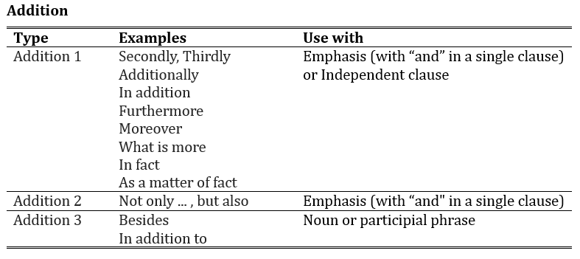
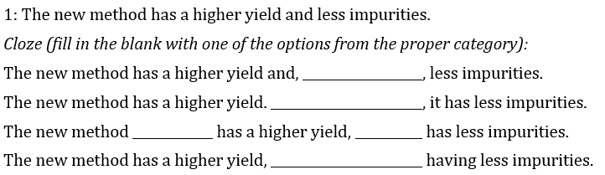
Logical connectors: Addition

Slide 30
Logical Connectors – Contrast
The second type of logical connector alerts readers to a contrast between the preceding idea and the following idea.
Basic sentence: (Conjunction)
Some research is truly groundbreaking, but most is not.
Logical connector:
Some research is truly groundbreaking. However, most is not.

Slide 31
Logical Connectors –
Result and Cause
Result and cause connectors both express a causal relationship, but in the opposite order. Result connectors take the form A causes B, whereas causal connectors have the basic form A is caused by B. As with addition and contrast, it is possible to express result and cause using coordinating conjunctions, in this case “so” and “for,” respectively.

Slide 32
Logical Connectors – Result
Basic sentence: (Conjunction)
The equipment was not properly calibrated, so the data were inaccurate.
Logical connector:
The equipment was not properly calibrated, therefore the data were inaccurate.

Slide 33
Logical Connectors – Result
Incorrect (Imposition from Chinese):
Because the equipment was not properly calibrated, so the data were inaccurate.
The data were inaccurate is that the equipment was not properly calibrated.

Slide 34
Logical Connectors – Cause
Basic sentence: (Conjunction)
The data were inaccurate, for the equipment was not properly calibrated.
Logical connector:
The data were inaccurate, because the equipment was not properly calibrated.
Because the equipment was not properly calibrated, the data were inaccurate.

Slide 35
Logical Connectors –
Unexpected result or cause
The next two categories are named for their similarity to result and cause connectors, except that in these cases the results are the opposite of what might have been expected. They express a relationship between a situation and an unexpected result, with the emphasis on the surprising nature of the relationship. For unexpected result, the basic relationship can also be expressed by the coordinating conjunction “yet.” There is no conjunction to express unexpected cause.

Slide 36
Logical Connectors –
Unexpected result or cause
Basic sentence: (Conjunction)
The power went out, yet we were able to collect sufficient data.
Logical connector:
The power went out, nevertheless we were able to collect sufficient data.
Although the power went out, we were able to collect sufficient data

Slide 37
Logical Connectors –
Clarification, Illustration
The final two types of logical connectors are used to restate or expand on a statement. These types are far more common in the humanities and social sciences than in natural science and engineering, but are included here for completeness.

Slide 38
Time Sequence
Connectors

Slide 39
Time Sequence
Time sequence connectors may denote the sequence of events within the course of the current research or change in thought over time in the field as a whole. They may also be used when discussing future possible applications or developments of your idea.

Slide 40
Time Sequence
May be found in all divisions
  Introduction
    Formerly it was thought
  Method/Process
    First we did this, then we did that
  Results/Testing
    Initially we saw, later we observed, finally we realized
  Discussion/Conclusion
    Previously it was thought, now we have shown

Slide 41
Adding Connectors to Strengthen your Argument
Exercise 22.2

Slide 42
Exercise 22.2
Look in your exemplars for continuity, logical, and time sequence connectors. Circle each, then list the most frequent types and words employed. Note where and how each are used.
How can you improve your use of connectors to clarify and strengthen your argument?

Slide 43
Evaluate your understanding
What is the purpose of adding connectors to your writing?
How are contribution markers, achievement markers and application markers similar? How are they different?
What devices can provide connection between sentences?
Why are there so many logical connectors, when the same basic ideas could be conveyed more simply by coordinating conjunctions?

