Slide 1

Chapter 21
Rewriting: Organization
Writing for Engineering and Science Students:
Staking your Claim
Gerald Rau

Slide 2
Goals:
How can you evaluate the coherence of your writing?
Why should you always begin with large changes like the order of paragraphs, before working on sentence structure and grammar?
What should you eliminate as you revise for conciseness?
How do you know when your writing is concise enough?

Slide 3
Rewriting in stages
Section 21.1

Slide 4
7Cs of Change
Rewriting
  1. Coherence
  2. Conciseness
  3. Connection
  4. Connotation
Revising
  5. Consistency
  6. Correctness
  7. Collaboration
Organization
Clarification
Finalization
American usage
Notes:
Paragraph/sentence level, this week: Elimination, Organization
Word level, next week: Clarification
Revision, last week: Modification

Slide 5
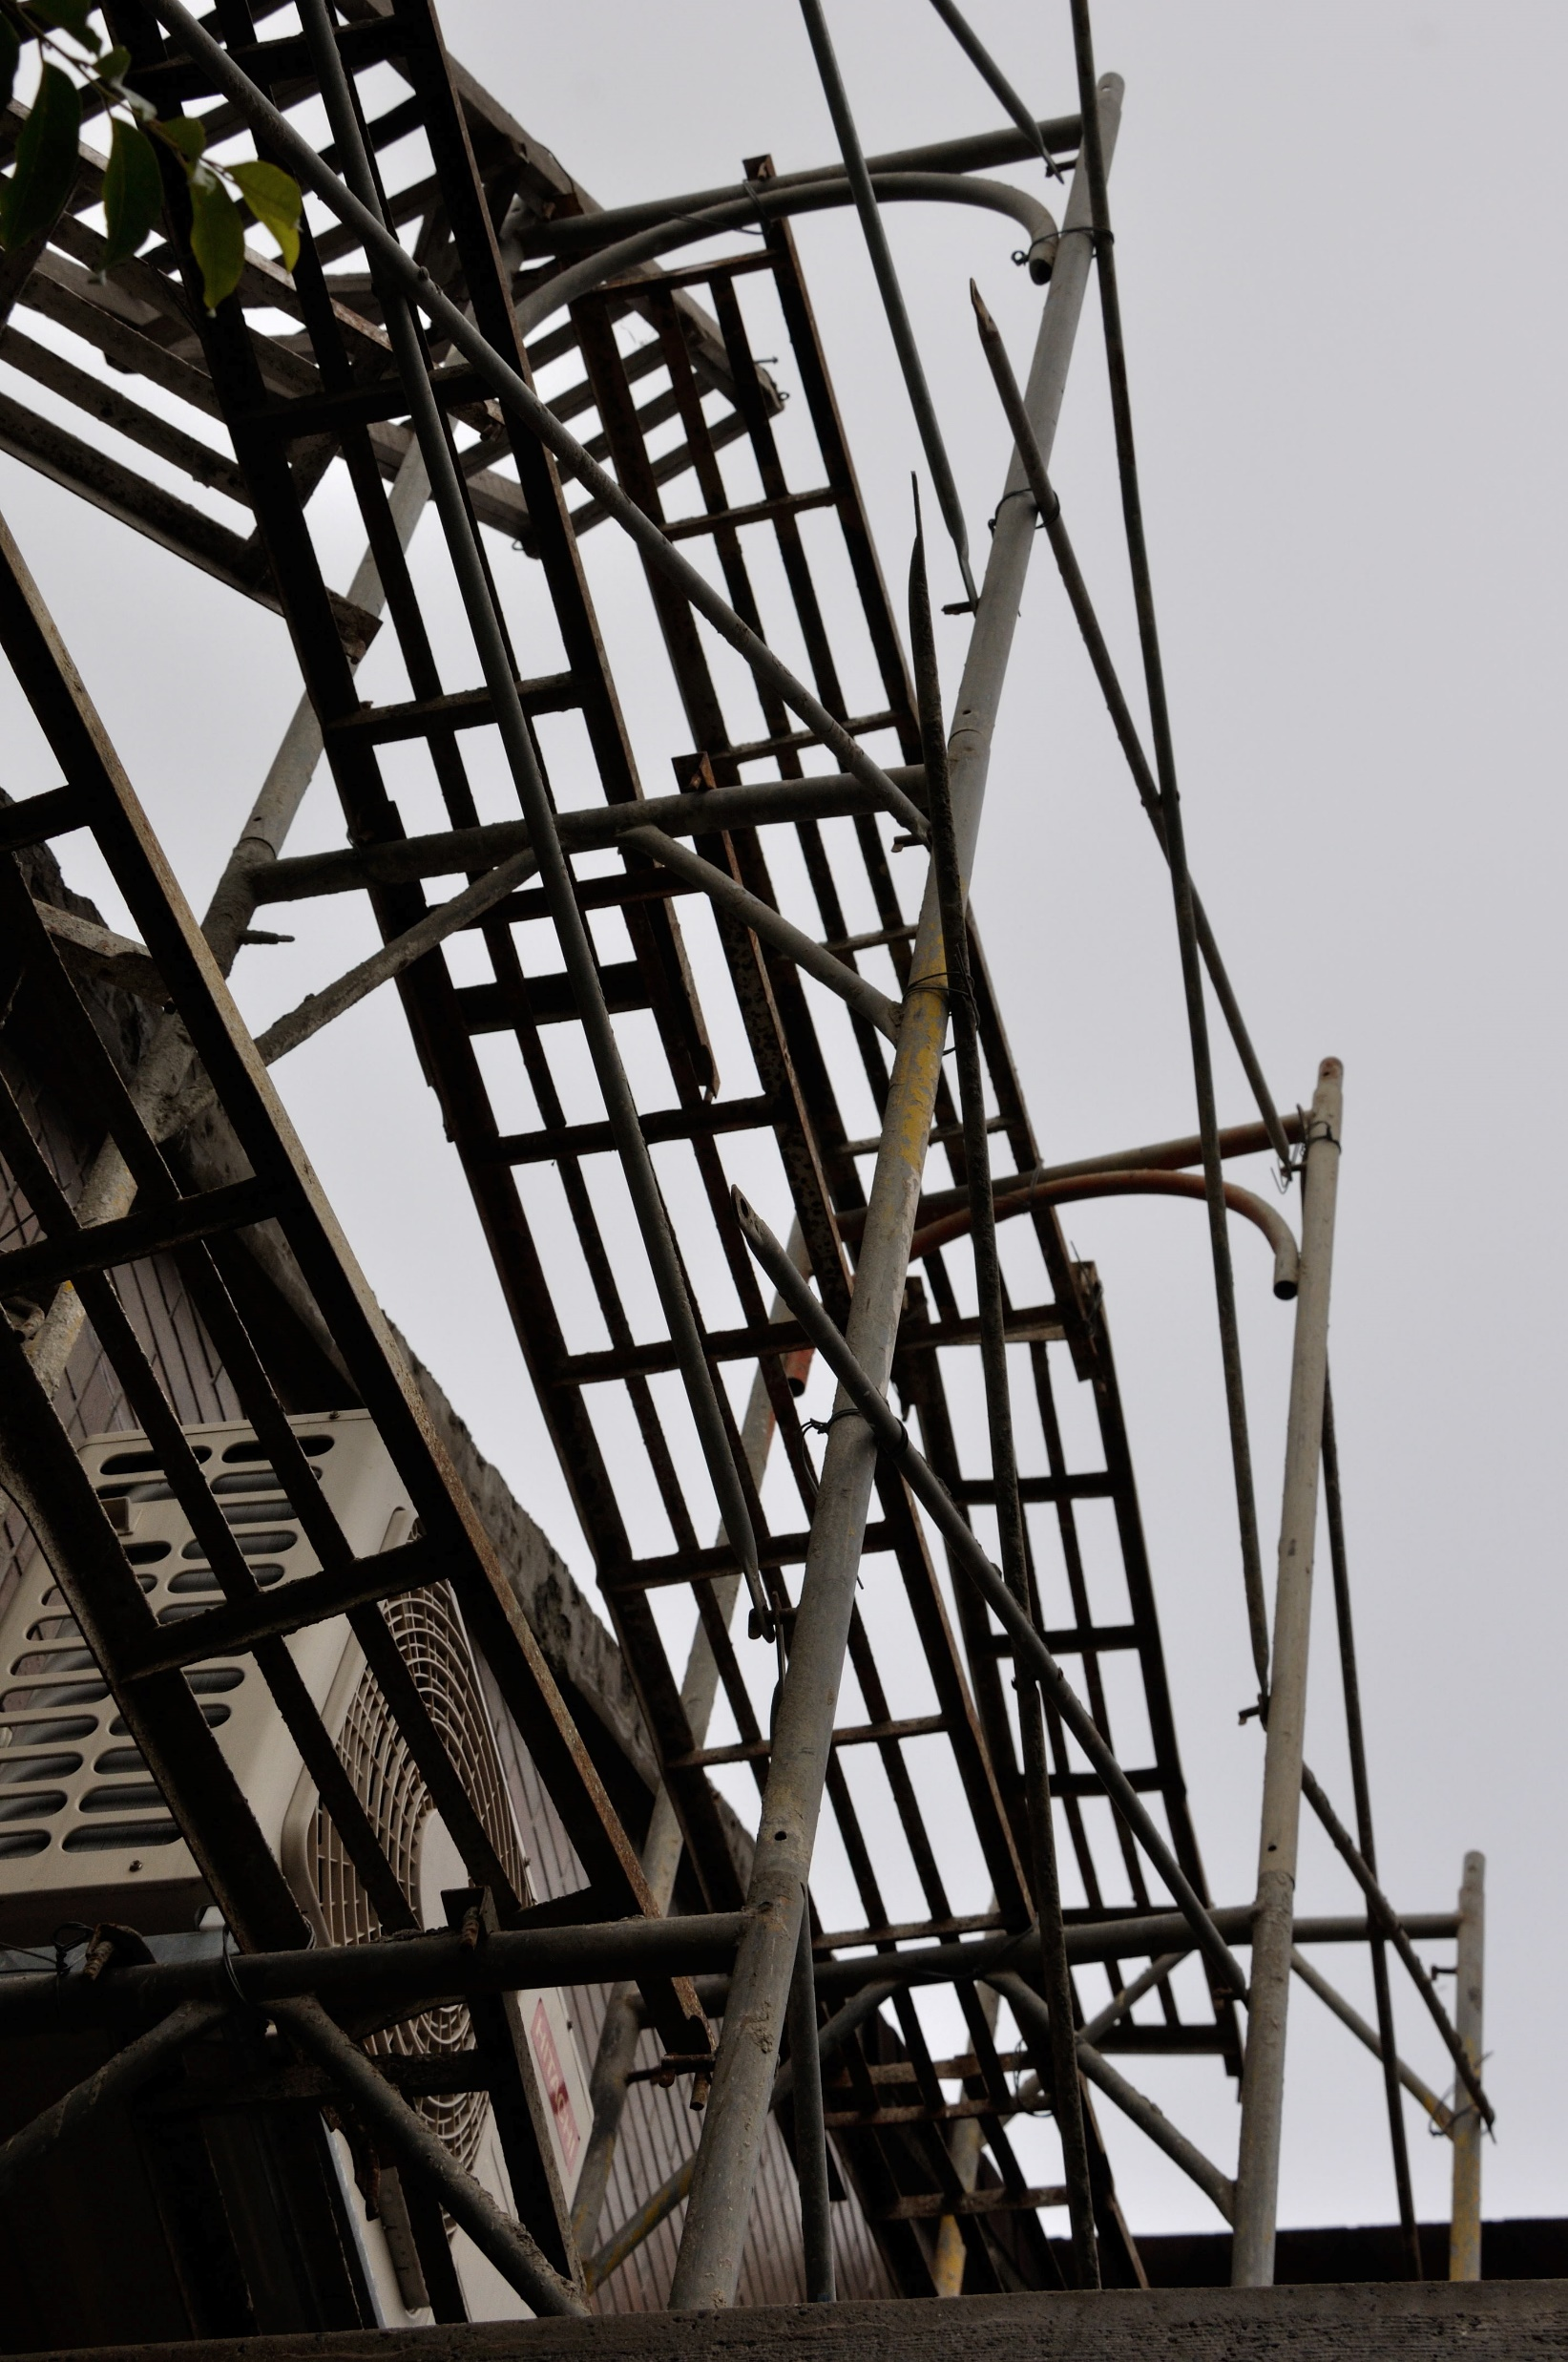
Scaffold
IPTC is a scaffold
  Help you build overall structure
7Cs is a scaffold
  Help you finish the structure

Slide 6
What works for me
I use the technique I propose
  But do not follow it rigidly, in order
Afternoon: writing and rewriting
  Organization
Morning: final rewriting and revision
  Clarification, finalization
Working on several places at once
  Always good idea, less likely to get stuck

Slide 7
May not work for you
Time schedule different
Experienced writer/editor vs. novice

Slide 8
C1: Coherence
Section 21.2

Slide 9
One clear road
Nothing missing, nothing blocking the road
No unexpected branches
No unexpected turns

Slide 10
Principles
Known information first
Argument:
  Claim or support first?
  Support: order?

Slide 11
Known Information First
Put known information first
  Already known – common knowledge in field
  Already introduced in paper
  Already mentioned in sentence
Connect new to old

Slide 12
Argument
Make a Claim
Supported by Evidence (before or after the claim)
Connected by Reasoning (Logic)
Evidence
Reasoning
Claim
Claim
Evidence
Reasoning

Slide 13
General to specific (or reverse)
Introduction
  General to specific
Society
Field
Current

Slide 14

Tailor made suit
Lay out the pattern on the fabric

Slide 15
Sentences within Paragraph
Each sentence should relate to the paragraph topic
  If not, in the wrong paragraph
Each sentence should have a distinct purpose
  If not, eliminate
Sentence order should flow logically
  If not, rearrange

Slide 16
Coherence: 3 questions
A. Amount of information
Is there enough information for the reader?
Think about your readers
  How much do they know?
  How much do you know that they do not?

Slide 17
Coherence: 3 questions
B. Paragraph order
Is the order of paragraphs logical?
Label each paragraph (Reverse outline)
  Purpose (component)
  Topic
Change the order to make it easier to read
  Strive for logical flow of thought
Split or combine paragraphs
  One main idea per paragraph

Slide 18
Coherence: 3 questions
C. Sentence order
Is the sentence order within a paragraph logical?
Examine each sentence within the paragraph
  Add or modify topic sentences if extended style
  Move sentences that do not fit in the paragraph
  Strive for logical flow of thought within paragraph

Slide 19
C2: Conciseness
Section 21.3

Slide 20
Tailor made suit
Covers everything, not tight or loose
Must start with extra material and cut

Slide 21
What to cut
Off-topic
  Related to your research, but not this paper
Repetition
  Same words
Wordiness
  More words than necessary

Slide 22
How much to cut
Depends on the style
  Condensed:
    No repetition
  Extended:
    Summaries
    Topic sentences
    Repetition for continuity between sentences
Depends on the audience
  How much do they know?

Slide 23
Conciseness: 3 questions
A. Off-topic
Is there anything not related to this paper?
Delete unnecessary paragraphs, sentences
  Does it relate to the research presented in this article?
  Is this information necessary to my argument?

Slide 24
Conciseness: 3 questions
B. Repetition
  Is there any unnecessary repetition?
Look for same or similar words
  Find a way to eliminate, especially in condensed style
    Combine sentences
    Use relative pronouns
  Extended style may repeat to link sentences

Slide 25
Conciseness: 3 questions
C. Wordiness
  Are there any unnecessary words?
Delete unnecessary words
  Sufficient (number of) tests
  (There are) two things (that) could be improved
Replace phrases with single word
  (In the vicinity of) ➔ near
  (Due to the fact that) ➔ because

Slide 26
Evaluate your understanding
How can you evaluate the coherence of your writing?
Why should you always begin with large changes like the order of paragraphs, before working on sentence structure and grammar?
What should you eliminate as you revise for conciseness?
How do you know when your writing is concise enough?

Slide 27
Exercises
Exercise 21.1
Coherence
Exercise 21.2
Conciseness
Classroom exercises available for practice

