Slide 1

Chapter 20
Writing
Writing for Engineering and Science Students:
Staking your Claim
Gerald Rau

Slide 2
Goals:
How does working on different parts of a large project at the same time allow you to work more effectively?
What is the advantage of using the Navigation Pane?
What are the benefits of using placeholders for citations as you write?
Why is it important to keep multiple versions and backups of your work?

Slide 3
Just do it
Section 20.1

Slide 4
Just say NO to writer’s block
Write every day
  Figure out when you write best
Write several sections at once
  Rewrite Methods/Process
  Write R & D/Testing
  Prewrite Introduction
Don’t be afraid to start over

Slide 5
Keeping track of where you are
Section 20.2

Slide 6
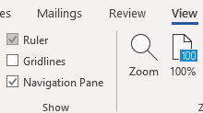
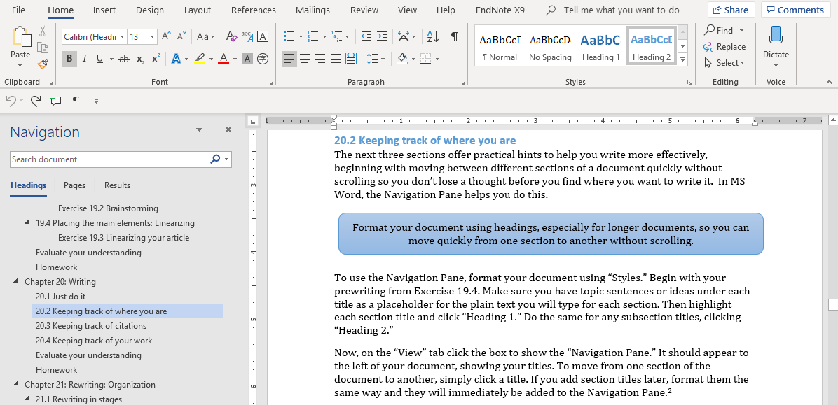
Use the Navigation Pane
Heading 2

Slide 7
Advantages
Move quickly between sections of a document
  Don’t lose ideas
Easy to generate a Table of Contents (References tab)
  Required for thesis

Slide 8
Keeping track of citations
Section 20.3

Slide 9
Use placeholders while writing
Particularly in engineering
  Citations: [1], numbered sequentially in document
  Use placeholders in (author, date) format while writing

Slide 10
Advantages
You become more familiar with the authors and dates of publication of important works in your field. You will need to refer to them that way in presentations.
The reference numbers will not change while writing, eliminating confusion.
You will not be distracted by entering information in the citation manager.
Citation managers add a level of complexity to word processing programs, making errors more likely, so delaying entry eliminates a source of frustration.

Slide 11
Keeping track of your work
Section 20.4

Slide 12
Back up your files
In a separate location
Multiple versions
  Version number 1.2
  Date Year-Month-Day

Slide 13
Evaluate your understanding
How does working on different parts of a large project at the same time allow you to work more effectively?
What is the advantage of using the Navigation Pane?
What are the benefits of using placeholders for citations as you write?
Why is it important to keep multiple versions and backups of your work?

Slide 14
Exercise
Start writing!
Use these ideas as you write

