Slide 1

Chapter 19
Prewriting
Writing for Engineering and Science Students:
Staking your Claim
Gerald Rau

Slide 2
Goals:
What is the purpose of prewriting?
How does making an outline based on argument structure of exemplars differ from a traditional content outline?
What methods can be used for brainstorming?
Why is it useful to consider various organizational strategies before beginning to write?

Slide 3
Planning your masterpiece
Section 19.1

Slide 4
Getting the big picture
Write like an artist paints
  Not from top to bottom
  In stages – sketch, overall picture, details
Prewriting = Quick sketch
  Overall size
  Main elements, how they relate
  Foreground, background

Slide 5
Different artists, techniques
Medium (type of paint)
Style (e.g. how realistic)
Subject (landscape, city, portrait …)
Personal preference
What works for me as a writer may not work for you

Slide 6
Big picture
Exemplars
Research article
Introduction
  Components 1, 2, 3, (4)
    ‘Relatively’ fixed order
Process/Methods
  Components (4), 5, (6)
    Order fixed or flexible
Testing/R&D
  Components (6), 7, 8, 9
    Linear or cyclical
Conclusion
  Component 10
Brainstorm
  What do I need to include
  What do I already know
  What to I need to find/do
Linearize
  Order within section
Write
  Start wherever easiest
Rewrite
  Organization, Clarification, Finalization

Slide 7
Big picture – Brainstorming
How have others talked about this?
Introduction
Process
Importance (think, borrow)
Need
Research goal (specify)
First element
Second element
Importance: society
First thing I did
Importance: field
Gray 2017
Second thing I did
Third thing I did
Black 2015
White 2015
Brown 2016
Remaining problems

Slide 8
Big picture – Linearizing
Linearizing
Topic sentence 1
Topic sentence 3
Topic sentence 2
Topic sentence 4
Evaluate:
Does the order make sense?

Slide 9
Big picture – Linearizing
Linearizing
Topic sentence 1
Topic sentence 2
Topic sentence 3
Topic sentence 4
That’s better!

Slide 10
Big picture – Writing/Rewriting
Writing
Rewriting (Organization)
Topic sentence 1
  Paragraph 1
Topic sentence 2
  Paragraph 2
Topic sentence 3
  Paragraph 3
Topic sentence 4
  Paragraph 4
Reorder paragraphs (again)
Move sentences
Add material
Cut material
Re-evaluate:
Does the order make sense?

Slide 11
Big picture – Rewriting
Rewriting
Topic sentence 1
  Paragraph 1
Topic sentence 2
  Paragraph 2
Topic sentence 3
  Paragraph 3
Topic sentence 4
  Paragraph 4
Topic sentence 5
  Paragraph 5
Clarification
  Make connections
  Strengthen argument
Finalization
  Grammar etc.

Slide 12
Initial Sketch:
Argument structure outline
Section 19.2

Slide 13
From exemplars to sketch
Chapter
1
2-3
4-6
7-8
9
Obtain examples of successful documents of your genre, if possible
Determine the overall organization and structure
Identify the main claims and components
Identify what is used for support
Speculate on reasons for the sequencing
Evaluate which document is the best pattern to follow for your own writing
Outline the argument structure of your own writing based on that pattern

Slide 14
Which exemplar should I follow?
Which is the best example for your writing?
  Which journal will you write for?
  Which article is most like your research?
  Which is the best written?

Slide 15
Argument Structure Outline
Exercise 19.1
Based on your exemplars
  List tentative section titles for your article
  Give an approximate length for each section (range)
  List components and support needed in each section
  Give approximate goal for citations per section
Tentative, Approximate
= They will change later

Slide 16
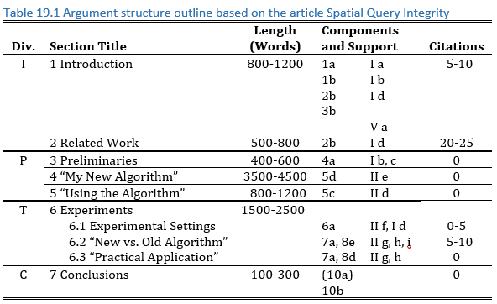
Argument structure outline

Slide 17
Adding the Base Layer:
Brainstorming
Section 19.3

Slide 18
Goal
Get as many ideas on paper (computer) as possible

Slide 19
Many Methods
Find one that works for you
Listing
Freewriting
Bubbles
Paper or computer

Slide 20
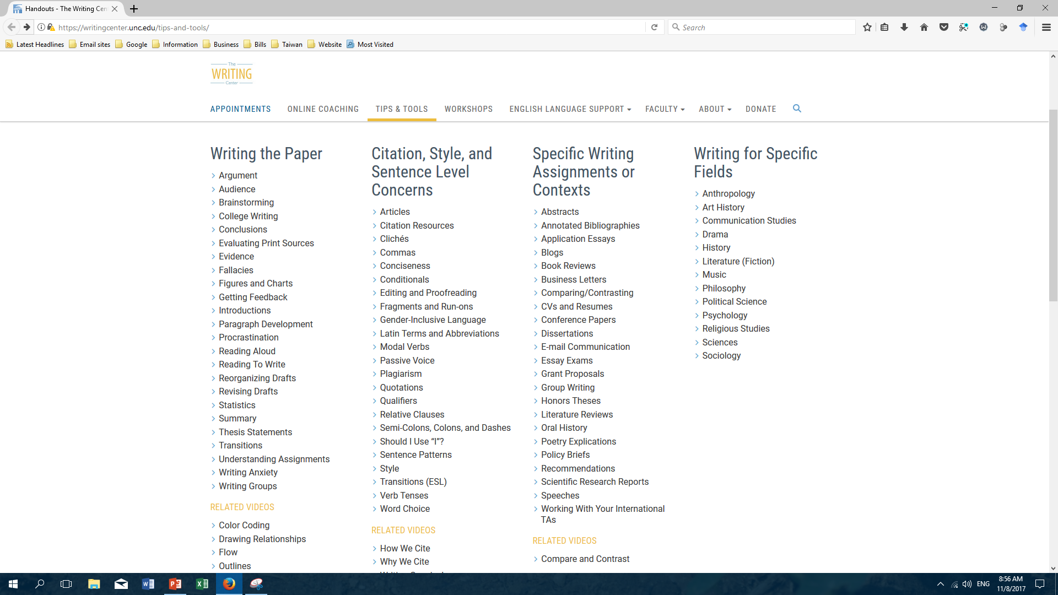
Resources: UNC Chapel Hill
http://writingcenter.unc.edu/tips-and-tools

Slide 21
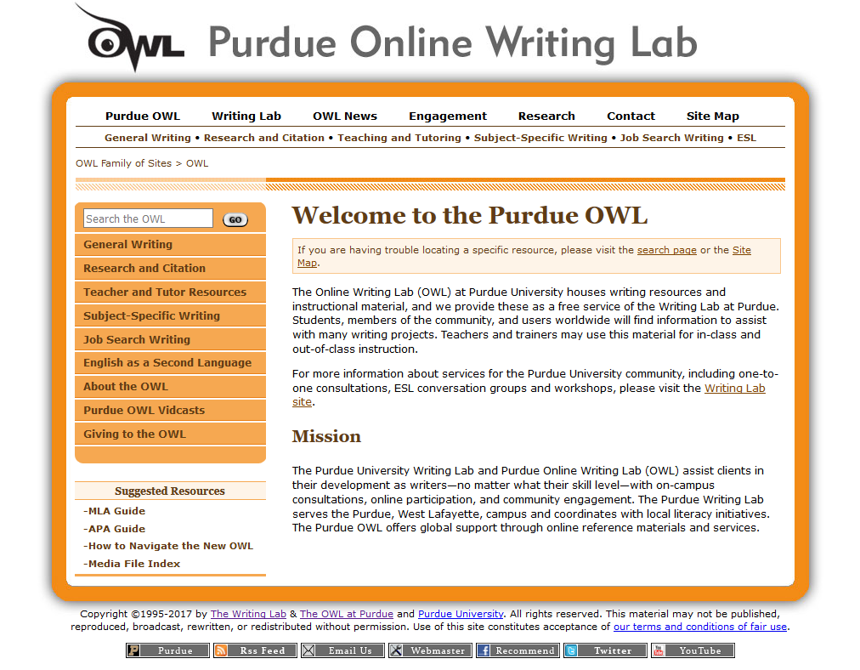
Resources: Purdue
https://owl.english.purdue.edu/owl/

Slide 22
Brainstorming (Exercise 19.2.1)
For each component you need to include
List what you know:
  Related papers
    What past research is related to that component?
  Related ideas (words or phrases)
    1) Why is your work important – to society, your field?
    2) What has been done already, what problems?
    3) What is the goal of your research?
    …

Slide 23
Planning (Exercise 19.2.2)
Make a plan
  What components/sections can you start writing now?
    Method/Process (Write as you work)
  What do you need to wait until later?
    R & D/Testing (Write as you work)
  Which can you start on now and finish later?
    Introduction (Write as you read)

Slide 24
Placing the Main Elements:
Linearizing
Section 19.4

Slide 25
Goal
Think about order within each section

Slide 26
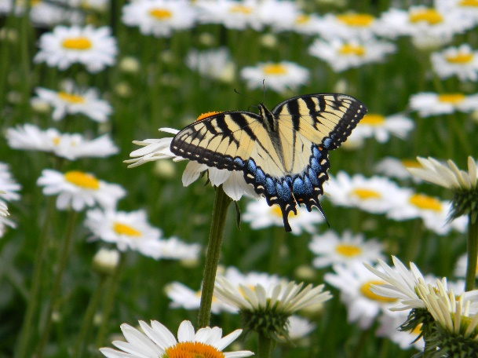
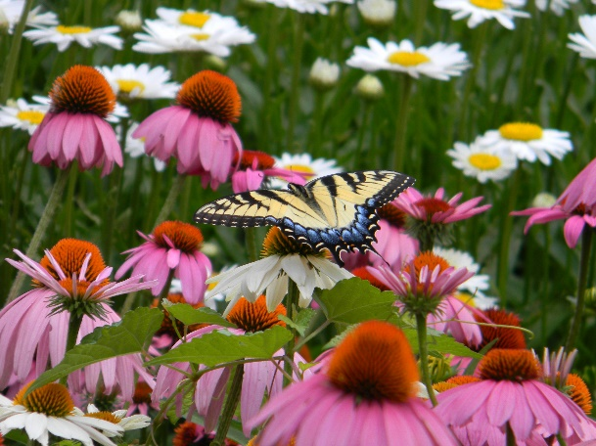
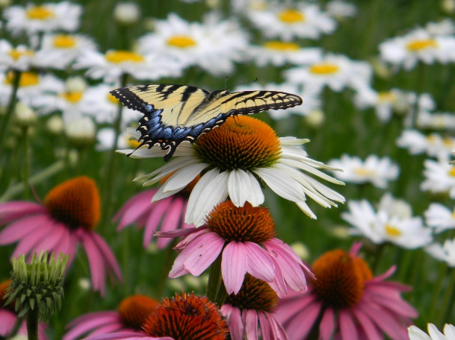
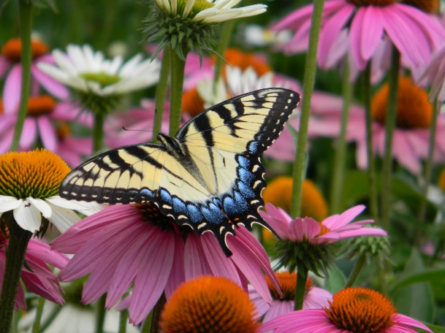

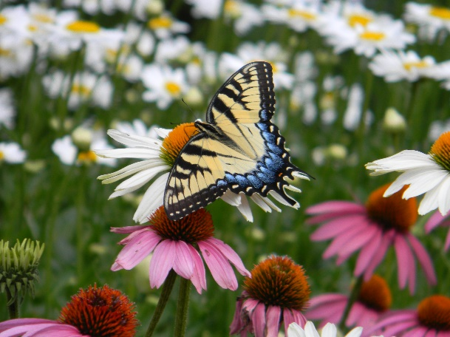
Consider Options

Slide 27
Step 1 (Exercise 19.3.1)
Group items from your list
  By subcomponent
  By ideas important in your field (similar to exemplars)

Slide 28
Step 2 (Exercise 19.3.2)
Reorder each group into an argument
  What would need to be presented first?
  What would need to be presented before/after others?

Slide 29
Step 3 (Exercise 19.3.3)
Generate a content outline
  Section
    Subsection
      Point one (claim, evidence, or reasoning)
      Point two

Slide 30
Step 4 (Exercise 19.3.4)
Generate a topic sentence outline
  Write a topic sentence for each paragraph/main point
  Use placeholders for information you do not have yet
    “Article on [best current method]”
    “Algorithm to be developed”
    “Results of testing method 1”
Evaluate the order
  Do the topic sentences show the argument?

Slide 31
Step 5 (Exercise 19.3.5)
Revise your outline
  Evaluate based on the logical order of topic sentences

Slide 32
Evaluate your understanding
What is the purpose of prewriting?
How does making an outline based on argument structure of exemplars differ from a traditional content outline?
What methods can be used for brainstorming?
Why is it useful to consider various organizational strategies before beginning to write?

Slide 33
Picture credits
Slide 26: Gerald Rau

