Slide 1

Chapter 17
Principles for successful email
Writing for Engineering and Science Students:
Staking your Claim
Gerald Rau

Slide 2
Goals:
What are four basic principles of email etiquette?
What factors interact in determining the level of formality appropriate for an email?
What is meant by terms of address, and why are these important in email success?
How can terms of address be used to negotiate a closer relationship?
What might affect your choice of where in an email to state a request?
How can you decide how much information to include?
What is the simplest method for reducing the imposition of your request?
Why are details like grammar and spelling the least important factor in email success when using English as a lingua franca?

Slide 3
Importance of email
Section 17.1

Slide 4

Is email important?
Main means of communication in academia
Medium, not genre (like paper and ink)
  Formal requests
  Communication with colleagues
  Informal memos and notes

Slide 5
Why study it?
Just like studying exemplars
  Can learn slowly by experience
  Purposeful study can increase chance of success
Same principles
  Emails are also arguments!
  If the email is important: plan, write, rewrite

Slide 6
Should I say Email or Emails?
Both!
  I got a lot of email today. (collective, large amount)
  I got a lot of emails today. (plural, large number)

Slide 7
General email etiquette
Section 17.2

Slide 8
General Principle 1
Respond promptly
  If you need time to think or act, say when you will be able to provide an answer
How long to wait?
  Depends on how soon you need a response
  Depends on how much time is needed to respond
  At least 1-2 days

Slide 9
General Principle 2
Use the subject line and identify yourself clearly
Subject line makes it easy for your reader
  To identify the topic
  To find the email later
  Personal information the reader will know is from you
  Write at least one line in your email
  Especially if you have an attachment or web link

Slide 10
General Principle 3
Send it to the right person
  Do check the addressee before hitting ‘send’
  Do not ‘reply all’ unless necessary

Slide 11
General Principle 4
Be careful what you say
An email is a written record, easily spread
It may even wind up being a classroom example

Slide 12
Position and imposition
Section 17.3

Slide 13
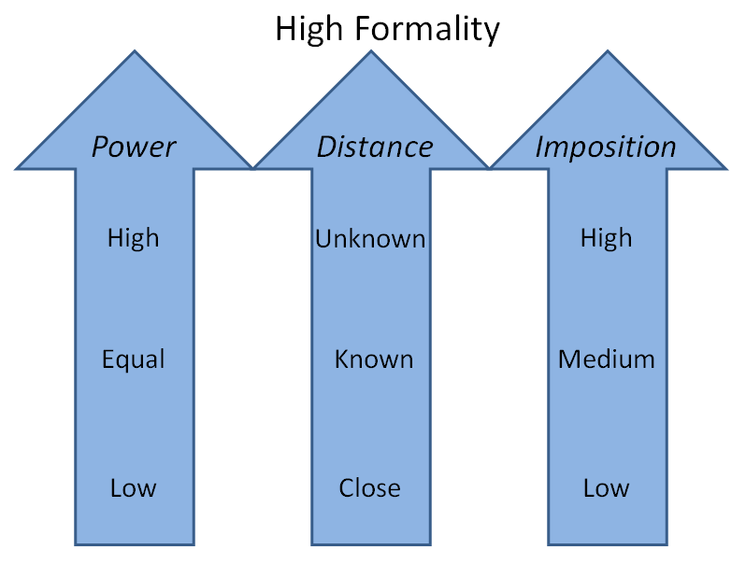
Assessing Formality (Fig 17.2)

Slide 14
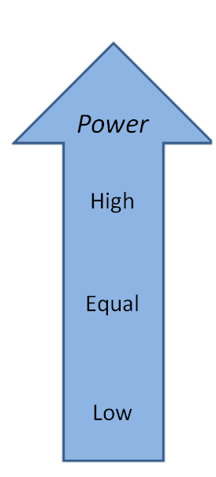
Power
Writing to someone with more power
  Student to Professor
  Professor to Chair or Dean
  Professor to Senior scholar
  Professor to Journal editor
Writing to equal
Writing to someone with less power
  Professor to Student

Slide 15
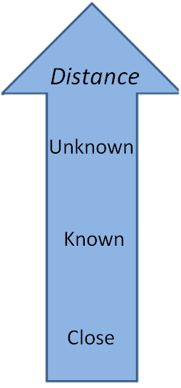
Distance
Writing to someone you do not know
  Journal editor
  Senior scholar
Writing to someone you know
  Professor
Writing to someone you know well
  Advisor
  Friend

Slide 16
Imposition
Impose:
force (an unwelcome decision or ruling) on someone.
take advantage of someone by demanding their attention or commitment.

Slide 17
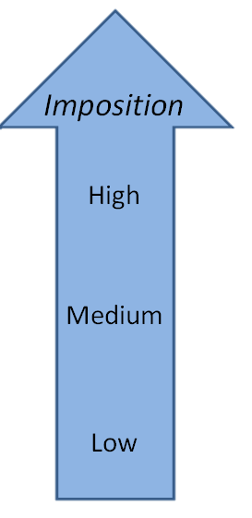
Imposition
Request, Invitation or Apology
  Extended time commitment
  Request or invitation can occur alone
  Apology linked to request
    I apologize that I cannot do X, may I do Y?
Quick response
  Time necessary to think and respond
Conveying information
  Time to read email, no need for response

Slide 18
Assessing Formality (Fig 17.2)
Highest determines

Slide 19
Five factors affecting email success
Section 17.4

Slide 20
Communicative Success (Table 17.2)
Factors affecting success
1. Terms of address
2. Justifying your request
3. Amount of information
4. Reducing imposition
5. Attention to detail

Slide 21
Communicative Success (Table 17.2)
Factors affecting success | Communication principle
1. Terms of address | Relationship
2. Justifying your request | Cooperation
3. Amount of information | Clarity
4. Reducing imposition | Politeness
5. Attention to detail | Intelligibility

Slide 22
Communicative Success (Table 17.2)
Factors affecting success | Communication principle | Related writing principle
1. Terms of address | Relationship | Fitting in
2. Justifying your request | Cooperation | Argument structure
3. Amount of information | Clarity | Coherence, Conciseness
4. Reducing imposition | Politeness | Connection, Connotation
5. Attention to detail | Intelligibility | Correctness
5 of the 7 Cs of Change

Slide 23
Terms of address
Section 17.4.1
Factors affecting success | Communication principle | Related writing principle
1. Terms of address | Relationship | Fitting in

Slide 24
Terms of Address
Terms of Address (Relationship)
  Salutation, closing
  Appropriate to required level of formality

Slide 25
Relationship
Do terms of address reflect or negotiate relationship?
  Salutation:
  Closing:
Salutation: Reflect what exists
Closing: Negotiate possible change

Slide 26
Salutation
Salutation = Greeting
Show respect appropriate to relationship
Example: Dear Professor Rau
Format: 1 Address 2 Title 3 Name
All have a range in formality: See Table 17.3

Slide 27
Academic Salutations (Table 17.3)
Formality | Address | Title | Name
Formal | Dear | President Dean Professor/Prof. Dr./Mr./Ms. | Family name Family name Family name Family name
Informal | Hello Hi | Professor/Prof. Professor - | Family name - Given name
Very informal | - | Professor - - | - Given name -
Inappropriate | Dear Hello Hi - | Professor/Prof. Professor/Prof. - Teacher Teacher | Given name + Family name Given name Family name Family name -

Slide 28
Salutation: Avoid
Dear Teacher
  Mix of Chinese/English
Dear Dr. Gerald Rau
  First or title and family name, not both
Dear Prof. Gerry
  Titles attached to family name, not given
Dear Rau
  Doesn’t work in any language
  Must use title with family name

Slide 29
Closing
Negotiate relationship
  Do you want to encourage closeness (use less formal)
  Do you want to remain distant (use more formal)
Example: Sincerely, Professor Rau
Format: 1 Closing, 2 Signature

Slide 30
Closing (Table 17.4)
Closing | Use
Most formal
Respectfully yours, Respectfully | Legal documents
Sincerely | General, emphasizing distance
Best wishes, Best regards, Best | General, emphasizing relationship
Cordially, Warmly, Warm regards | General, close relationship
Thank you, Take care | Informal
[no closing] | Very informal
Least formal

Slide 31
Signature (Table 17.5)
Signature | Example
Most formal
Given name, Family name, Degree | Gerald Rau, Ph.D.
Title, Given name, Family name | Professor Gerald Rau
Title, Family name | Professor Rau, Dr. Rau
Given name, Family name | Gerald Rau
Given name | Gerald
Nickname | Gerry
Least formal

Slide 32
Negotiating Relationship
Salutation: Initial relationship
Closing: Can be used to negotiate closer relationship

Slide 33
Justifying your request
Section 17.4.2
Factors affecting success | Communication principle | Related writing principle
2. Justifying your request | Cooperation | Argument structure

Slide 34
Justifying your Request
Email is an Argument
  Parts
    Claim (Request)
    Support (Justification)
  Order
    Either can come first

Slide 35
Order of justification
Argument or justification first?
  Justification first, then request (Asian style)
  Request first, then justification (American style)

Slide 36
Location of request
Comparison of email and research article
  First paragraph functions as “Introduction”
  Where should you put the request?
    Like research aim, at end of Introduction = end of first paragraph

Slide 37
Need for relationship
Request must be appropriate to relationship
  Existing – usually no need to state
  Non-existent – must first build

Slide 38
Imposition
Timeframe appropriate to amount of work involved
  Remember they have other things planned
Leave final decision in their hands
  ‘If you can/could’ (expressed or implied)

Slide 39
Amount of information
Section 7.4.3
Factors affecting success | Communication principle | Related writing principle
3. Amount of information | Clarity | Coherence, Conciseness

Slide 40
Amount of Information
Clarity
  Direct statement of purpose of email
  Sufficient background information
Not too much or too little
  Clear, concise

Slide 41
Personal Identification
This is Mary, from your Technical Writing class …
Not necessary if recipient knows you
  In contact list, unless writing from new email address
Necessary in a distant relationship
  Establishes relationship or basis for relationship
  I don’t know if you remember me, but we met when you spoke at Chung Cheng University last year.

Slide 42

Clear and Concise
Their time is precious
  Reading email as well as fulfilling request

Slide 43
Which is Best?
I cannot come to class tomorrow:
  for personal reasons
  because I need to take my mother to the doctor
  because my mother has chronic arthritis, and can’t get around by herself, so I have to take her to see the doctor, and won’t be able to get a bus back in time to make it to class
How much information does the person need?
  Enough to act appropriately

Slide 44
Reducing imposition
Section 17.4.4
Factors affecting success | Communication principle | Related writing principle
4. Reducing imposition | Politeness | Connection, Connotation

Slide 45
Reducing imposition
Appropriate to level of formality and imposition
  Appropriate level of directness
  Sufficient politeness

Slide 46
Directness
English viewed as being very direct
  Speak directly to individual, using indirect speech
  Particularly in request, face-threatening situations
C
Chinese
Direct Speech
Direct Speech
A
B
English
A
Indirect Speech
B

Slide 47
Ways of requesting (Table 17.6)
Most polite | I wonder if it would be too much bother for you to … I wonder if you could … I would appreciate it if you could … If possible, I would like you to … Would you mind …
Polite | Could you please be so kind as to … Could you please … Could you …
Less polite | Can you please … Can you … I hope you can …
Impolite | Please … I want you to … I need you to …
Most indirect
Use of modals:
would, could

Slide 48
Attention to detail
Section 17.4.5
Factors affecting success | Communication principle | Related writing principle
5. Attention to detail | Intelligibility | Correctness

Slide 49
Attention to detail
Correctness vs. Comprehension
  Grammar
  Word choice
  Phrasing (natural sounding)
Least important to success
  Comprehension primary
  World Englishes, English as a Lingua Franca
  Only one that does not affect relationship

Slide 50
Evaluate your understanding
What are four basic principles of email etiquette?
What factors interact in determining the level of formality appropriate for an email?
What is meant by terms of address, and why are these important in email success?
How can terms of address be used to negotiate a closer relationship?
What might affect your choice of where in an email to state a request?
How can you decide how much information to include?
What is the simplest method for reducing the imposition of your request?
Why are details like grammar and spelling the least important factor in email success when using English as a lingua franca?

