Slide 1

Chapter 14
Technical writing
Writing for Engineering and Science Students:
Staking your Claim
Gerald Rau

Slide 2
Goals:
What makes learning technical writing more challenging that academic writing?
What accounts for differences between the reporting formats?

Slide 3
Intertextuality
Section 14.1

Slide 4
Intertextuality
Connection between texts (of any kind)
  Reports
  Meetings
  Email
  Conversations
Harder to learn from a textbook or in a classroom
  Assumes familiarity with previous communication
  Getting authentic exemplars is difficult
  Extremely varied
Within a department
Within a research group
Within a business

Slide 5
Progress reports
Section 14.2

Slide 6
Goal, audience, criteria, claim
Audience(s): Supervisor, (Colleagues)
Goal: Demonstrate progress
Criteria: Based on project goals
Implicit claim:
you have made progress toward the goal(s)

Slide 7
What to include
Assumes familiarity with project
  Changes since previous report
Depends on stage in the project
Depends on how much detail the supervisor wants!

Slide 8
Progress report
Depends on stage in the project
Included but modified
Not included
Components
  Research details
  Testing methods
  Data patterns
  Comparisons (maybe)
  Interpretations (maybe)
  Conclusion (progress)
Support
  Present research
Components
  Importance
  Need
  Research goal
  Framework
Support
  Past research
Additional possible
Timeframe Problems
Accounting Plans

Slide 9
Technical reports
Section 14.3

Slide 10
Goal, audience, criteria, claim
Many kinds, many situations, hard to generalize
Audience: Supervisor with technical expertise
Goal: Propose a design solution, predict potential problems, or analyze actual design failures
Criteria: Complete and accurate analysis
Implicit claim:
you have done a complete and accurate analysis

Slide 11
Technical report
Included but modified
Not included
Components
  Goal (not research)
  Framework (maybe)
  Testing methods
  Data patterns
  Comparisons (maybe)
  Interpretations (maybe)
  Conclusion (recommendation)
Support
  Present research, Evaluation
Components
  Importance
  Need
  Research details
Support
  Past research

Slide 12
Management or consulting reports
Section 14.4

Slide 13
Management vs. Consulting
Similarities
  Non-technical audience
Differences
  Management – within organization
  Consulting – outside organization

Slide 14
Goal, audience, criteria, claim
Audience: Non-technical decision makers
Goal: Propose a design solution, predict potential problems, or analyze actual design failures
Criteria: Complete and accurate analysis
Implicit claim:
you present a fair and accurate assessment of the situation that will be beneficial to the one receiving it

Slide 15
Management report
Included but modified
Not included
Components
  Goal (not research)
  Research details (maybe)
  Testing methods (maybe)
  Data patterns
  Comparisons (maybe)
  Interpretations
  Conclusion
Support
  Present research, Evaluation
Components
  Importance (maybe)
  Need
  Framework
Support
  Past research

Slide 16
SWOT analysis
Section 14.5

Slide 17
Goal, audience, criteria, claim
Goal: Vary
Audience: Vary
Criteria: Vary
Claims: one for each box:
e.g. Our strengths relative to this are …

Slide 18
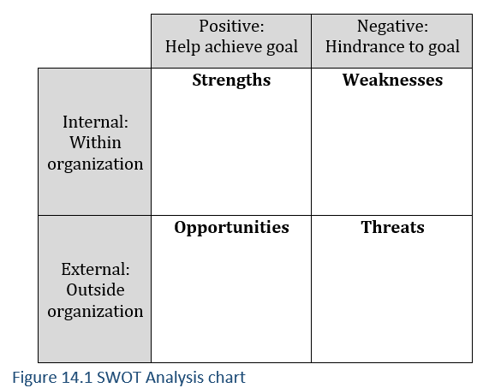
SWOT analysis
Each box is one type of claim:

Slide 19
SWOT analysis
Included but modified
Not included
Components
  Goal (not research)
  Conclusion
Support
  Strengths
  Weaknesses
  Opportunities
  Threats
Components
  All other
Support
  Past research
  Present research

Slide 20
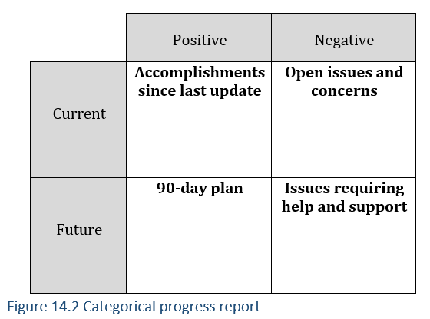
Adaptations

Slide 21
Evaluate your understanding
What makes learning technical writing more challenging that academic writing?
What accounts for differences between the reporting formats?

