Slide 1

Chapter 11
Undergraduate writing
Writing for Engineering and Science Students:
Staking your Claim
Gerald Rau

Slide 2
Goal:
How is each genre of undergraduate writing like and unlike research articles?

Slide 3
So near and yet so far
Section 11.1

Slide 4
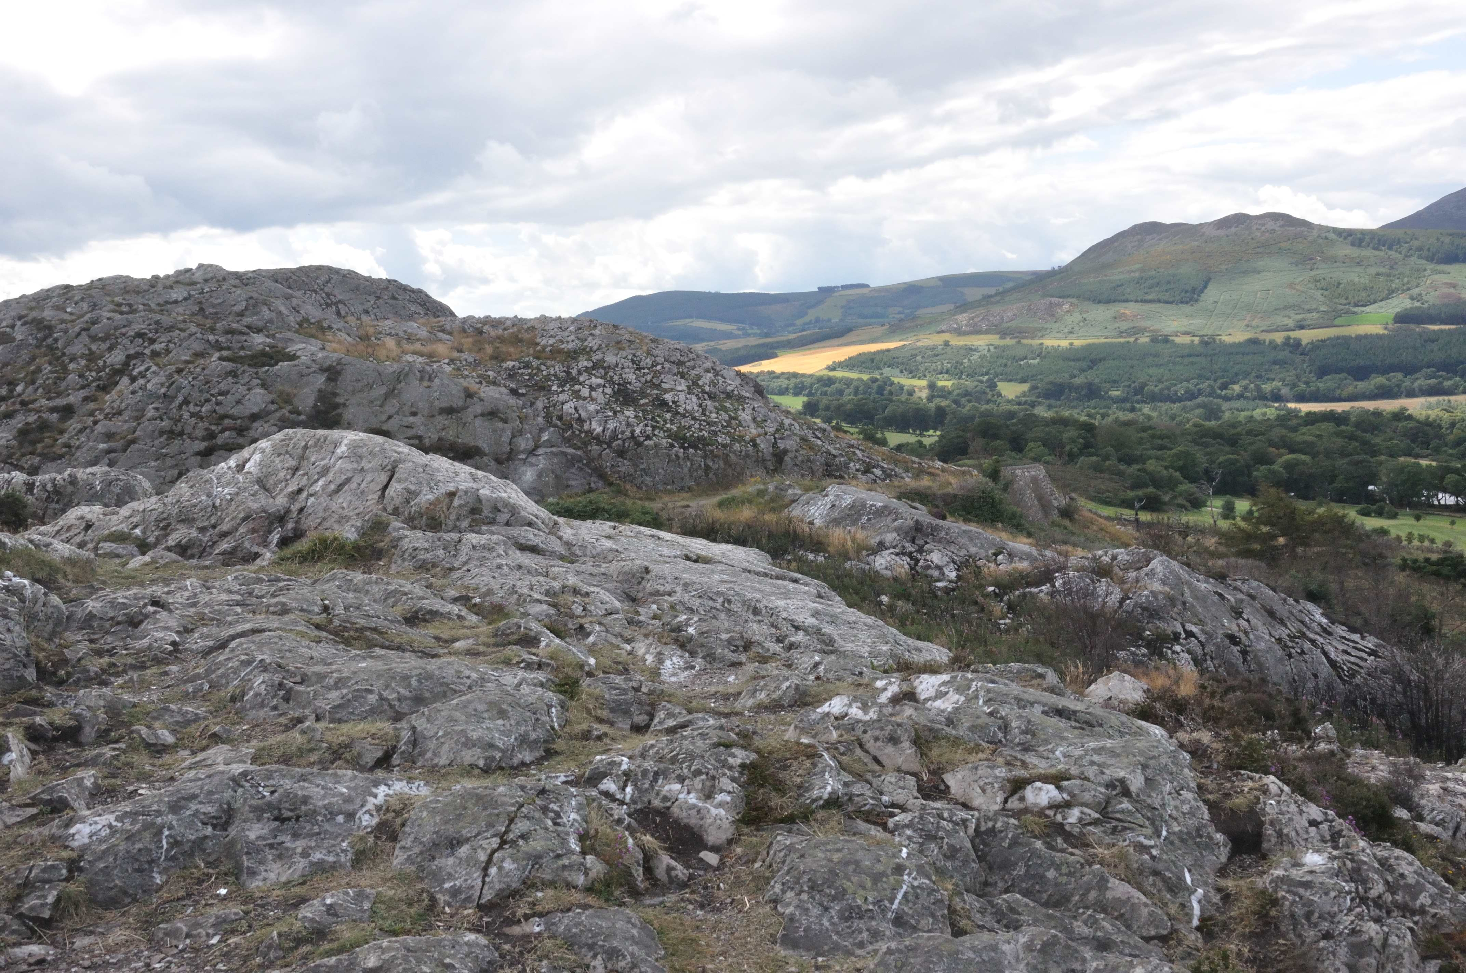
So near, and yet so far …

Slide 5
Lab reports
Section 11.2

Slide 6
Lab reports
Outwardly structured like research articles
  Similar section titles
  Not original research
Types:
  “Cookbook” labs
  Inquiry labs
  Design challenge

Slide 7
“Cookbook” labs
Procedures specified, predictable outcome
Included but modified
Not included or minimal
Components
  Data patterns
  Comparison
  Interpretation
  Conclusion (summary)
Support
  Present “research”
Components
  Importance
  Need
  Research goal
  Framework
  Research details
  Testing methods
Support
  Past research

Slide 8
Inquiry or design labs
Included but modified
Not included or minimal
Components
  Research details
  Testing methods
  Data patterns
  Comparison
  Interpretation
  Conclusion (summary)
Support
  Present “research”
Components
  Importance
  Need
  Research goal
  Framework
Support
  Past research

Slide 9
Goal, audience, criteria, claim
Audience: Professor
  Sets goal and criteria
Implicit claim:
you have mastered methods or principles taught in class

Slide 10
Essays
Section 11.3

Slide 11
Essays
More common in science than engineering
Many names:
  Research paper (but secondary research)
More like survey or review article
  But not comprehensive

Slide 12
Essays
Included but modified
Not included or minimal
Components
  Importance
  Frameworks (of others)
  Data patterns (of others)
  Comparisons (of others)
  Interpretations
  Conclusion (summary)
Support
  Past research
Components
  Need
  Research goal
  Research details
  Testing methods
Support
  Present research

Slide 13
Goal, audience, criteria, claim
Audience: Professor
  Sets goal and criteria
Implicit claim:
you have a deeper understanding of one topic

Slide 14
Senior projects
Section 11.4

Slide 15
Senior projects
Honors projects
  May involve original research
  Similar to graduate thesis (chapter 12)
Senior seminar
  May be more similar to Essay (previous section)

Slide 16
Goal, audience, criteria, claim
Audience: Professor or committee
Department sets goal and criteria
Implicit claim:
depends on the type of project

Slide 17
Next steps (Homework)
Obtain exemplars and criteria for whatever you plan to write.
Before you start to write, decide what claims and components you will need to include and how you will support the claims.

Slide 18
Photo credit
Slide 4: Gerald Rau

