Slide 1

Chapter 9
Clear reasoning
Writing for Engineering and Science Students:
Staking your Claim
Gerald Rau

Slide 2
Goals:
Describe the difference between deductive, inductive, and abductive reasoning in scientific research.
How does evaluation differ in engineering and science?
What are the main differences between extended and condensed style, and why would an author choose to use different styles in different sections?
Why are there sometimes cycles of the same components?

Slide 3
Follow the yellow brick road
Section 9.1

Slide 4
Wizard of Oz
How do I get to the Emerald city to see the wizard?
“Follow the yellow brick road”
Readers need to be able to follow an article
  No unexpected turns
  No missing segments

Slide 5
Gottfried Leibnitz ~1700
“There are also two kinds of truths:
those of [mathematical] reasoning and those of [empirical] fact.
Truths of [mathematical] reasoning are necessary and their opposite is impossible;
a²+b²=c² a²+b²≠c²
truths of [empirical] fact are contingent and their opposite is possible.”
water boils = 100 degrees water boils ≠ 100 degrees
Necessary
Impossible
Contingent
Possible

Slide 6
Logical reasoning
Section 9.2

Slide 7
Logical reasoning
Deductive: Tests predictions made by a hypothesis
Inductive: Develops a new model or theory
Abductive: Identifies the best explanation
Many research articles are predominantly one type
  Experimental – deductive
  Theoretical – inductive
  Observational – abductive

Slide 8
Evaluative reasoning
Section 9.3

Slide 9
Evaluative reasoning
Evaluation of previous research
  Introduction
Evaluation of present data
  Later divisions
Data never speak for themselves
  Guide reader how to view the data
Determine:
Best explanation (science)
Best solution (engineering)

Slide 10
Extended vs. condensed style
Section 9.4

Slide 11
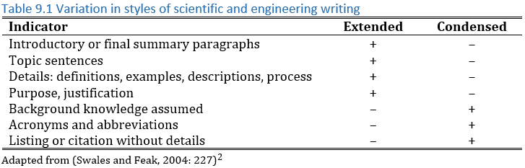
Extended vs. Condensed style

Slide 12
Extended style
Summary paragraph
  Initial summary at beginning of a section
  Like GPS: “In 100 meters, turn left”
Topic sentences
  First sentence summarizes the paragraph
  Like GPS: “Turn left”
Help readers follow the argument

Slide 13
Condensed style
No summary, no topic sentence
  Every sentence has different information
  Like turning off GPS in familiar territory – not needed

Slide 14
Sequencing strategies
Section 9.5

Slide 15
Sequencing strategies
Not really reasoning
Help reader follow the reasoning
Unlike components or evidence
  Not recognized by words (e.g. component markers)
  Recognized by sequence of components or evidence

Slide 16
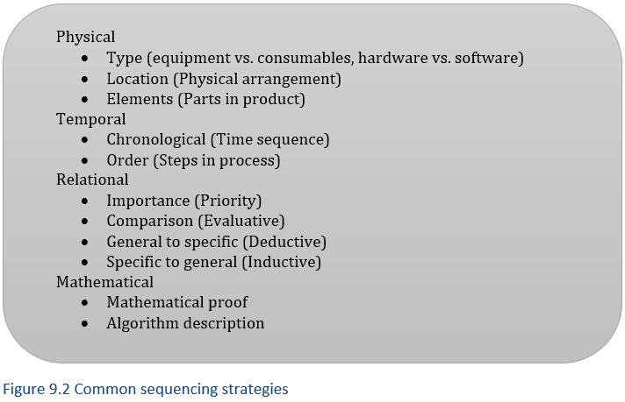
Common sequencing strategies
Often used in second or third division

Slide 17
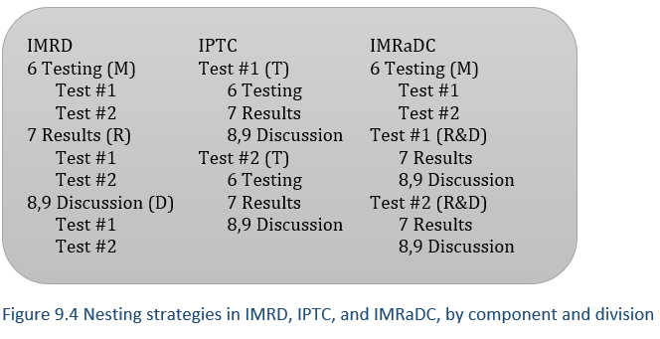
Nested or cyclical strategies
Components linear

Slide 18
Nested or cyclical strategies
Components linear
Components cycle

Slide 19
Nested or cyclical strategies
Components linear
Components cycle

Slide 20
Evaluate your understanding

Slide 21
Evaluate your understanding
Describe the difference between deductive, inductive, and abductive reasoning in scientific research.
How does evaluation differ in engineering and science?
What are the main differences between extended and condensed style, and why would an author choose to use different styles in different sections?
Why are there sometimes cycles of the same components?

Slide 22
Exercises
9.1 Extended and condensed styles
  Which style is used in each division
9.2 Sequencing strategies
  Linear or cyclical, which division determines the order
Exemplars
Writing

Slide 23
References
SWALES, J. M. & FEAK, C. B. 2004. Academic writing for graduate students: Essential tasks and skills (Vol. 1), Univ. of Michigan Press.

