Slide 1

Chapter 8
Evidence from current research
Writing for Engineering and Science Students:
Staking your Claim
Gerald Rau

Slide 2
Goals
Why does science tend to switch suddenly from past to present evidence at the beginning of the Methods division, whereas the switch may be more gradual in engineering?
What is the purpose of highlighting examples or equations with numbers or bullets?
How do science and engineering differ in the location and type of graphics, and why?
If statistical tests are conducted, what information needs to be included in describing the experimental design?
What is the difference between locating and highlighting graphics?
Why is present tense always used with pointing verbs?

Slide 3
From Past to Present
Section 8.1

Slide 4
Connect past/present research
Past Research
Present Research
Typical communication pattern
  Begin with shared knowledge
  Connect new knowledge to shared knowledge

Slide 5
Transition – IMRD vs. IPTC
Introduction
  Past
Method
  Present (based on past)
Results
  Present
Discussion
  Present (compare past)
Introduction
  Past
Process
  Past / Present
Testing
  Present (compare past)
Conclusion
  Present

Slide 6
Transition – Past/Present
Past Research
Present Research
Often not a single firm boundary

Slide 7
How clear is the break?
Clearest
  Beginning of a section: “In this section we …”
Less clear
  Beginning of a section: Switch to current research
  Middle of a section: “In this paper we …”
Least clear
  Middle of a section: Switch to current research
  Multiple breaks: Past/present … Past/present
In your own writing
Stand out for clarity

Slide 8
Evidence: Current Research
Section 8.2

Slide 9
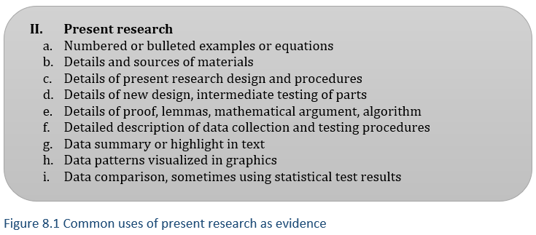
Evidence from present research
Throughout (math)
Data collection
5 Research details
6 Testing methods
Data
7 Data patterns

Slide 10
Overlap with components
What is written in the article is largely support
Underlying component claims are implicit:
  5: Data were collected in a valid and reliable way
  6: Testing was done in a valid and reliable way
  7: A pattern can be discerned in the data

Slide 11
Examples and Equations
Section 8.3

Slide 12
Common in math
Numbered equations
  Easy to refer to
Common in framework and research details
May be found with other components as well
Similar numbered examples in linguistics, education
Rare in science and non-mathematical engineering

Slide 13
Research and testing details
Section 8.4

Slide 14
Research details (5)/Testing (6)
5a: Materials
5b: Methods
5c: New design
5d: New math
6: Testing
Details support claim 2:
Reliable, valid data
Workable solution
Type of evidence cited more similar than in 5

Slide 15
Data: Text and Graphics
Section 8.5

Slide 16
Graphics ≠ Graph
Graphics
  Tables
    Numerical – mostly numbers, often comparing down columns
    Non-numerical – mostly words, often comparing across rows
  Figures
    Graphs
      Line – used for time or other continuous variables
      Bar – used for non-continuous variables
    Illustrations
      Photograph – including digital microscopic images
      Diagram – many different types

Slide 17
Text AND Graphics
All Tables and Figures must be referred to in text
  “As shown in Table 1, …”
Preferable: Summarize important features

Slide 18
Location of graphics
Comparison of sample articles
  Tables and Graphs common in R
 | IMRD
 | I | M | R | D
Tables
Numerical |  |  | 9
Figures
Graphs
Illustrations

Slide 19
Location of graphics
Comparison of sample articles
  Tables and Graphs common in R
 | IMRD
 | I | M | R | D
Tables
Numerical |  |  | 9
Figures
Graphs
Illustrations | Map

Slide 20
Location of graphics
Comparison of sample articles
  Tables and Graphs common in R or T
 | IMRD |  |  |  | IPTC
 | I | M | R | D | I | P | T | C
Tables
Numerical |  |  | 9
Figures
Graphs |  |  |  |  |  |  | 11
Illustrations | Map

Slide 21
Location of graphics
Comparison of sample articles
  Tables and Graphs common in R or T
  Far more illustrations in I, P of IPTC
 | IMRD |  |  |  | IPTC
 | I | M | R | D | I | P | T | C
Tables
Numerical |  |  | 9
Figures
Graphs |  |  |  |  |  |  | 11
Illustrations | Map |  |  |  | 2 | 5

Slide 22
Data: Statistics
Section 8.6

Slide 23
Statistics
Descriptive statistics
  Mean, standard deviation
Inferential statistics
  Based on hypothesis testing
  Allow inference about how well data fit a pattern

Slide 24
Experimental design
MUST be included if research involves statistics:
  test subjects, treatments;
  the experimental (independent)
  and response (dependent) variables;
  repetitions, degrees of freedom;
  the statistical package or procedure used.

Slide 25
Commonly misused words
Experiment
Hypothesis/Prediction
Significant [chapter 22]

Slide 26
Pointing verbs
Section 8.7

Slide 27
Used to point to graphics
Can locate: direct readers to a graphic
Can highlight: information to note in the graphic
Uses present tense
  Visible to reader in the present

Slide 28
Evaluate your understanding
Why does science tend to switch suddenly from past to present evidence at the beginning of the Methods division, whereas the switch may be more gradual in engineering?
What is the purpose of highlighting examples or equations with numbers or bullets?
How do science and engineering differ in the location and type of graphics, and why?
If statistical tests are conducted, what information needs to be included in describing the experimental design?
What is the difference between locating and highlighting graphics?
Why is present tense always used with pointing verbs?

Slide 29
Exercises
8.1 Past to present research
  Where is the break, how clear?
8.2-4 Type and location of support from present research
  Examples and equations
  Graphics
  Statistics
8.5 Pointing verbs
  Verbs, use
Exemplars
Writing

