Slide 1

Chapter 7
Evidence from past research
Writing for Engineering and Science Students:
Staking your Claim
Gerald Rau

Slide 2
Goals
How does the location of past research differ in IMRD and IPTC, and why?
Which components tend to use past research as evidence, and why?
What differences are there between author prominent and information prominent citations, and when might an author choose to use each?
How does the choice of citation verb, voice or tense affect the connotation?

Slide 3
Published work = Accepted evidence
Section 7.1

Slide 4
Evidence
Past (previously published) [This chapter]
  Accepted by research community
  Can be cited to support claims of present article
  Specific information from one article requires citation
Present (published in this article) [Chapter 8]

Slide 5
Citation vs. Reference
Citation:
mark in the body of the text
that directs readers to a reference
usually either (author, date) [IMRD] or numerical [IPTC]
Reference:
listing at the end of the document
with complete information on how to find the source
including author(s), title, publication information
(Rau, 2012)
[1]
RAU, G. 2012. Mapping the origins debate: Six models of the beginning of everything, Downers Grove, IL, InterVarsity Press.

Slide 6
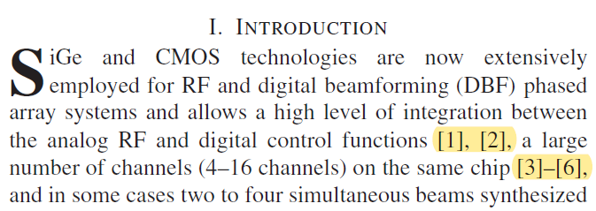
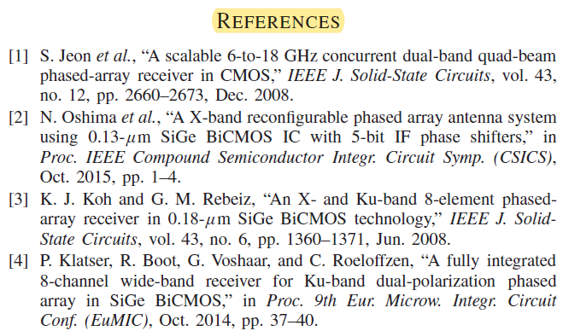
Citation vs. Reference
Citations:
References:
From Sayginer & Rebeiz, 2016

Slide 7
Suggestion
Use citation placeholders as you write: (Name, date)
Become familiar with important works
(Refer by name in conference or other presentations)
Reference numbers will not change while writing
(Eliminates confusion)
No need to use citation manager as you write
(Less distracting)
Less complex document
(Less chance of computer errors)
Insert citations at the end using reference manager

Slide 8
Categories of
Past Research
Section 7.2.1

Slide 9
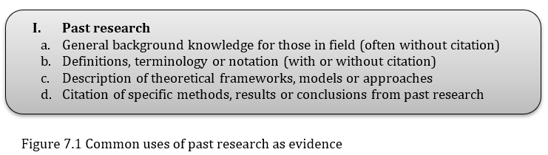
Using past research as support
Always there for a purpose
Where would you find each of these used as support?
With which components?

Slide 10
General background knowledge
Considered to be true, accepted by field
  Written in present tense [always true]
  Without citation
  Not about the new research presented in that article
  Known and accepted by experienced researchers
Supports Importance

Slide 11
Definitions or Notation
Needed to understand current work
  Definitions
  Mathematical notation
  Often presented as a list
Supports Framework

Slide 12
Framework
Needed to understand current work
  Approaches, models, theoretical approaches
  Specific background information
  Anything except definitions and notations
Supports Framework
  Claim is implicit, seen by support, therefore hard to see

Slide 13
Citations
Numbered (or named) citations
Easy to recognize
Supports many components
  (See next section)

Slide 14
Past Research as Evidence
Section 7.2.2

Slide 15
Citations: which components?
Importance?
  Show that others think it is important
Need?
  Show what has, what has not been done
Research goal?
  Tell what we will do in this article
Y
Y
N

Slide 16
Citations: which components?
Framework?
  Background information to understand current work
Research details?
  Details of current work
Testing methods?
  How the tests will be conducted
?
?
?

Slide 17
Citations: which components?
Data patterns?
  Data from the current work
Comparisons?
  Comparison with expectations or previous work
Interpretations?
  Why we got the results
Conclusion?
  What is important about current research
?
Y
Y
N

Slide 18
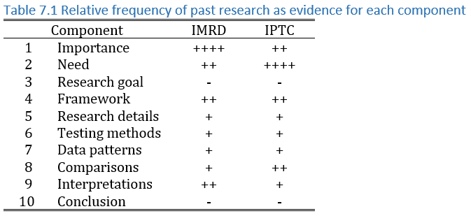
Overall pattern

Slide 19
Author prominent vs. Information prominent
Section 7.3

Slide 20
Author or information?
Author prominent
  Author’s name in the sentence
  Highlights their importance
  Often used for the first, or most closely related work
Information prominent
  Author’s name not in the sentence
  Highlights the research findings
  Variation – “Reference [x]”

Slide 21
Greater impact in numerical
Information
Author
Based on [3], Cheng and Tan designed a mechanism for authenticating kNN queries on multidimensional databases, ensuring that the result set is complete, authentic, and minimal [4, 5].
We plotted the epicenter of the mainshock estimated by Shin et al. (2000) and that of the aftershock estimated by the Taiwan rapid earthquake information release system (Wu et al., 1997).
From Hu et al. 2013
Author
Information
From Satoh et al. 2001

Slide 22
Citation verbs
Section 7.4

Slide 23
Citation verbs
Required in author prominent (the author has to act)
Optional in information prominent (often passive)
Verb choice differs in different fields
  Positive or neutral connotation dominate
Voice and tense can be varied and convey connotation
More advanced, more detailed
Please see the chapter

Slide 24
Evaluate your understanding

Slide 25
Evaluate your understanding
How does the location of past research differ in IMRD and IPTC, and why?
Which components tend to use past research as evidence, and why?
What differences are there between author prominent and information prominent citations, and when might an author choose to use each?
How does the choice of citation verb, voice or tense affect the connotation?

Slide 26
Exercises
7. 1 Past research and components
  Using citations to support claims
7.2 Citation types
  Type and age of citations
7.3 Citation verbs
  Verbs, tense and voice, connotations
Exemplars
Writing

Slide 27
References
HU, L., KU, W.-S., BAKIRAS, S. & SHAHABI, C. 2013. Spatial query integrity with voronoi neighbors. IEEE Transactions on Knowledge and Data Engineering, 25, 863-876.
SATOH, T., KAWASE, H., IWATA, T., HIGASHI, S., SATO, T., IRIKURA, K. & HUANG, H.-C. 2001. S-wave velocity structure of the Taichung basin, Taiwan, estimated from array and single-station records of microtremors. Bulletin of the Seismological Society of America, 91, 1267-1282.
SAYGINER, M. & REBEIZ, G. M. 2016. An eight-element 2–16-GHz programmable phased array receiver with one, two, or four simultaneous beams in SiGe BiCMOS. IEEE Transactions on Microwave Theory Techniques, 64, 4585-4597.

