Slide 1

Chapter 6
Verifying your Contribution
Writing for Engineering and Science Students:
Staking your Claim
Gerald Rau

Slide 2
Goals
Why are the last two divisions discussed together in this chapter?
What is the purpose of each component found in the last two divisions?
How do science and engineering articles differ in the last two divisions?

Slide 3
Staking your Claim
Section 6.1

Slide 4
Staking your claim
When you discover something valuable
X
Name
Location, Time
Claim number

Slide 5
Staking your claim
When you discover something valuable
Prove no one else discovered it first (I)
Mark the boundaries of your claim (M/P)
Prove the value of what you discovered (R&D/T&C)

Slide 6
The contribution of your work
Sections 6.2

Slide 7
Implicit Claim
You have a good explanation for your data (IMRD)
or
Your solution is better than existing solutions (IPTC)
Two divisions, one claim
IMRD
IPTC

Slide 8
Implicit Claim 3
IMRD: You have a good explanation for your data
IPTC: Your solution is better than existing solutions
Argument split between R & D – neither complete
  Results = Data pattern
  Discussion = Interpretations
Brief restatement at end of Discussion (1-2 paragraph)
  Summary, conclusion
Evidence
Reasoning

Slide 9
Implicit Claim 3
IMRD: You have a good explanation for your data
IPTC: Your solution is better than existing solutions
Argument complete in Testing – one or more sections
  Data patterns
  Comparisons
Conclusion is a brief restatement (1-2 paragraph)
  Advantage, contribution
Evidence
Reasoning

Slide 10
Common Components IMRD
7 Data patterns
8 Comparisons
9 Interpretations
10 Conclusion
= Results
Often statistical
= Discussion
Last paragraph

Slide 11
Common Components IPTC
6 Testing methods
7 Data patterns
8 Comparisons
9 Interpretations
10 Conclusion
To allow comparison
To allow comparison
With previous solutions
May not be required
Summarize contribution

Slide 12
Testing methods
Section 6.3

Slide 13
Testing methods
Commonly found in Testing in IPTC
See section 5.5

Slide 14
Data Patterns
Section 6.4

Slide 15
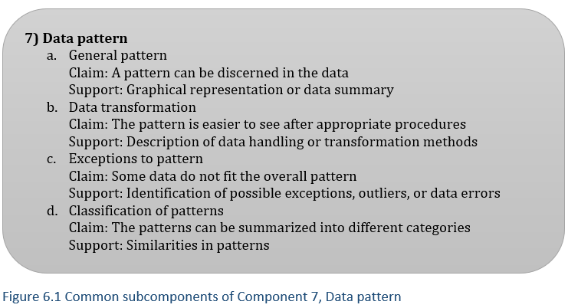
Data Patterns
Required component in almost all science and engineering studies except mathematical proof
Often visualized in graphs or tables

Slide 16
Data Patterns
Summary – not all the data you collected
  Tables, Graphs
  Means
  Only what is essential to interpretations or comparisons
IMRD – usually highlights main points in text
IPTC – often merely points to graphic

Slide 17
Comparisions
Section 6.5

Slide 18
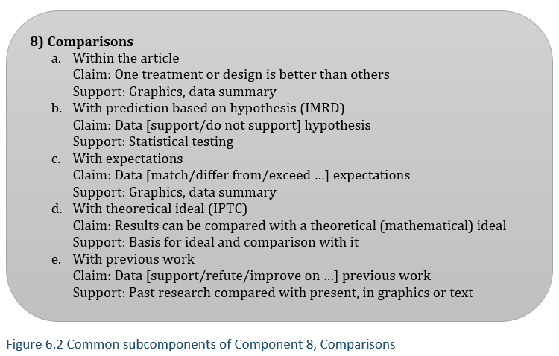
Comparisons
Usually present, unless first study of its type
Only if using statistics

Slide 19
Interpretations
Section 6.6

Slide 20
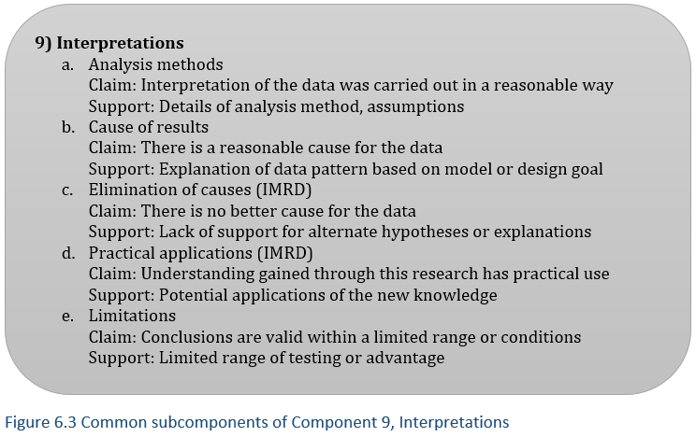
Interpretations
Most varied part of a research article = reasoning
Often not needed in engineering

Slide 21
Importance of Comparison/Interpretations
Convince your readers to see the data a certain way
  Your explanation of the question is correct
  Your solution to the problem is the best
Most variable part of paper
  Hardest part of research to do
  Hardest part of writing to teach
Most important part of paper
  Determines contribution

Slide 22
Conclusion
Section 6.7

Slide 23
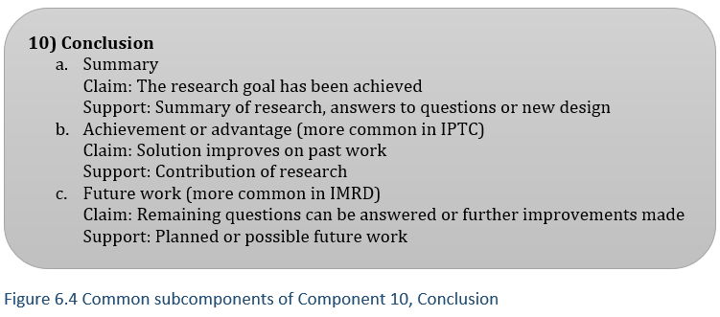
Conclusion
Separate section or last 1-2 paragraphs

Slide 24
Comparison of
IMRD and IPTC
Section 6.8

Slide 25
IMRD vs. IPTC
Generalizations:
Considerable variation between articles
Location of Testing methods
  In Methods (IMRD) vs. Testing (IPTC)
Components
  Focus on Interpretations (IMRD) vs. Comparisons (IPTC)
Order
  Linear (IMRD) vs. Cyclical (IPTC)
  Several components in one paragraph (IPTC)

Slide 26
Evaluate your understanding

Slide 27
Evaluate your understanding
Why are the last two divisions discussed together in this chapter?
What is the purpose of each component found in the last two divisions?
How do science and engineering articles differ in the last two divisions?

Slide 28
Exercise 6.1
1) Identify the components in each paragraph in the last two divisions of your first exemplar article and the component markers that help you identify them. Summarize this in a table.
Hint: Remember that there is frequently more than one component per paragraph in these divisions.
Hint: As you start, look at the section and subsection titles. Do they give you an idea what you will find in each section?

Slide 29
Exercise 6.1
2) Does the order of components generally follow the order listed? Do any of them repeat cyclically? Can you figure out a reason for the order?
Hint: The order may repeat cyclically.
3) How close is the wording of the Conclusion to the research goal in the Introduction? How similar is the wording of the same idea in the Abstract?
4) Is there an introductory paragraph at the beginning of any section? If so, does it point back to the research goal or forward to the contents of that section?

