Slide 1

Chapter 5
Continuity and novelty of your research
Writing for Engineering and Science Students:
Staking your Claim
Gerald Rau

Slide 2
Goals
How is the purpose of the second division similar yet different in IMRD and IPTC?
How do the components present in the second division differ in IMRD and IPTC?
Why are organizational features like summaries and topic sentences more important in the second division of IPTC than IMRD?

Slide 3
Connected yet Distinct
Section 5.1

Slide 4

Research and puzzles
How is research like working on a puzzle?
How is it different?
How does it connect to what others have already done?
Which puzzle is it a part of?
Has anyone already added that piece?
Not problems with pre-cut puzzles,
but major problems in research
Notes:
Activity: Puzzles in different groups. 2 identical pieces. Some with wrong puzzle.

Slide 5












Research and houses
How is the second division like moving into a new house?
Similar to others, but not identical
Performs similar functions

Slide 6
Not just a report
Report = What y0u did
Journal article > What you did
  How it connects with previous work
  + How it is distinct from previous work
  = How it adds to previous work

Slide 7
Reliability (IMRD) or
Feasibility (IPTC)
Section 5.2

Slide 8
Implicit Claim
You have gathered data in a valid, reliable way (IMRD)
or
You have designed a workable solution to the problem (IPTC)
Implicit (not directly stated)
Recognized by support

Slide 9
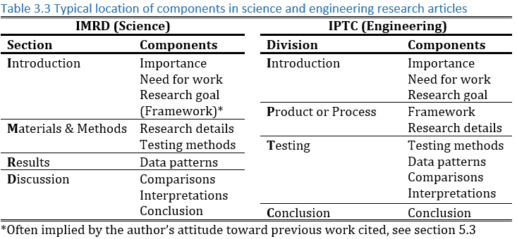
Common Components
Framework:
Past Research
Research Details: Present Research
Past
Present

Slide 10
Support for claim: IMRD
Describe your work in context of former work
  Continuity – connection to former work
  Novelty – difference from former work
Main claim of second Division
  Your data are valid and reliable (IMRD)
Research Details, Testing Methods:
Follow methods of past research, with modification
Research Details, Testing Methods:
Emphasize attention to detail in present work

Slide 11
Common Components
Framework:
Past Research
Research Details: Present Research
Past
Past
Past
Present
Present

Slide 12
Support for claim: IPTC
Framework:
Builds on past research
Describe your work in context of former work
  Continuity – connection to former work
  Novelty – difference from former work
Main claim of second Division
  Your solution will work (IPTC)
Research Details:
Present research adds something
Research Details:
Present research achieves goal

Slide 13
Framework
Section 5.3

Slide 14
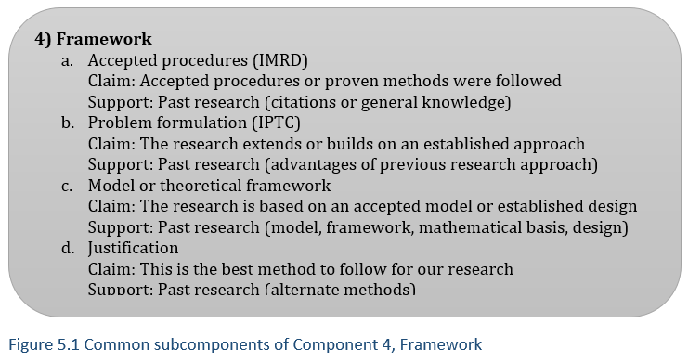
Framework
4c overlaps with both 4a and 4b, emphasis on theory

Slide 15
Focus of each component
Need: gaps or limitations of previous work
Framework: advantages of one previous approach
Research details: distinctive features of present work

Slide 16
Distinguishing Framework
Is this describing limitations of previous research (2) or advantages the current work builds on (4)?
Is this background necessary to understand the current research (4) or the current research itself (5)?

Slide 17
Research Details
Section 5.4

Slide 18
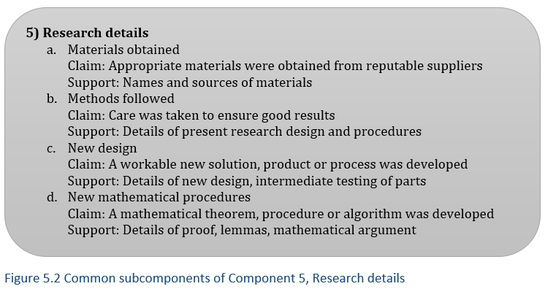
Research Details
a, b = mostly other’s ideas
IMRD, IPTC
c, d = mostly our ideas
IPTC

Slide 19
Testing Methods
Section 5.5

Slide 20
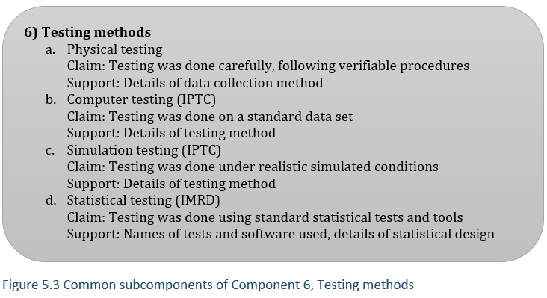
Testing Methods
With a, b, or c

Slide 21
Comparison of
IMRD and IPTC
Section 5.6

Slide 22
IMRD vs. IPTC:
Framework
IMRD
IPTC
Introduction
  What past work is cited
  Attitude toward past work
Method
  Methods used
  Justification of choice
Background information
  With or without citations
Introduction
  Last past work cited
  Least limitations
Process
  Foundation of present work
  Advantages
Background information
  With or without citations

Slide 23
IMRD vs. IPTC:
Importance of the second division
IMRD – Method = Low importance
  Sometimes at end of article or online
  Condensed style – familiar to most readers
IPTC – Process = High importance
  Central contribution of article
  Extended style – new to all readers
    Summary paragraphs, topic sentences

Slide 24
Evaluate your understanding

Slide 25
Evaluate your understanding
How is the purpose of the second division similar yet different in IMRD and IPTC?
How do the components present in the second division differ in IMRD and IPTC?
Why are organizational features like summaries and topic sentences more important in the second division of IPTC than IMRD?

Slide 26
Exercise 5.1
Identify the components in each paragraph in the second division of your first exemplar article and the component markers that help you identify them. Summarize this in a table.
Does the second division follow the order of components as listed?
Are there any organizational features such as an introductory paragraph? Are there any other important features to help the reader, such as a figure showing the overall process?

Slide 27
IMRD
You may need to go back to the Introduction
to identify the framework.
Ask yourself:
Is this talking mainly about the gap in research (2)
or is it talking about a good method that will be used (4)?

Slide 28
IPTC
Ask yourself :
Is this background necessary to understand the current research (4),
or something actually done or developed in the current research?
Does this describe something that has been used before, perhaps with modification (5a or 5b),
or is developed by the current authors as part of the research goal (5c or 5d)?

