Slide 1

Chapter 4
Importance of and need for the research
Writing for Engineering and Science Students:
Staking your Claim
Gerald Rau

Slide 2
Goals:
Why is it important to be part of an academic, disciplinary or research community? How does the Introduction help you claim your role in that community?
What common components are generally present in an Introduction, and what is the role of each in supporting the main claim?
Why is the research goal the most important component of any research article?
How do topic sentences and component markers help you, both as a reader and a writer?
How do Introductions differ in IMRD and IPTC format?

Slide 3
Joining a community
Section 4.1

Slide 4
Joining a community
Is this conversation important?
Only if you follow MLB.
“Hey, who do you think will win the Cy Young this year?”
“I think Sale deserves it, but maybe Kluber. Probably depends who wins the pennant.”
“What about the Nationals? The Dodgers’ Kershaw and Jansen both have a shot.”
“Maybe, but it almost always goes to a starter, so I say Kershaw, even though it would be his fourth. Last time a reliever won was Gagne in 2003.”

Slide 5
Joining a community
Know the vocabulary
Know the people
Know the history
Use the right vocabulary the right way
Refer to the right people (important researchers)
Cite the history (important papers)
Joining a disciplinary community

Slide 6
Claim 1: Importance of and need for your work
Section 4.2

Slide 7
Implicit Claim
Importance
Need
You have identified an important unanswered question (IMRD)
or
You have identified an important unresolved problem (IPTC)
Importance
Need
Research goal
How you will meet that need
Allows you to fit into and add to conversations in your community

Slide 8
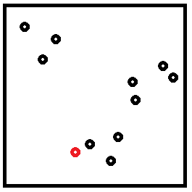

Common component claims
IMRD
Divisions | Components
Introduction | Importance Need for work Research goal
IPTC
Divisions | Components
Introduction | Importance Need for work Research goal
*
*
*More past research cited
Research space
Why the difference?
Has not been done
Important to do

Slide 9
Overall Goal of Introduction Division
Establish that your research is
  Interesting
  Worthy of publication
By: Looking back (at other research) to show:
  You are familiar with current research
  Question not answered/Problem not solved
By: Pointing forward (to the rest of the paper) to show:
  You have a valid approach to solve it (M/P)
  Adds to existing research in some way (R&D/T)
  Therefore: relevant, significant, new contribution (C)

Slide 10
Component analysis and component markers
Section 4.3

Slide 11
By paragraph
Determine the intent of the author
Why is each paragraph there?
  Assumes the authors are good writers (may not be true)

Slide 12
Component markers
General patterns
  Common in many articles
  Can be reused in your article
Add specifics to make it unique
Beef noodles
  Beef + Noodles
  + Vegetables, egg, spices …

Slide 13
Component 1)
Importance
Section 4.4

Slide 14
1. Importance
How expressed?
  Importance to society
  Importance to researchers
Where?
  Usually first paragraph
  May be more than one paragraph
  May be only one sentence, or not present in IPTC

Slide 15
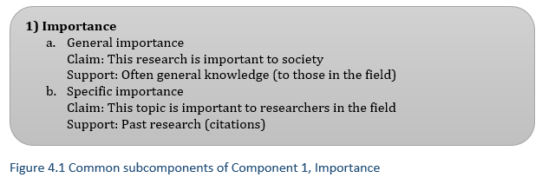
1. Importance

Slide 16
1. Importance:
Component markers
Society
  The rising incidence of … has emerged as a great concern …
  … is of particular value for emerging mobile applications.
  … is widely used in …
Researchers
  … has been actively studied for decades.
  … is increasingly recognized as an important research area for current and future devices.

Slide 17
Component 2)
Need
Section 4.5

Slide 18

Your place in the community
Where can you build?
  Connected to a road
  Unclaimed space
What can you build?
  Match community standards
?

Slide 19
Finding the research gap
Must be familiar with the
latest research

Slide 20
2. Need
How expressed?
  Problems, limitations
  However, nevertheless
Where?
  Middle of Introduction
  More prominent in IPTC

Slide 21
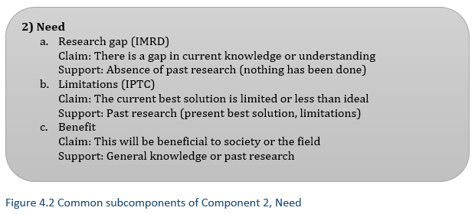
2. Need

Slide 22
Component 3)
Research goal (main claim)
Section 4.6

Slide 23
Field-specific Names
Science: Questions → Explanation
  Research questions, hypotheses
Engineering: Problem → Solution
  Problem definition
  Research objectives, aims, goal, focus
Use common term in your field = fit in

Slide 24
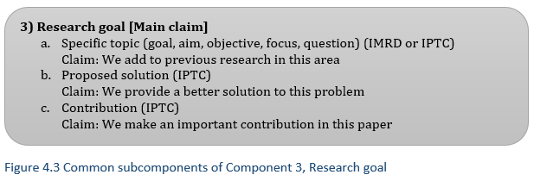
3) Research goal

Slide 25
Filling the Gap
Identify your goal: to fill the gap
  This paper demonstrates that …
  The purpose of this study is to develop a method to …
  We propose a new system for …
  (See section 4.6 for more)

Slide 26
Research Goal Location
Last paragraph of the Introduction section
Second to last paragraph
  If last paragraph is Organization of the article
[First paragraph of Process]

Slide 27
Organization
Purpose:
Show argument structure
How expressed?
  The organization of this paper is as follows:
  In section 2 … in section 3 …
Where?
  Last paragraph of Introduction (if present)

Slide 28
Asian vs. English writing
Asian sentences and paragraphs longer
Need (gap) and goal may be in one paragraph
  Makes research goal hard to find in English
Notes:
Winnie 1, Liu et al.

Slide 29
Component 4)
Framework
Section 4.7

Slide 30
Often implied
Immediately clear to senior researchers
  Attitude toward other research
IMRD: What cited as important
  If several methods, choice may be justified in M
IPTC: Often last method mentioned, least limitations
  Often expanded on in the first part of P

Slide 31
More in next chapter
May be determined from either first or second division

Slide 32
Structure of a well-written article
Section 4.8

Slide 33
Topic sentences
Each paragraph in English writing
  One purpose, one main point
Topic sentence = Summary of main idea of a paragraph
  Often the first sentence
Topic sentences often related to components
  Argument clear by reading topic sentences only

Slide 34
Introduction section Table 4.1
Topic sentence | Purpose (component)
“The amount of digital spatial information available … has grown at an exceptional pace over the past decade.” | 1a General importance
“Consequently, … is becoming increasingly popular and has received a lot of attention in the research community.” | 1b Specific importance
Importance
Hu et al. 2013

Slide 35
Introduction section Table 4.1
Topic sentence | Purpose (component)
“The amount of digital spatial information available … has grown at an exceptional pace over the past decade.” | 1a General importance
“Consequently, … is becoming increasingly popular and has received a lot of attention in the research community.” | 1b Specific importance
“In this work, we focus on the … model, … However, there exist two major concerns with this model.” | 2b Limitations
“The general framework commonly used in the literature … is based on … | 2b Current best solution
“The current state-of-the-art solution … | 2b Current best solution
“We argue that … suffer from several drawbacks.” | 2b Limitations
Need
Hu et al. 2013

Slide 36
Introduction section Table 4.1
Topic sentence | Purpose (component)
“The amount of digital spatial information available … has grown at an exceptional pace over the past decade.” | 1a General importance
“Consequently, … is becoming increasingly popular and has received a lot of attention in the research community.” | 1b Specific importance
“In this work, we focus on the … model, … However, there exist two major concerns with this model.” | 2b Limitations
“The general framework commonly used in the literature … is based on … | 2b Current best solution
“The current state-of-the-art solution … | 2b Current best solution
“We argue that … suffer from several drawbacks.” | 2b Limitations
“Motivated by the above observations, we propose … a novel approach … based on …” | 3b Proposed solution
“This paper subsumes our earlier work … by extending the … approach …” | 3a Specific objective
“The remainder of the paper is organized as follows.” | Organization
Research goal
Hu et al. 2013

Slide 37
Related work section Table 4.2
Topic sentence and last sentence of paragraph | Purpose (component)
The idea … was first introduced by … Nevertheless, both solutions incur significant authentication overhead … | 2b Limitations
… introduced … supporting fast query processing and verification. Nevertheless, neither … handle data updates efficiently. | 2b Limitations
Efficient verification in the presence of frequent updates has been studied … The proposed mechanism achieves both correctness and … | 2b Current best solution
All the aforementioned solutions require changes … The … method introduced in this paper is both efficient and deterministic, and does not require any modifications … | 2b Limitations 3c Contribution
Mostly Need
Restates research goal at end
Hu et al. 2013

Slide 38
Components in the Introduction
Importance
General importance (society)
Specific importance (researchers)
Need
Research gap
Problem identification
Benefit
Research goal
Specific objective
Proposed solution
Contribution
✓
✓
✓
✓
✓
✓
+ Organization

Slide 39
Comparison of
IMRD and IPTC
Section 4.9

Slide 40
IMRD vs. IPTC
Generalizations
Length of Introduction section
  Extremely variable in engineering
    One paragraph, all citations in Related work
    Several pages, including illustrations of overall design
Components
  Importance often longer in IMRD, more citations
  Need often more prominent in IPTC
Research goal
  Terms used, way of stating
Organization paragraph

Slide 41
Evaluate your understanding

Slide 42
Evaluate your understanding
Why is it important to be part of an academic, disciplinary or research community? How does the Introduction help you claim your role in that community?
What common components are generally present in an Introduction, and what is the role of each in supporting the main claim?
Why is the research goal the most important component of any research article?
How do topic sentences and component markers help you, both as a reader and a writer?
How do Introductions differ in IMRD and IPTC format?

Slide 43
Exercise 4.1
1) Identify the components in each paragraph in the Introduction division of your first exemplar article and the component markers that help you identify them. Summarize this in a table.
2) Does the Introduction follow the order of components as listed? [This is a claim.]
3) Where is the research goal stated in your exemplar articles, and how? If they use the phrase “to [the best of] our knowledge” or additional bullet points or sentences to expand on the goal, make note of that.
4) Is there a paragraph at the end of the Introduction that describes the organization of the rest of the paper?

Slide 44
Remember the hints!
See online material:
Component analysis
Use the list of components in Appendix 1 to avoid flipping pages.
Remember that component markers are general words that could help identify that component in many different articles, not the specifics of that article.
Mark components in the margins of your article.
If your article contains a second section in the Introduction division, include it.

Slide 45
Reference
HU, L., KU, W.-S., BAKIRAS, S. & SHAHABI, C. 2013. Spatial query integrity with voronoi neighbors. IEEE Transactions on Knowledge and Data Engineering, 25, 863-876.

