Slide 1

Chapter 3
Argument structure of research articles
Writing for Engineering and Science Students:
Staking your Claim
Gerald Rau

Slide 2
Goals:
Why is it important to understand the argument structure of research articles?
What implicit claims are commonly made in science and engineering articles?
What components are found in most science and engineering writing?
Why are some components found in different divisions in IMRD and IPTC?
How are claims supported in research articles?

Slide 3
Argument structure
Section 3.1

Slide 4
Empirical research
Empirical = based on or verifiable by observation
(using any of our senses)
(not theory or pure logic)
Natural sciences
Social sciences
Engineering
Not mathematics

Slide 5
Empirical research
Presuppositions: hold to be true, no empirical basis
  “The world is real, our senses can detect reality”
Evidence: what we observe
  “Light is reflecting off a road”
Inference: how we interpret what we observe
  “The road is wet”
Argumentation: how we support our inference
  “Light reflects well off water, but not off asphalt”
Ethics
Fact
Explanation
Reason

Slide 6
Argument Structure
All journal articles are written as logical arguments
  Make a claim
  Provide evidence for that claim
  Explain the reasoning
Support
Claim
I have contributed to my field
Evidence
What I did
Reasoning
What it means
Data

Slide 7
Implicit claims
Section 3.2

Slide 8
Implicit Claims in Journal Articles
Figure 3.1
IMRD (science)
1) You have identified an important, unanswered question
2) You have gathered data in a valid, reliable way
3) You have a good explanation for your data
I
M
R
Evidence
D
Reasoning

Slide 9
Implicit Claims in Journal Articles
Figure 3.1
IPTC (engineering)
1) You have identified an important, unresolved problem
2) You have designed a workable solution to the problem
3) Your solution is better than other existing solutions
I
P
T
C

Slide 10
Component claims
Section 3.3

Slide 11
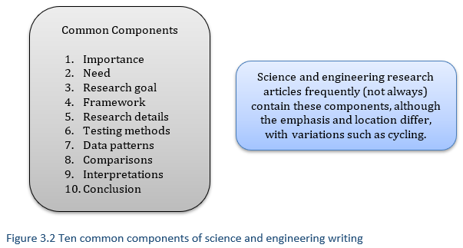
Ten Component Claims

Slide 12
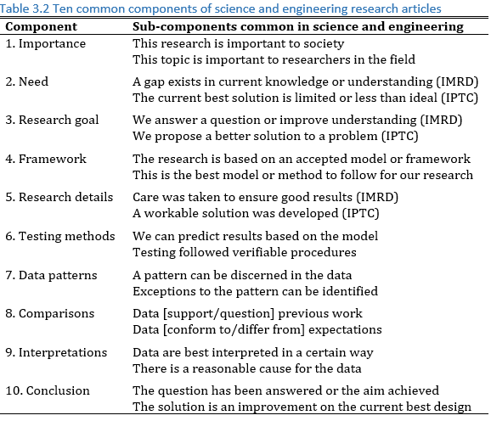
Ten Component Claims
Why did we do this?
Main claim
How will we do this?
What did we find out?
Contribution

Slide 13
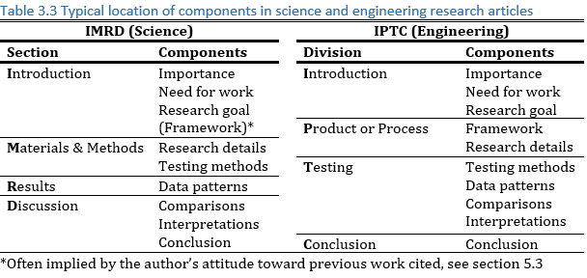
Location of Components
Gathered data reliably
Good explanation for data
Workable solution
Better than other solutions

Slide 14
Supporting claims
Section 3.4

Slide 15
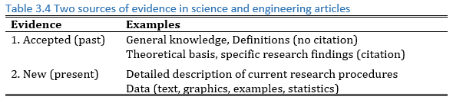
Supporting Claims: Evidence
Mainly first two divisions
Mainly second, third divisions

Slide 16
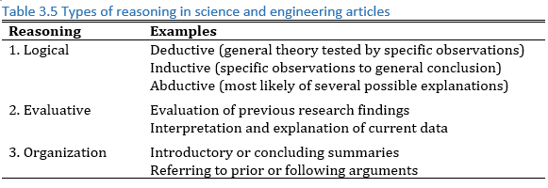
Supporting Claims: Reasoning
Throughout article

Slide 17
Evaluate your understanding

Slide 18
Evaluate your understanding
Why is it important to understand the argument structure of research articles?
What implicit claims are commonly made in science and engineering articles?
What components are found in most science and engineering writing?
Why are some components found in different divisions in IMRD and IPTC?
How are claims supported in research articles?

Slide 19
Exercise 3.1
Look for components, which are in each division?
First look – more details on each in later chapters
  Framework – harder to find
  Often implicit in attitude toward other research, method chosen

Slide 20
Exercise 3.2
Write a claim
  “My articles follow IMRD / IMRaDC / IPTC / IPC”
Support the claim
  Table showing section titles, division length
  Evidence: “As shown in Table 1, …”
    Number of sections
    Titles of sections
    Length of divisions
    Location of components by division
  Reasoning: “This fits the expected structure”

