Slide 1

Chapter 2
Overall format of research articles
Writing for Engineering and Science Students:
Staking your Claim
Gerald Rau

Slide 2
One Format or Two?
Section 2.1

Slide 3
Exemplar articles
First: read research articles effectively
  Understand argument structure of exemplars
Later: Use that structure to guide writing
Exemplars?
  If you don’t know what exemplars are
  Or how to find them
  See Chapter 1

Slide 4
IMRD and IPTC
IMRD (or IMRaDC): Prototypical structure for science
IPTC: Analogous prototypical structure for engineering

Slide 5
Goals:
1) What is the difference between a “section” and a “division” of a research article?
2) How do section titles differ in IMRD and IPTC?
3) Why does the relative length of divisions differ in IMRD and IPTC?
4) Why are there differences in reporting format (article structure) within a field?

Slide 6
Research Article Formats:
IMRD vs. IPTC
Section 2.2

Slide 7
Section vs. Division
Section: Names given by the author to parts of a paper
  Usually with a number and title (sometimes only title)
Division: Conceptual units of a format (IMRD/IPTC)
  Each division may include one or more sections

Slide 8
IMRD
Effects of Rainfall (Biology)
I: 1. Introduction
M: 2. Materials and Methods
R: 3. Results
D: 4. Discussion
Division
Section

Slide 9
IMRaDC
Pt-Ni Nanocages (Chemical engineering)
I: 1. Introduction
M: 2. Experimental section
R&D: 3. Results & Discussion
C: 4. Conclusion
Division
Section

Slide 10
IPTC
Eight Element Receiver (Electrical engineering)
I: I. Introduction
II. Eight Element Programable PPA Receiver Architecture
P: III. Technology, Design, and Building Block Measurements
T: IV. System-Level Simulations
V. Measurements
C: VI. Conclusion
Division
Section
Different format for numbers, titles

Slide 11
First look
Number of sections
Titles of sections: general or specific to the research?
 | IMRD IMRaDC | IPTC
Number of sections | 4 | >4
Titles of sections | General | Specific

Slide 12
First look
Number of sections
Titles of sections: general or specific to the research?
Length of divisions
 | IMRD IMRaDC | IPTC
Number of sections | 4 | >4
Titles of sections | General | Specific
Longest division | R (R&D) | P

Slide 13
Science: Effects of Rainfall
Table 2.1
Division | Section/Subsection Titles | Para- graphs | Word count | %
I | 1. Introduction | 6 | 787 | 15
M | 2. Materials and Methods 2.1. Water Sample Collection 2.2. Water Sample Collection after Rainfall Event 2.3. Sample Analysis 2.4. Statistical and Graphical Analysis | 2 2 1 1 | 257 449 48 79 833 | 16
R | 3. Results Tables (9) | 9 | 1274 1629 2903 | 55
D | 4. Discussion | 6 | 788 | 15
Total |  | 27 | 5341 | 100
IMRD

Slide 14
Engineering: Spatial Query …
Table 2.5
Division | Section/Subsection Titles | Para- graphs | Word count | %
I | 1 Introduction 2 Related Work | 8 4 | 1164 742 1906 | 19
P | 3 Preliminaries 3.1 Voronoi Diagrams 3.2 Signature Aggregation 4 Data Transformation 5 Authenticating Spatial Inquiries 5.1 Query Processing at the SP 5.2 Signature Verification 5.3 Geometric Verification (5.3.1-4) | 8 4 27 | 551 609 4304 5464 | 53
T | 6 Experiments 6.1 Experimental Settings 6.2 VN-Auth and MR- and MR*-trees 6.3 Advanced Spatial Inquiries 7 Discussion | 13 2 | 2219 471 2690 | 26
C | 8 Conclusions | 1 | 172 | 2
Total |  | 67 | 10248 | 100
How did you decide?
IPTC

Slide 15
IMRD vs. IPTC
IMRD | IPTC
Introduction | Introduction
Materials and Methods | [Process]
Results | [Testing]
Discussion | Conclusion
Notes:
I – other people’s work
Other – your work

Slide 16
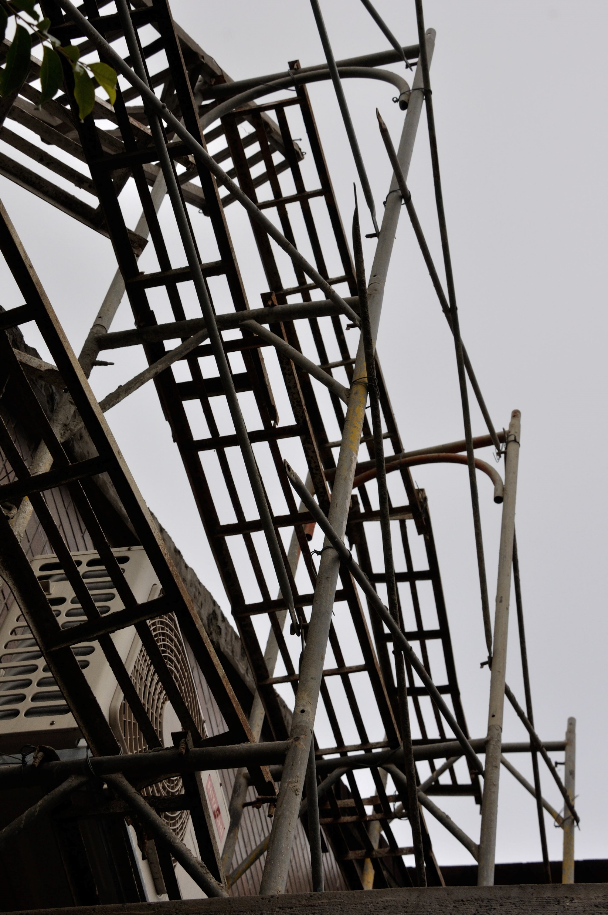
Overall Structure – IMRD vs. IPTC
Figure 2.1
Introduction
Introduction
Methods
Process
Results
Section names general, vary by field
Section names specific to research
Testing
Discussion
Conclusion
Final Structure
Scaffolding

Slide 17

Divisions – IMRD
Figure 2.2
Introduction: Questions to be addressed by the data
  What we know importance of this study
Methods: How the data were generated
  Materials, subjects, methods, procedures, statistics
Results: Summary of the data
  Summary in words, tables or figures
Discussion: Explanation of the data
  What we found out what to do next

Slide 18
Divisions – IPTC
Figure 2.2
Introduction: Problem to be addressed by the design
  What has been done need for something new
Process: Solution proposed by the design
  Steps in development of process or product
Testing: Comparison with previous design
  Summary in words, tables or figures
Conclusion: Advantage of new design
  What we found out importance of research

Slide 19
Mathematics: 4-ordered …
Table 2.6
Division | Section/Subsection Titles | Para- graphs | Word count | %
I | 1. Introduction | 6 | 595 | 19
P | 2. 4-Ordered cells 3. Generalized honeycomb torus | 17 24 | 1966 1819 3785 | 84
C | 4. Main result and concluding remarks | 3 | 125 | 3
Total |  | 50 | 4505 | 100
IPC
Testing not necessary
Based on logical proof
IEEE (electrical engineering) articles:
Most use IPTC
Some use IPC
Some use IMRD

Slide 20
Variation in Research Article Formats
Section 2.3

Slide 21
Field vs. Research methodology
Field: Topic studied
Research methodology: How it is studied
  Theoretical
  Design
  Quantitative
  Qualitative
  Inductive
  Deductive

Slide 22
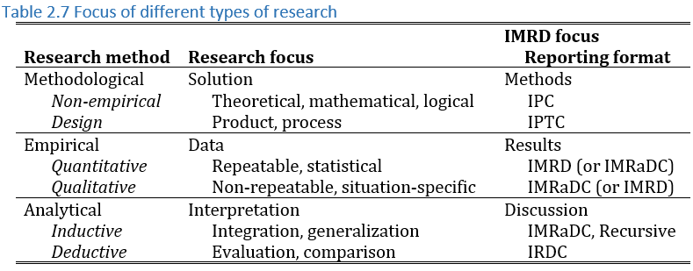
Variation in article structure
Typical of:
Mathematics
Engineering
Science
Social science

Slide 23
Evaluate your understanding:
1) What is the difference between a “section” and a “division” of a research article?
2) How do section titles differ in IMRD and IPTC?
3) Why does the relative length of divisions differ in IMRD and IPTC?
4) Why are there differences in reporting format (article structure) within a field?

Slide 24
Determining Exemplar Article Structure
Section 2.4

Slide 25
Placing the divisions – IMRD
Division | Clear | Common Alternatives
I | Introduction
M | Materials & Methods
R | Results
D | Discussion

Slide 26
Placing the divisions – IMRD
Division | Clear | Common Alternatives
I | Introduction
M | Materials & Methods | Experimental methods Experimental procedures
R | Results
D | Discussion

Slide 27
Placing the divisions – IMRD
Division | Clear | Common Alternatives
I | Introduction
M | Materials & Methods | Experimental methods Experimental procedures
R | Results | Experimental results
D | Discussion
Division | Clear | Common Alternatives
R&D | Results & Discussion
C | Conclusion

Slide 28
Placing the divisions – IMRD
Division | Clear | Common Alternatives
I | Introduction
M | Materials & Methods | Experimental methods Experimental procedures
R | Results | Experimental results
D | Discussion
Division | Clear | Common Alternatives
R&D | Results & Discussion | Testing Results (although it also includes Discussion)
C | Conclusion

Slide 29
Placing the divisions – IPTC
Division | Clear | Less Clear
I | Introduction
P
T
C | Conclusion

Slide 30
Placing the divisions – IPTC
Division | Clear | Less Clear
I | Introduction | Related Work, Previous Work, Background, Motivation (Related to Importance/Need)
P
T
C | Conclusion

Slide 31
Placing the divisions – IPTC
Division | Clear | Less Clear
I | Introduction | Related Work, Previous Work, Background, Motivation (Related to Importance/Need)
P
T | Testing Discussion | Experiment, Comparison, Verification, Simulation (Related to comparison to current best or ideal)
C | Conclusion

Slide 32
Placing the divisions – IPTC
Division | Clear | Less Clear
I | Introduction | Related Work, Previous Work, Background, Motivation (Related to Importance/Need)
P |  | Preliminaries, [Specific to Research] (Related to new Design)
T | Testing Discussion | Experiment, Comparison, Verification, Simulation (Related to comparison to current best or ideal)
C | Conclusion

Slide 33
Overall Exemplar Article Structure
Exercise 2.1

Slide 34
Exercise 2.1
1) Identify the format (IMRD, IMRaDC, IPTC, or IPC) and break points between the divisions for your first exemplar article.
2) Make a table showing the section titles, paragraph numbers and word count for each division in your exemplar article, following a format similar to Tables 2.1-2.5.
3) Note any difficulties, for example in getting an accurate word count, just as you would any other problem with data collection.
Homework:
Same for all 3 exemplars

Slide 35
Hint: Look at hints in textbook
Hint: List the section numbers and titles in the format used by the journal, to get used to it and note differences between journals. If your journal does not use numbers, you will have to pay close attention to font size and location to determine the level of the headings.
Hint: Word count will be useful not only to determine the relative length of each division, but also total length, giving you a goal for your own writing. Export the text from pdf into Word, or copy each section into a Word document, then use the Word Count feature (Review tab).
Hint: It may be hard to get an accurate word count for articles with large numbers of non-text features like equations. Give the best estimate you can.
Hint: Should you count the words separately for each section and subsection? I did for most of the tables in section 2.3, but not for Table 2.4 because the large number of sub-sub-sections was not a common feature in that journal. Your goal is to establish the typical pattern.

Slide 36
Photo credit
Picture on slide 16: © Gerald Rau

