Slide 1

Chapter 1
General principles of writing
Writing for Engineering and Science Students:
Staking your Claim
Gerald Rau

Slide 2
Title of PowerPoint vs. Chapter
PowerPoint titles
  Shorter, keywords

Slide 3
Sorry, no pictures
☹
Copyright laws require obtaining permissions
Too much time and money

Slide 4
Goals:
What are the advantages of the method proposed in this book?
Why will we begin by analyzing the structure of research articles, no matter what you plan to write first?
What types of papers should you not use as exemplars, and why?
What is the advantage of using three exemplar articles rather than only one, and three from the same rather than different journals?

Slide 5
Fitting in, standing out
Section 1.1

Slide 6
Fitting in, standing out
You cannot learn the expectations for a particular journal by reading a book that gives you a general style for scientific writing.
Submit article
Fit journal
Reject
N
Y
Good content
Reject
N
Y
You must fit in
the expected structure
before you can stand out
for quality
Accept

Slide 7
Academic English:
A new language
Section 1.3

Slide 8
Does anyone talk like this?
All water samples were collected into 100mL sterile, polystyrene collection bottles (IDEXX Corp., Portland, ME) and placed at 4◦C until E. coli concentration analysis was conducted.
Outfall pipe #1 (located closest to the beach proper) had a constant concentration of E. coli discharging to surface water during the first three hours of a rain event, and these outfall pipe E. coli concentrations were significantly different from the beach E. coli concentration means (P < .001 at 1 and 2 hours, and .024 at 3 hours).
From Kleinheinz et al. 2009

Slide 9
Why begin with research articles?
Section 1.2

Slide 10
Why begin with research articles?
You will learn to read more effectively to get the information you need to work in science or engineering.
Research articles are complete arguments, thus a good example for your own writing, but also part of an ongoing research effort.
Other genres of student and technical writing are predictable modifications of research article structure in that field.
Research articles are readily available.

Slide 11
Exemplar articles
Section 1.4

Slide 12
Easier with an Example
Everything is easier with an example to follow
  Especially at first
Exemplar articles will be used extensively
  Different fields have different styles
  Different journals within a field have different styles

Slide 13
Exemplar Articles
Evaluate features, determine unstated expectations
Become part of the “disciplinary community”
  “Fitting in”
  Write, think like they do
Excel in research writing
  “Standing out”
  Clarity, quality of work

Slide 14
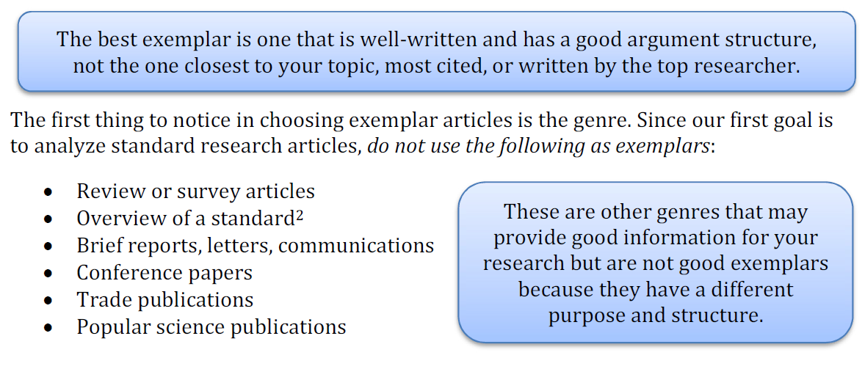
What makes a good exemplar?

Slide 15
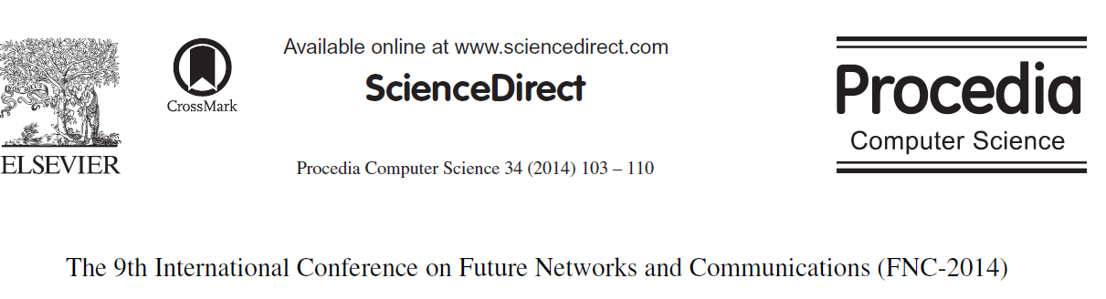
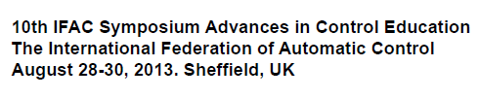

Not acceptable exemplars
Conference papers (Proceedings, Symposium)

Slide 16

Not acceptable exemplars
Letters and brief articles

Slide 17
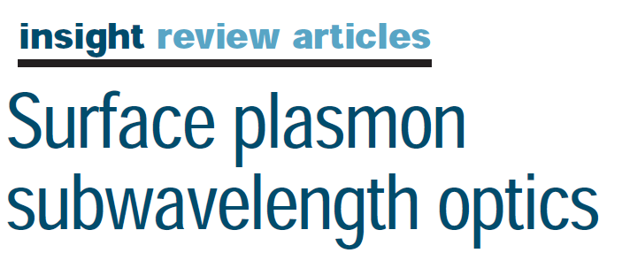
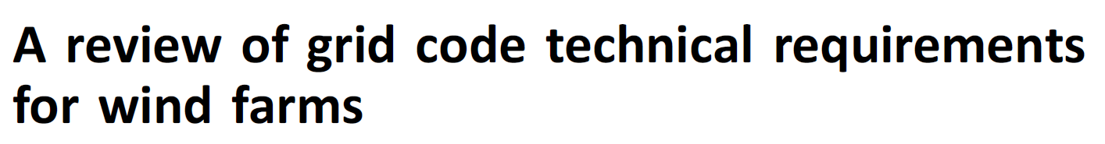
Not acceptable exemplars
Survey or review articles
Analysis or review of standard

Slide 18



Not acceptable exemplars
Trade publications
Popular science publications
Short, simple text
Eye-catching illustrations, title

Slide 19
Finding exemplars
Homework 1 (1)

Slide 20
Three by Three from One
Three articles
  To determine what is typical
By three authors
  To make sure it is not just the style of one author
From one journal
  Because each journal has different expectations

Slide 21
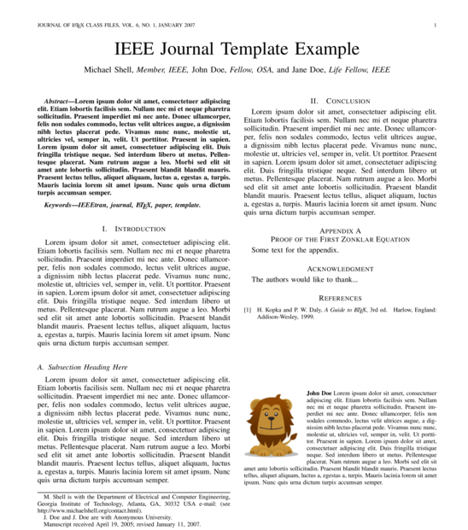
Find First Article
Key article in your research field

Slide 22
Find Previous Articles
References in your present article
Previous articles Cited in References

Slide 23
Find Later Articles
More recent is better – especially in engineering
Google Scholar/Citations
Later articles
Citing this article

Slide 24
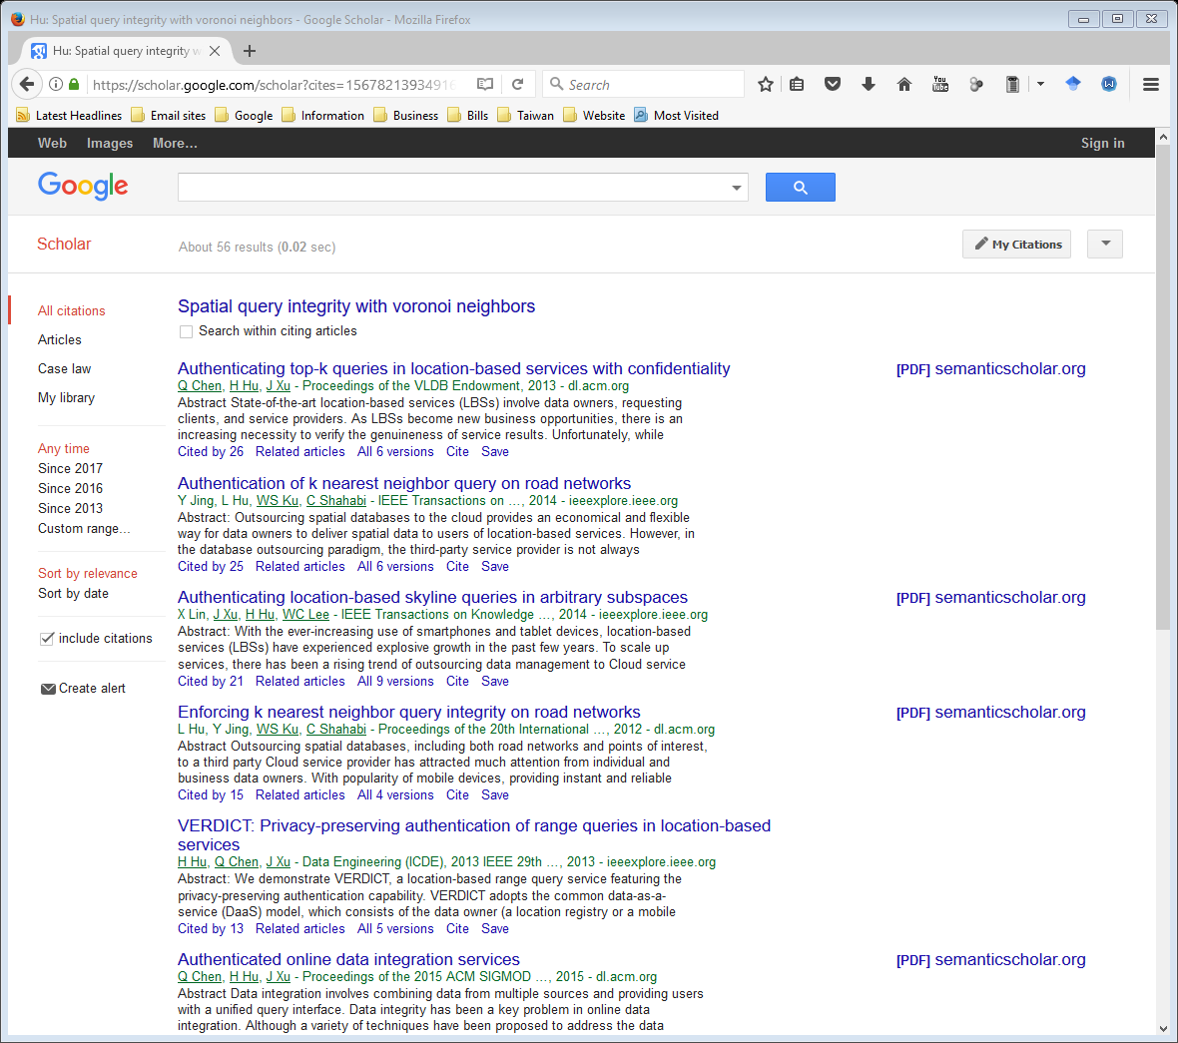
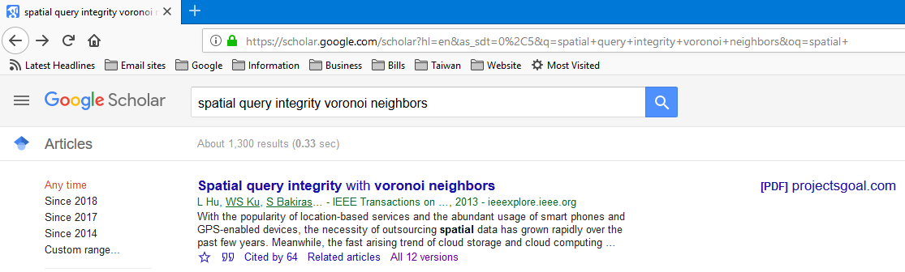

Google scholar

Slide 25
Listing references
Homework 1 (2)

Slide 26
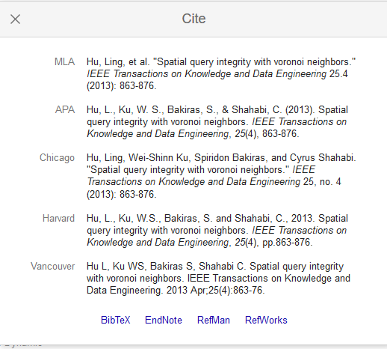
Google scholar
Copy to Word
document

Slide 27
Evaluate your understanding

Slide 28
Evaluate your understanding
What are the advantages of the method proposed in this book?
Why will we begin by analyzing the structure of research articles, no matter what you plan to write first?
What types of papers should you not use as exemplars, and why?
What is the advantage of using three exemplar articles rather than only one, and three from the same rather than different journals?

Slide 29
Learning the fundamentals
Section 1.5

Slide 30
Writing is an art
Learn the fundamentals
  Part 1, Chapters 1-3
  Overall structure
  Argument structure
Study and copy the style of successful artists
  Part 2, Chapters 4-9
  Component analysis
  Supporting the argument

Slide 31
Exploring different genres
Section 1.6

Slide 32
Different formats for each task
Different genres (types of writing)
  Different claims
  Different audiences and criteria for success
Part 3, Chapters 10-17
  Undergraduate
  Graduate and academic
  Technical
  Presentations and email

Slide 33
Creating your own masterpiece
Section 1.7

Slide 34
Completing the masterpiece
Writing like an artist
  Part 4, Chapters 18-23
  Initial sketch: Prewriting
  General picture: Writing
  Details: Rewriting
Finishing touches
  Part 5, Chapters 24-27
  Title, abstract, graphics, references, submission

Slide 35
References
KLEINHEINZ, G. T., MCDERMOTT, C. M., HUGHES, S. & BROWN, A. 2010. Effects of rainfall on E. coli concentrations at Door County, Wisconsin beaches. International journal of microbiology, 2009.

